Slide 1


Slide 2
Declaration of
Financial Interests or Relationships
Fernando Calamante - Stefano Mandija
We have no financial interests or relationships to disclose with regard to the subject matter of this presentation.

Slide 3
Schedule
9:15 Introduction
9:25 Footprint contributions
9:50 Past AMPC Chair and ISMRM President contributions
10:05 ISMRM + EDI Representative contributions
10:15 Open discussion
10:55 Networking
11:15 Ending

Slide 4
Purpose
To celebrate 40 years of our community
To highlight the key role of our annual meetings
To recognize the impactful work to our field
To look at the past to help us envision the future
To serve as inspiration to our trainees
To publicize the amazing historical resource in our website

Slide 5
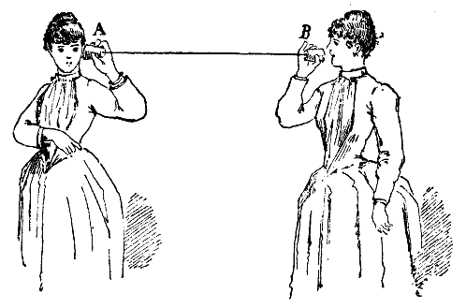
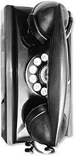
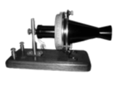



‘Classic’ abstracts
The First
The ‘Classics’

Slide 6
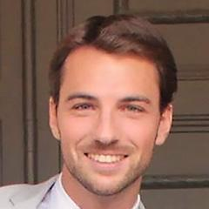
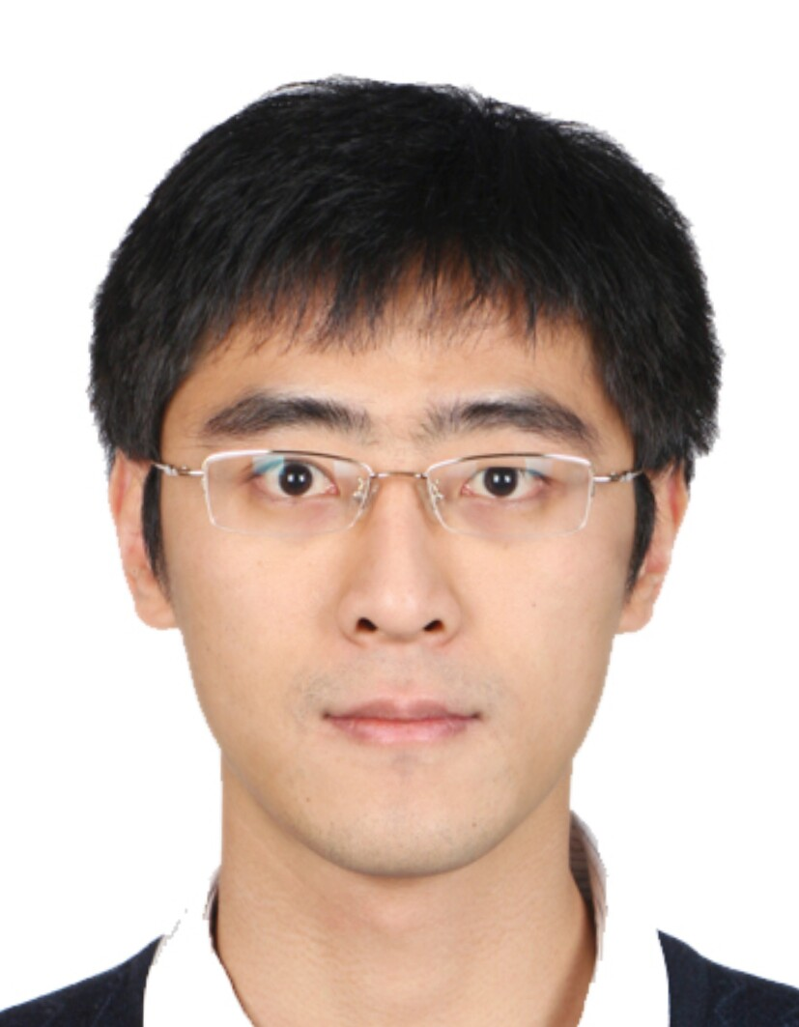
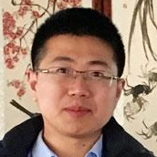
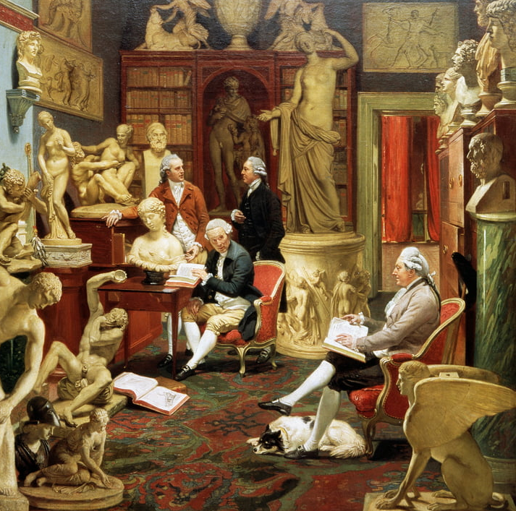
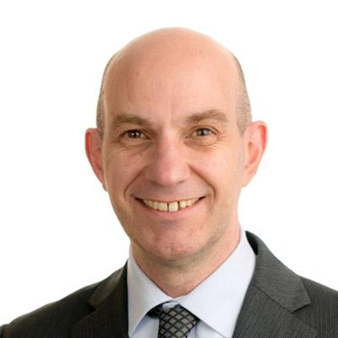
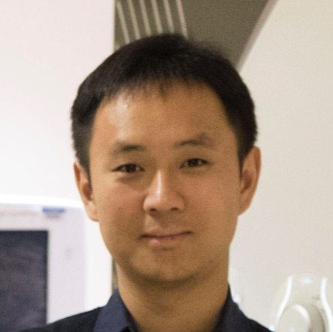
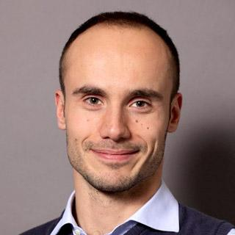
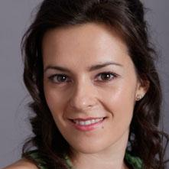
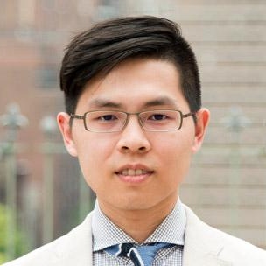

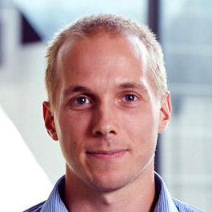
Looking for ‘classics’
Chair
Vice-chair
Stefano Mandija
Chao Ma
Ruiliang Bai
President
Fernando Calamante
Li Feng
Francesco Giganti
Andrada Ianus
Johann Zoffany (1733-1810)
Charles Townley in his Sculpture Gallery
Hong-Hsi Lee
Fei Li
Thomas Welton

Slide 7
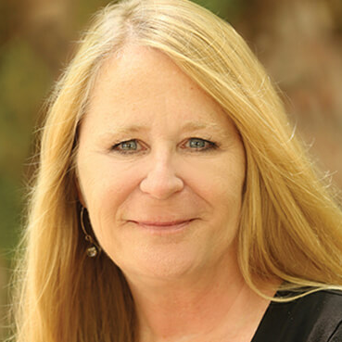
Stakeholders
Advisory group
MRM/JMRI
Chief Editors
AMPC
Table Chairs
Board of Trustees
ISMRM President
(Fernando Calamante)
MRM Editor in Chief
(Peter Jezzard)
Equity, Diversity &
Inclusion Committee
Past ISMRM
Presidents
ISMRM Vice-President
(Scott Reeder)
JMRI Editor in Chief
(Mark Schweitzer)
Chapters’ Governing Committees
Gold Medallists
ISMRM Vice-President Elect
(Derek Jones)
AMPC Chair
(Steven Sourbron)
Historical Archives Committee
Silver Medalists
ISMRM Executive Director (Roberta Kravitz)
Chair of the Ad Hoc Committee on Historical Archives
(Greg Hurst)
30 Study groups
Chair of the Web Editorial Board
(Wally Block)
Special thanks to Roberta Kravitz and
the Central Office for constant support.

Slide 8

100 classical abstracts in 40 years

Slide 9





Oct 28, 2021
1st committee meeting
Dec 2021
Collect abstracts &
create long list
Mar 2022
Interviews
Jan-Mar
2022
Detective
work
Apr 2022
Classical abstract
book
100
Timeline

Slide 10
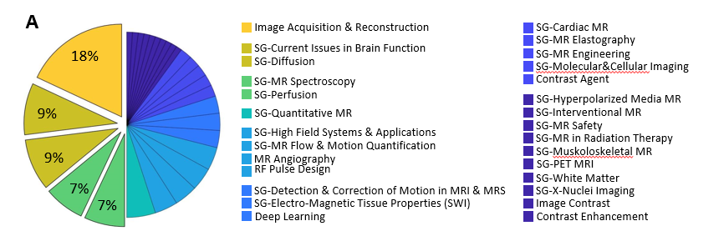
Abstracts assigned according to indicative Study Group topic

Slide 11
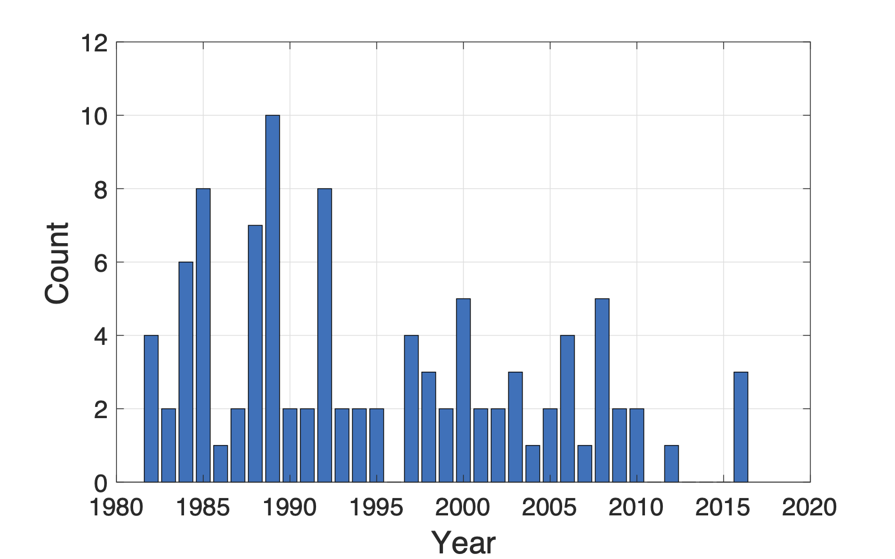
# classic abstracts per year

Slide 12
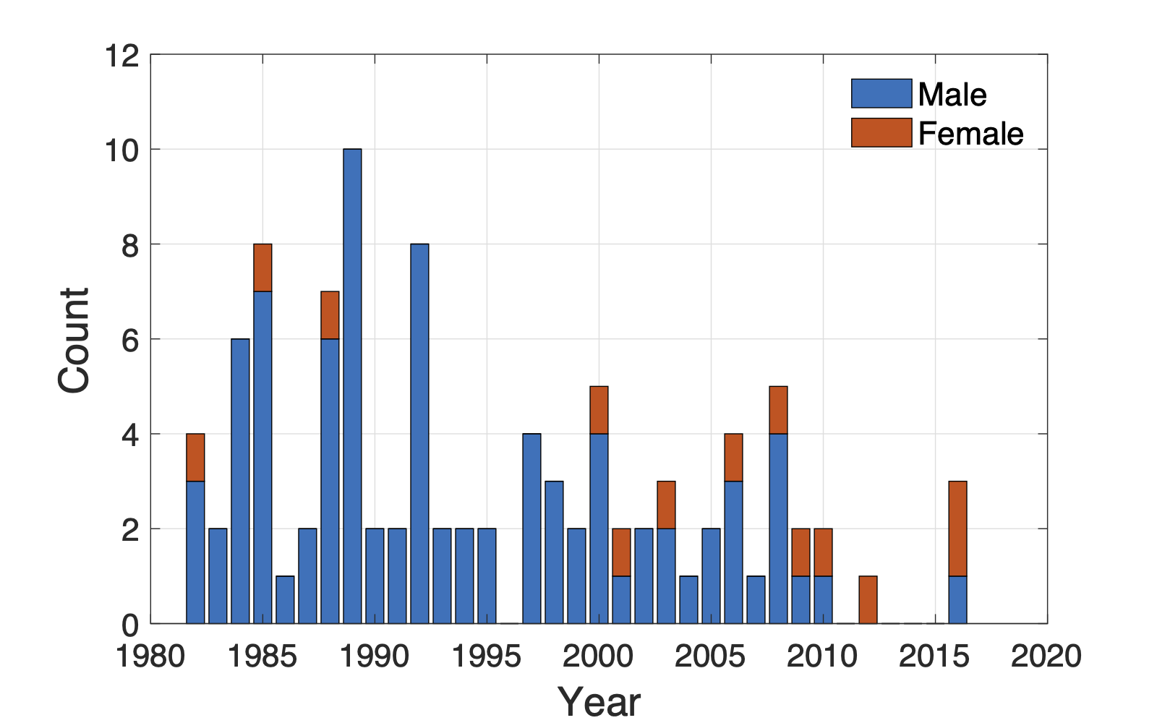
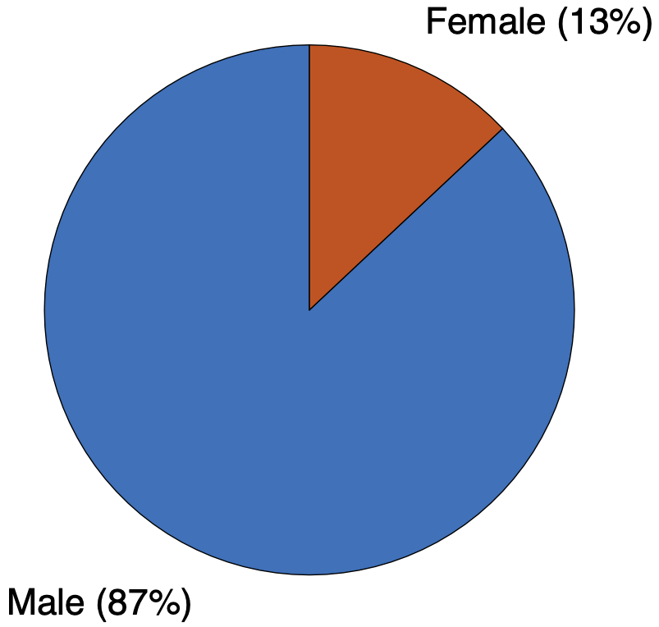
First author’s sex

Slide 13
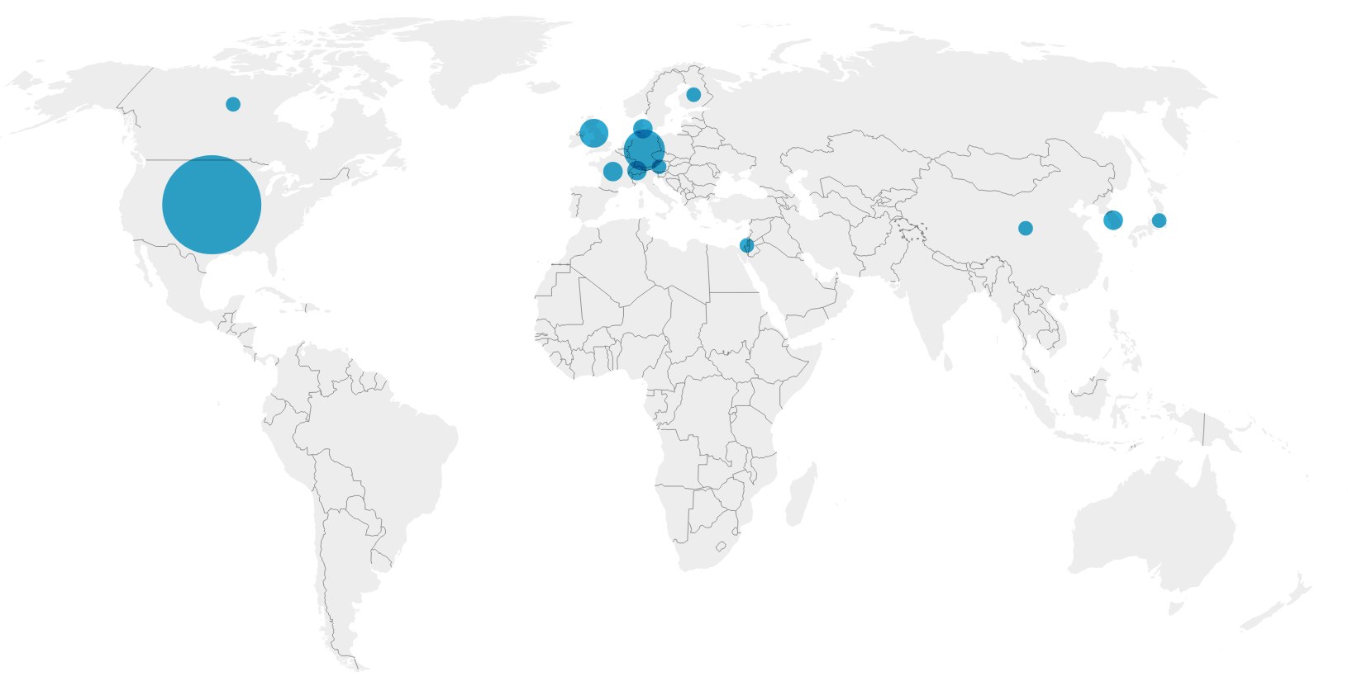
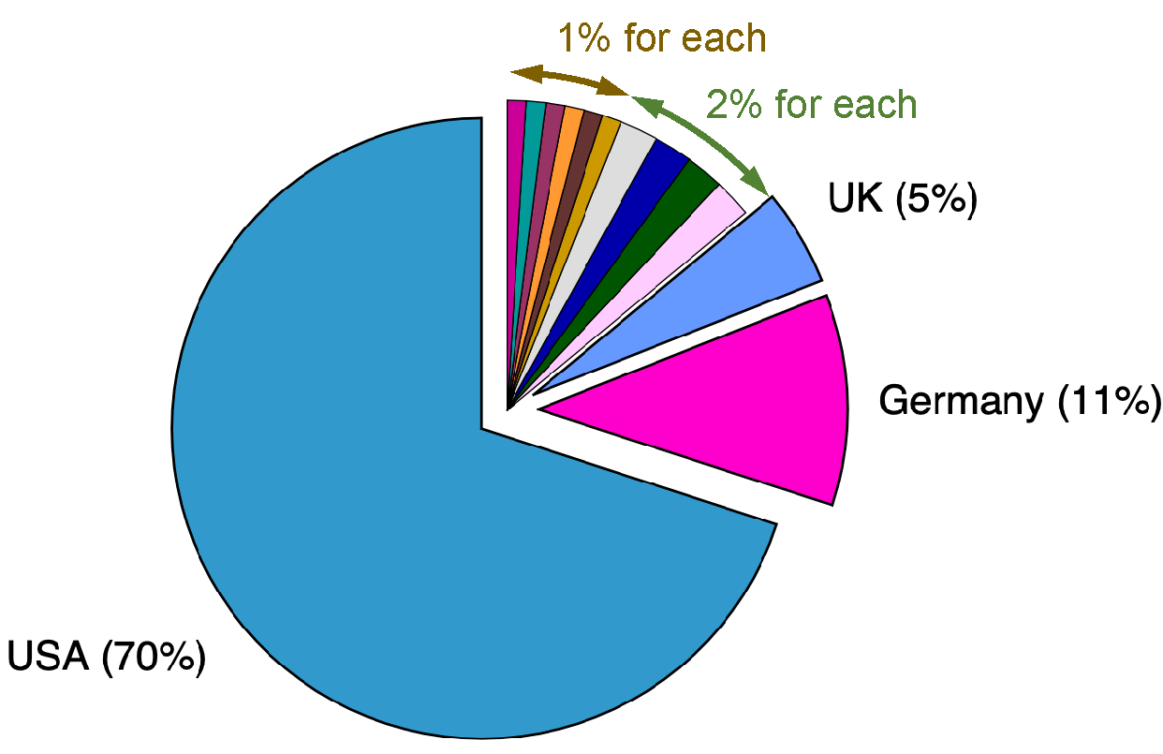
First author’s affiliation

