Slide 1
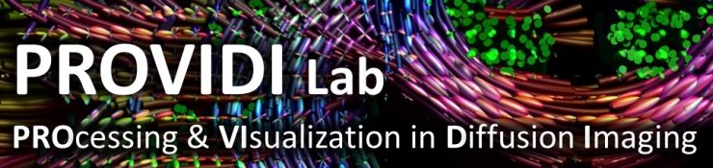
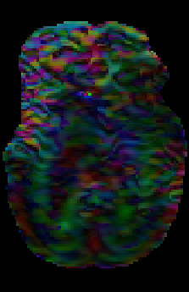
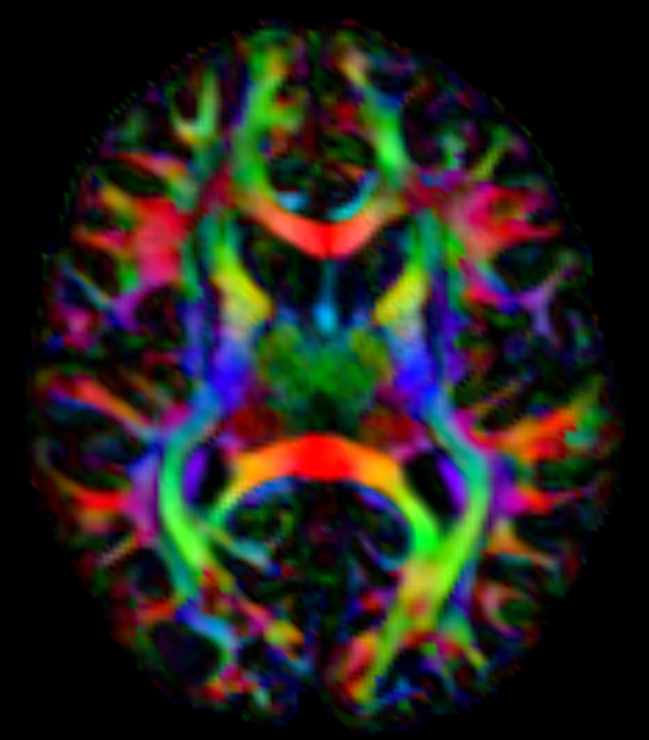


“Diffusion Imaging and Fiber Tractography: Tips & Tricks for Clinical Use” ISMRM Diffusion Study Group Virtual Meeting, 24 October 2018
DTI Processing: Pitfalls in Clinical Applications
Alexander Leemans
Image Sciences Institute
University Medical Center
@Alex_Leemans
Utrecht, the Netherlands

Slide 2
Declaration of Financial Interests or Relationships
Speaker Name: Alexander Leemans
I have no financial interests or relationships to disclose with regard to the subject matter of this presentation.

Slide 3
Email from Claire Mulcahy (SMRT rep for the ISMRM DSG)…
Hi Alex,
…
Would you consider re-presenting your lecture “DTI Processing: Pitfalls in Clinical Applications” from the 2015 SMRT Annual Meeting in Toronto for a collaboration virtual meeting between the SMRT & DSG?
…
Many thanks, Claire

Slide 4
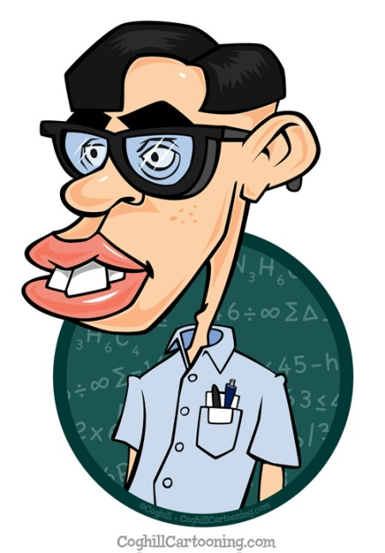


A typical day at the office…

Slide 5
Hi Alex, I have been collecting “advanced DTI data”. Can you help me with the analysis?*
* Read: “Can you do the analysis for me?”

Slide 7
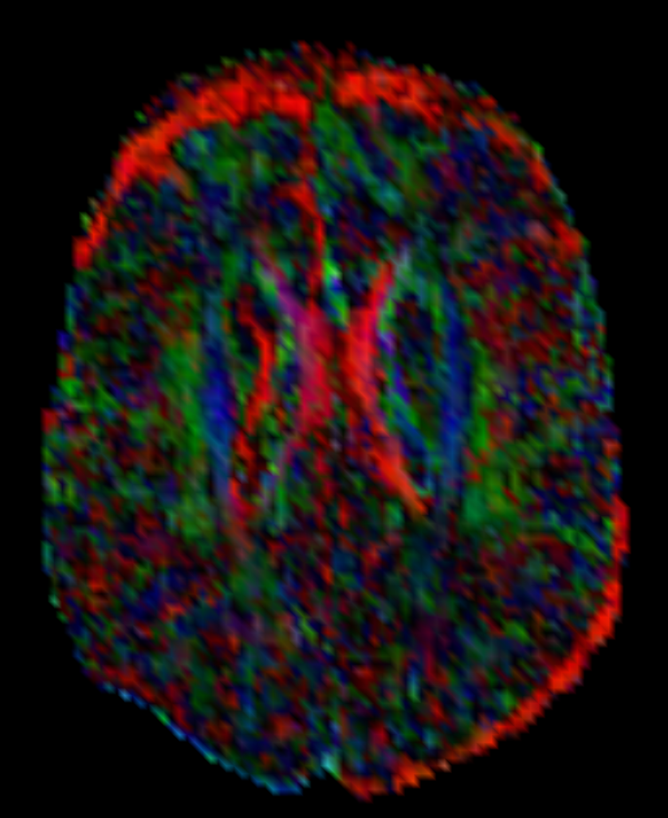

Slide 8
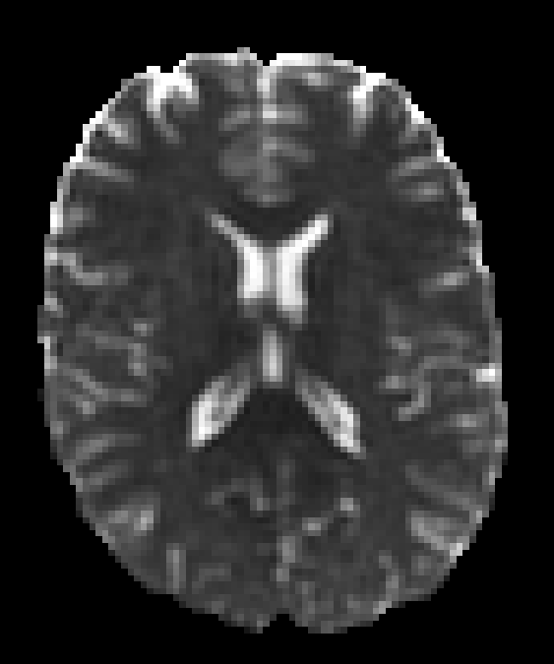
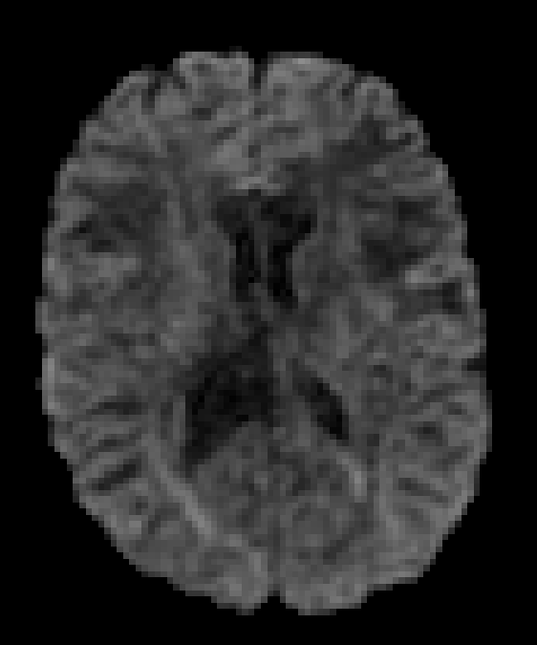
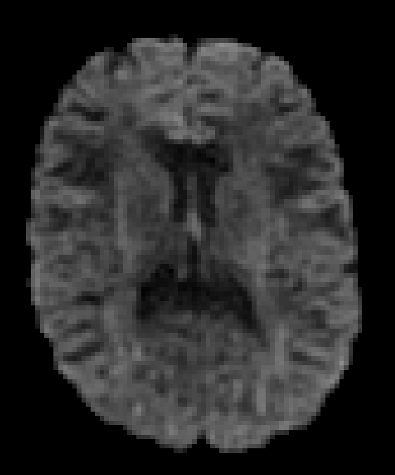
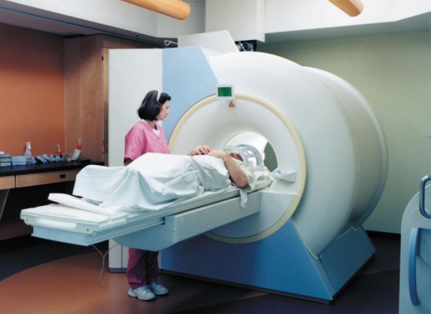
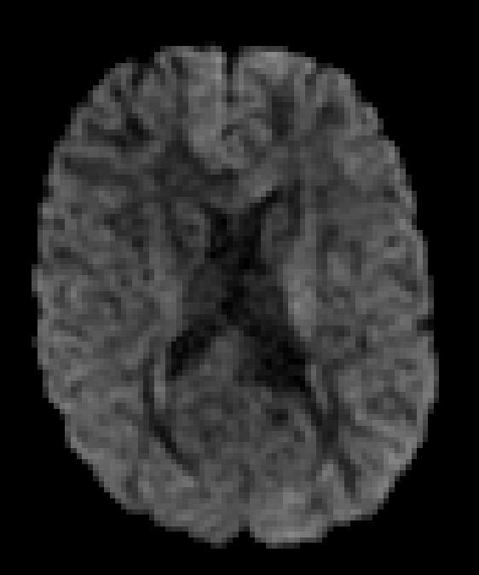
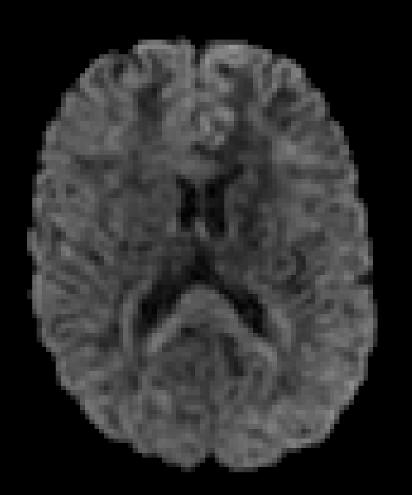
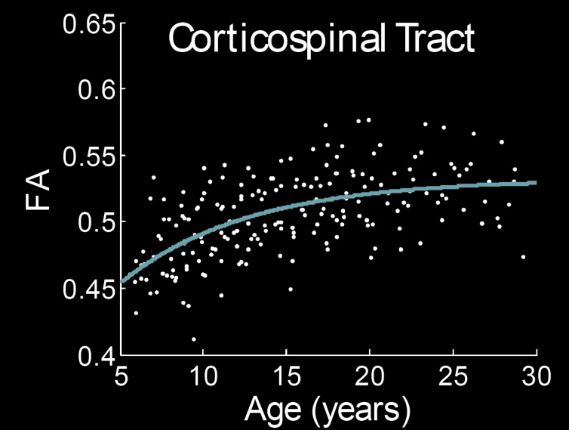
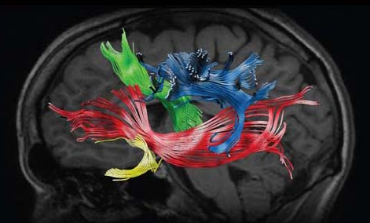
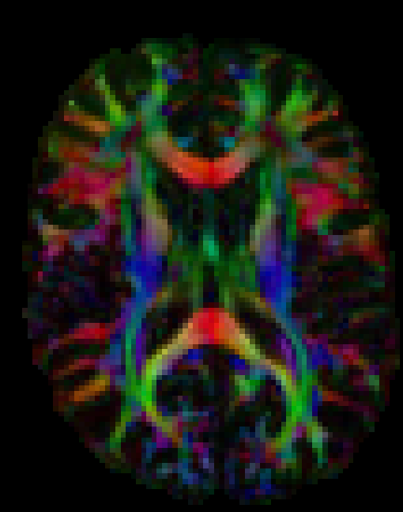
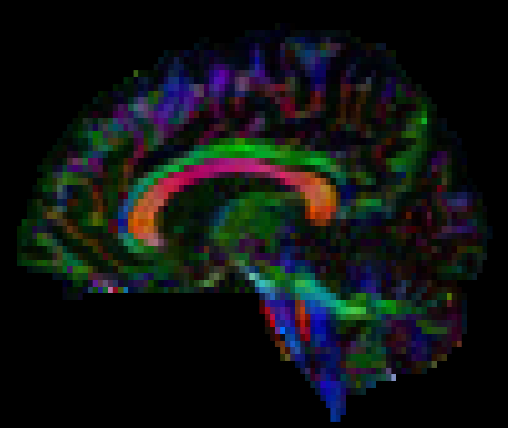
The pipeline ...
ANISOTROPY
Lebel C. et al, NeuroImage (2008)

Slide 9
Data quality assessment ...
?
Lebel C. et al, NeuroImage (2008)

Slide 10
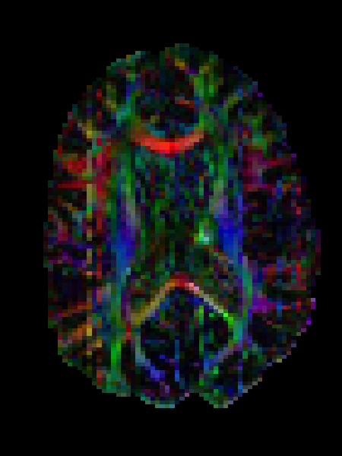
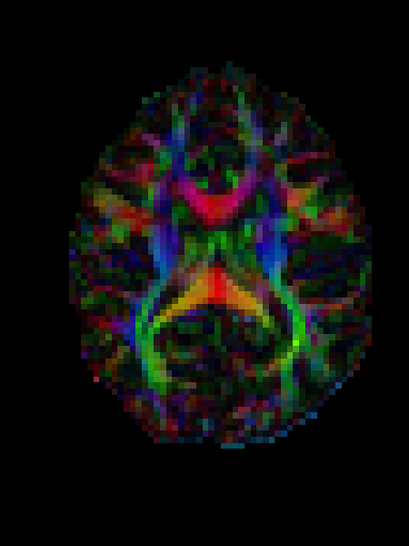
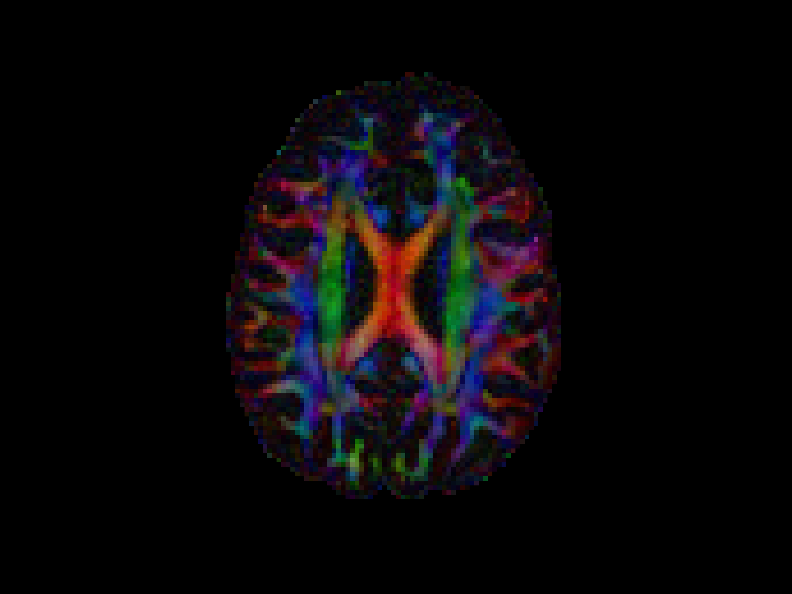
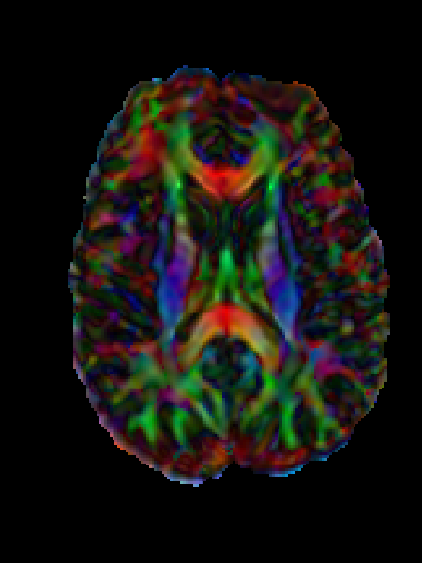
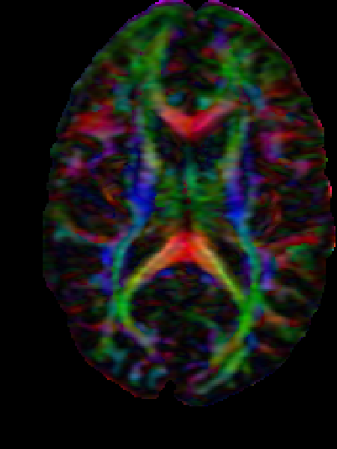
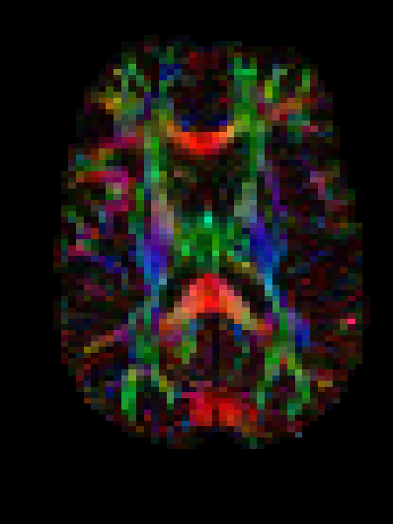
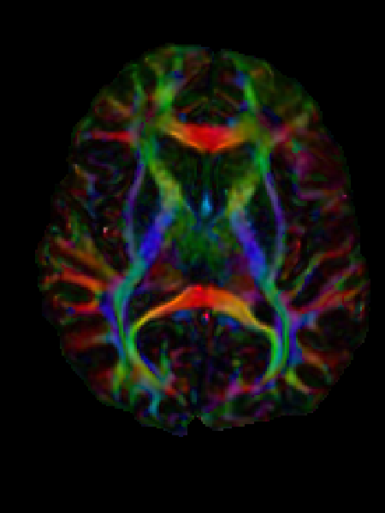
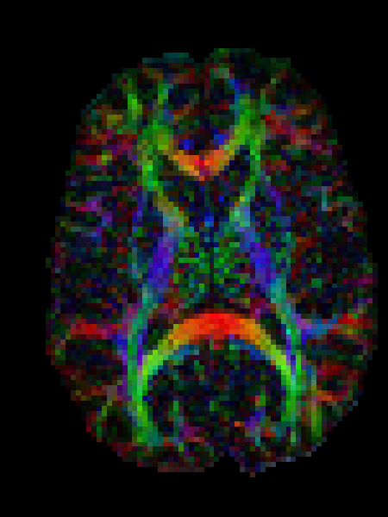
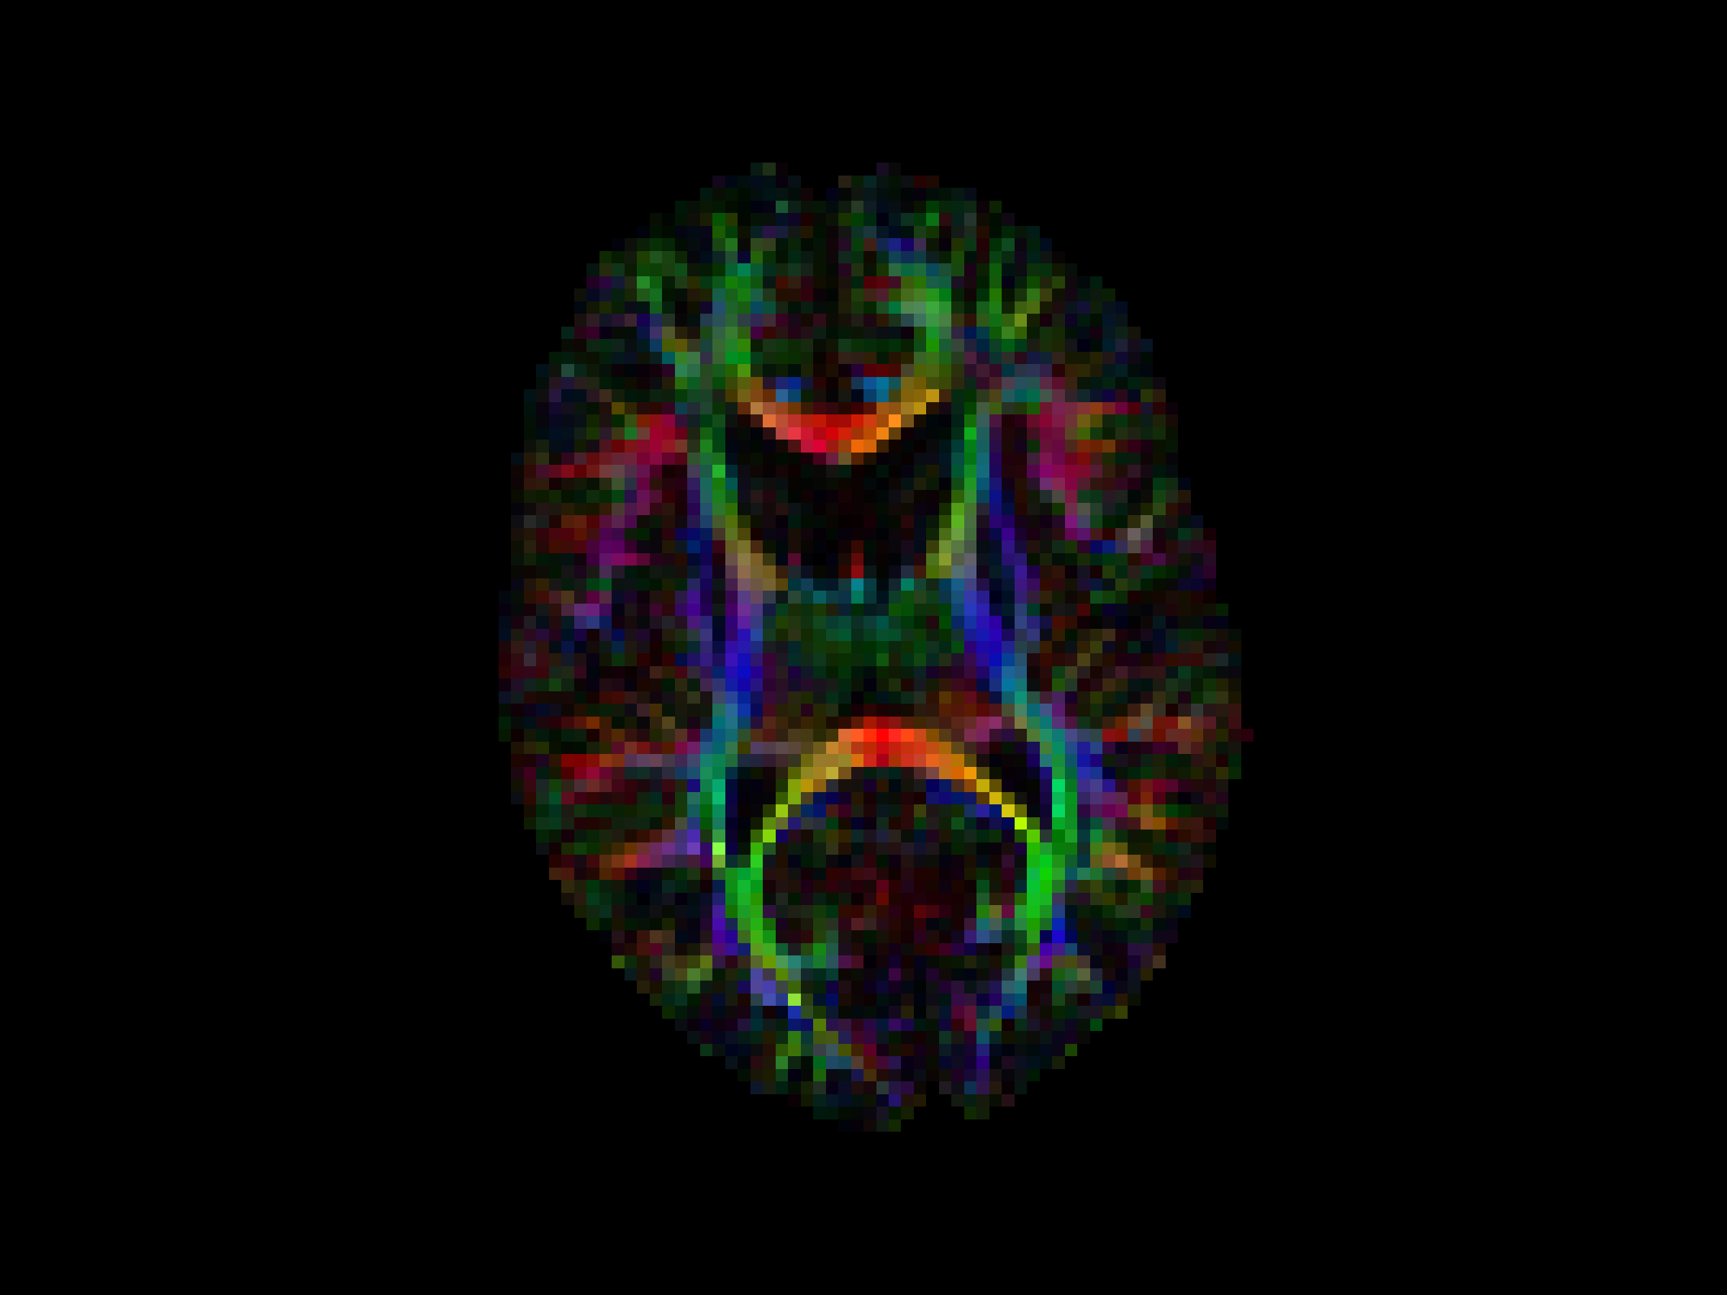
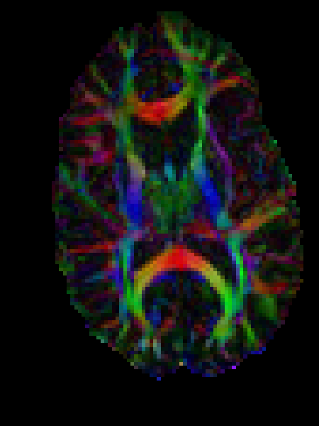
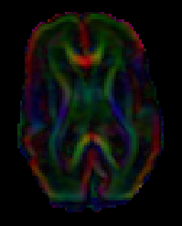
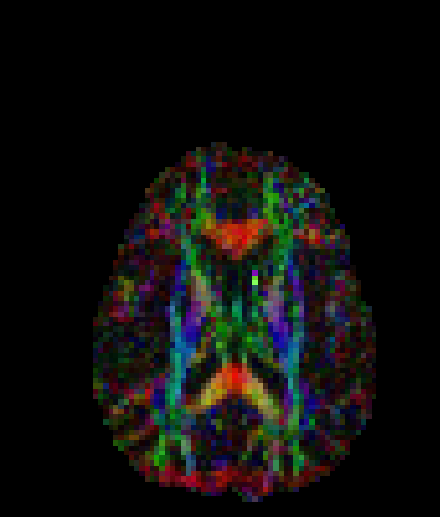
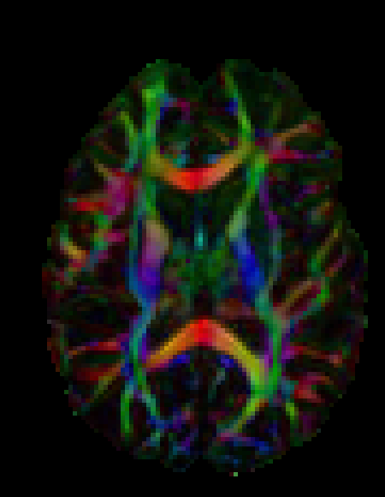
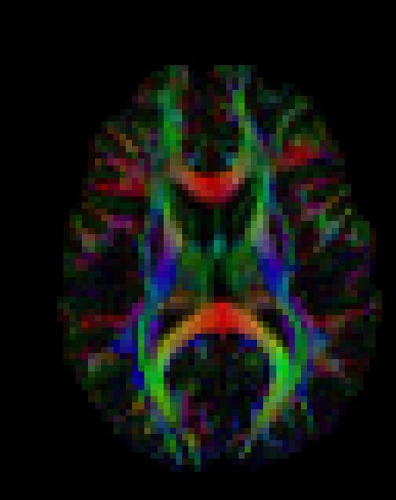
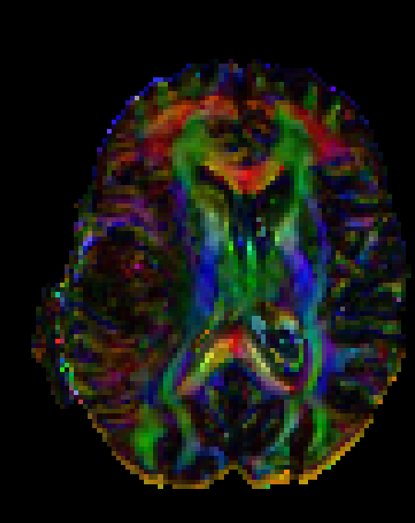
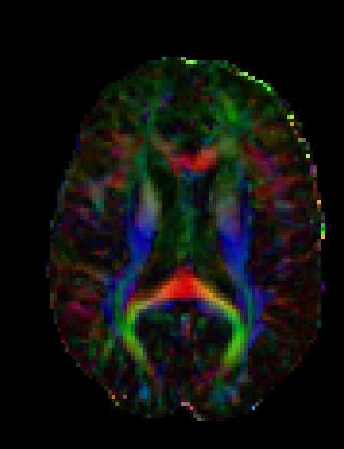
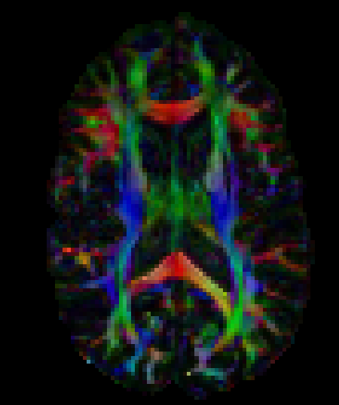
Data quality assessment ...
Tournier J.-D. et al, Magn Reson Med (2011)

Slide 11
Data quality assessment ...
Color-encoding is not conventional
Jeurissen B. et al, Medical Image Analysis (2014)

Slide 12
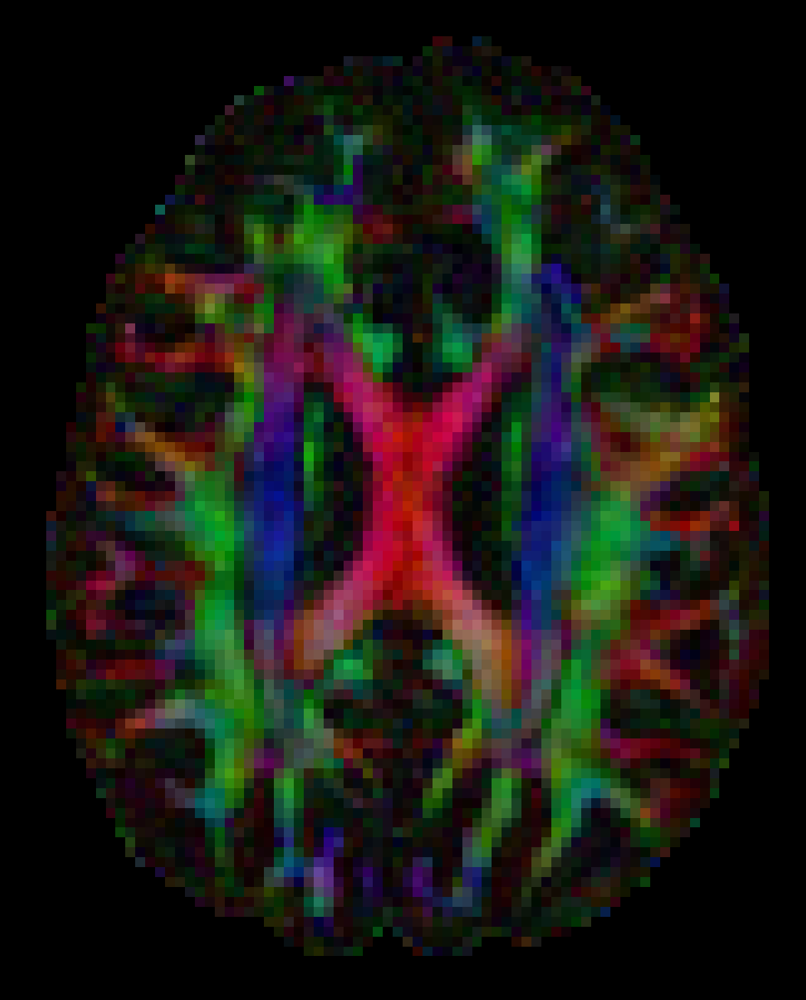
Data quality assessment ...
Conventional Color-encoding
Jeurissen B. et al, Medical Image Analysis (2014)

Slide 13
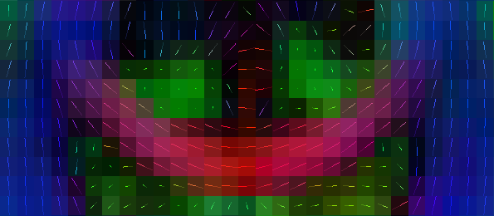
Data quality assessment ...
No axis mismatch
Jeurissen B. et al, Medical Image Analysis (2014)

Slide 14

Data quality assessment ...
Axis “sign flip”
Jeurissen B. et al, Medical Image Analysis (2014)

Slide 15
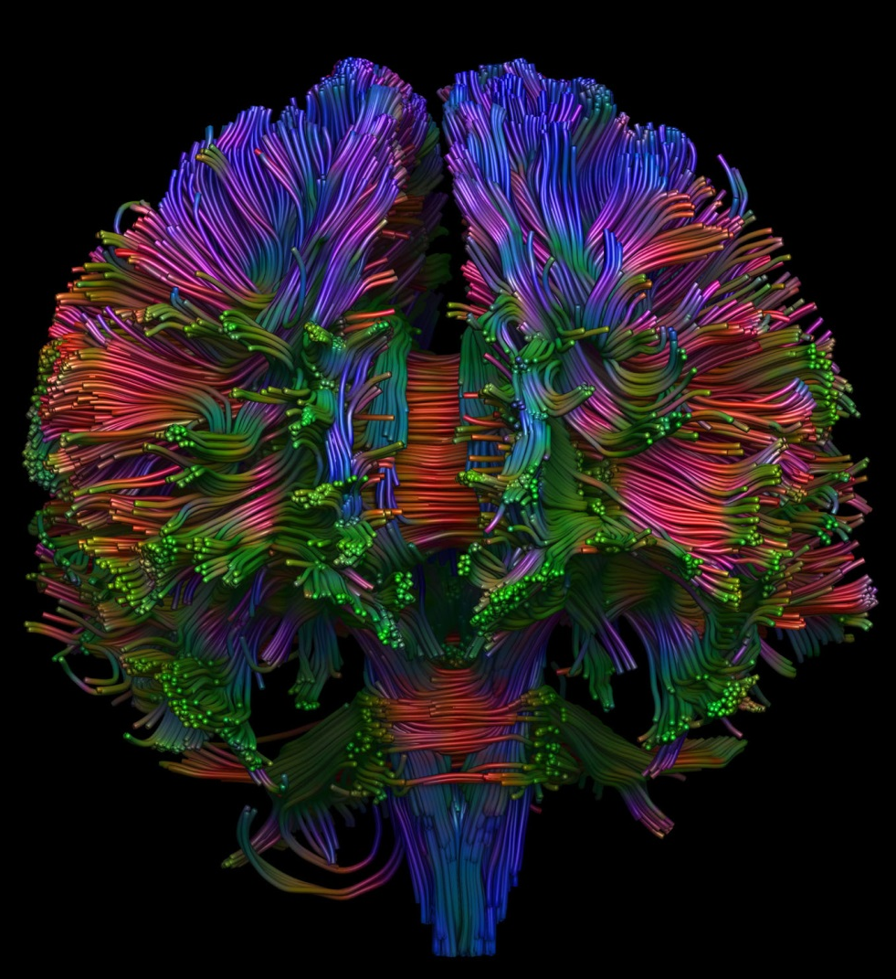
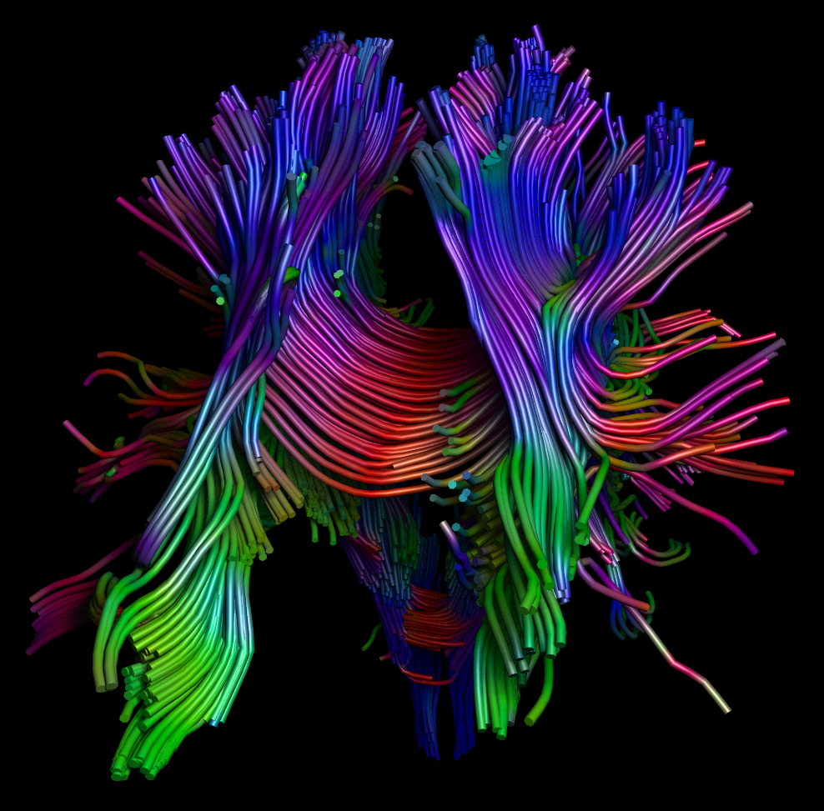
Data quality assessment ...
Axis “sign flip”
Correct
Jeurissen B. et al, Medical Image Analysis (2014)

Slide 16
Data quality assessment ...
Tournier J.-D. et al, Magn Reson Med (2011)

Slide 17
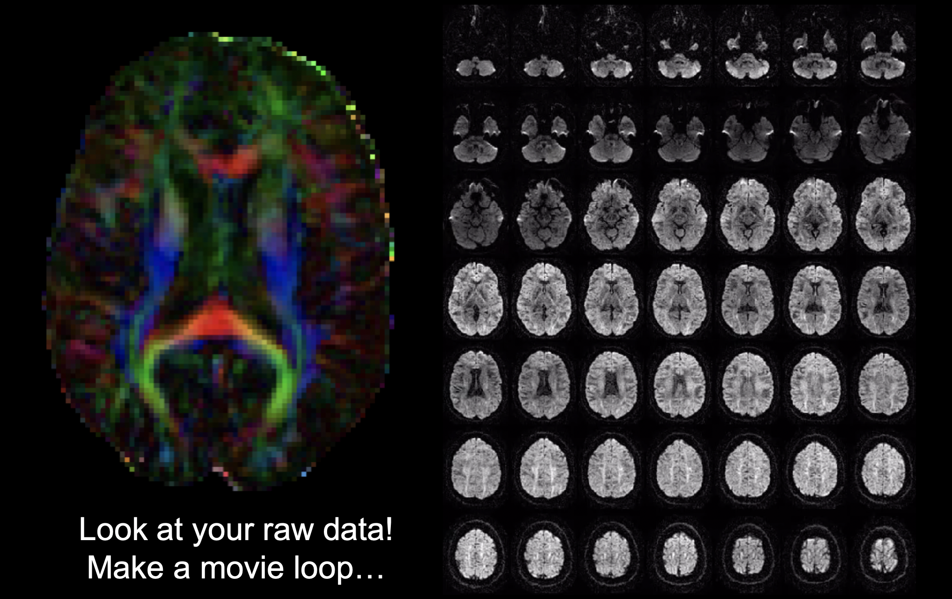
Data quality assessment ...
Tournier J.-D. et al, Magn Reson Med (2011)

Slide 18
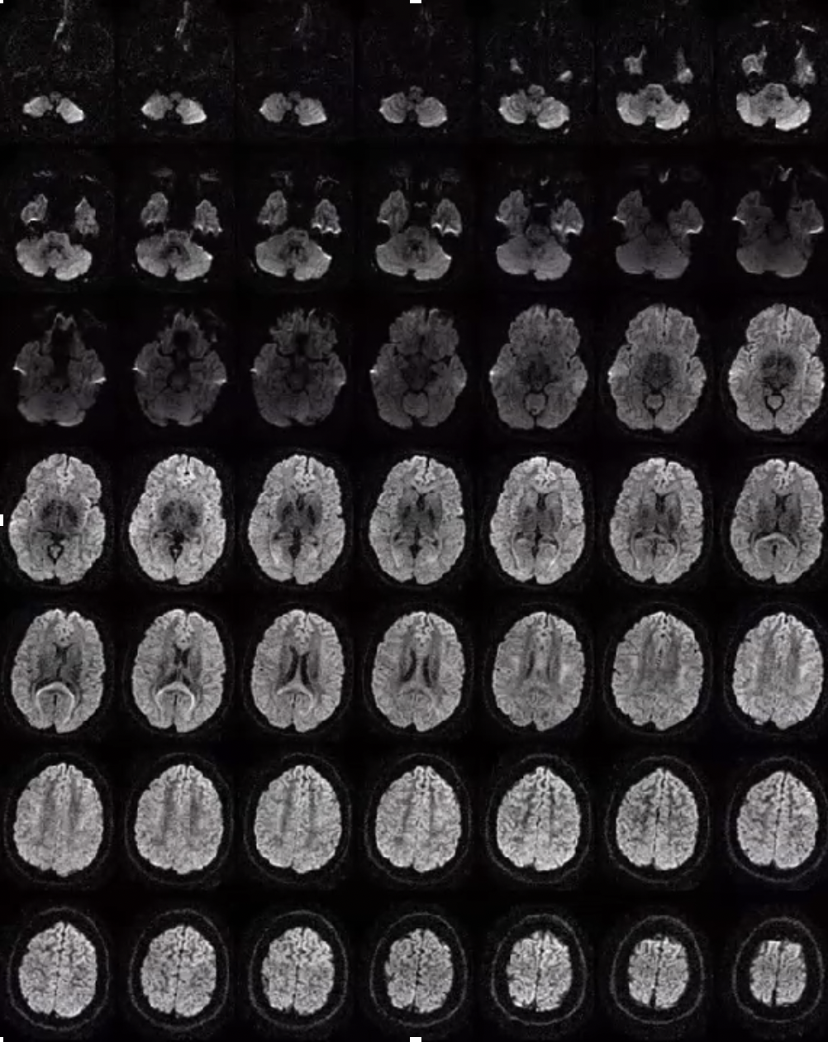
Data quality assessment ...
Tournier J.-D. et al, Magn Reson Med (2011)

Slide 19
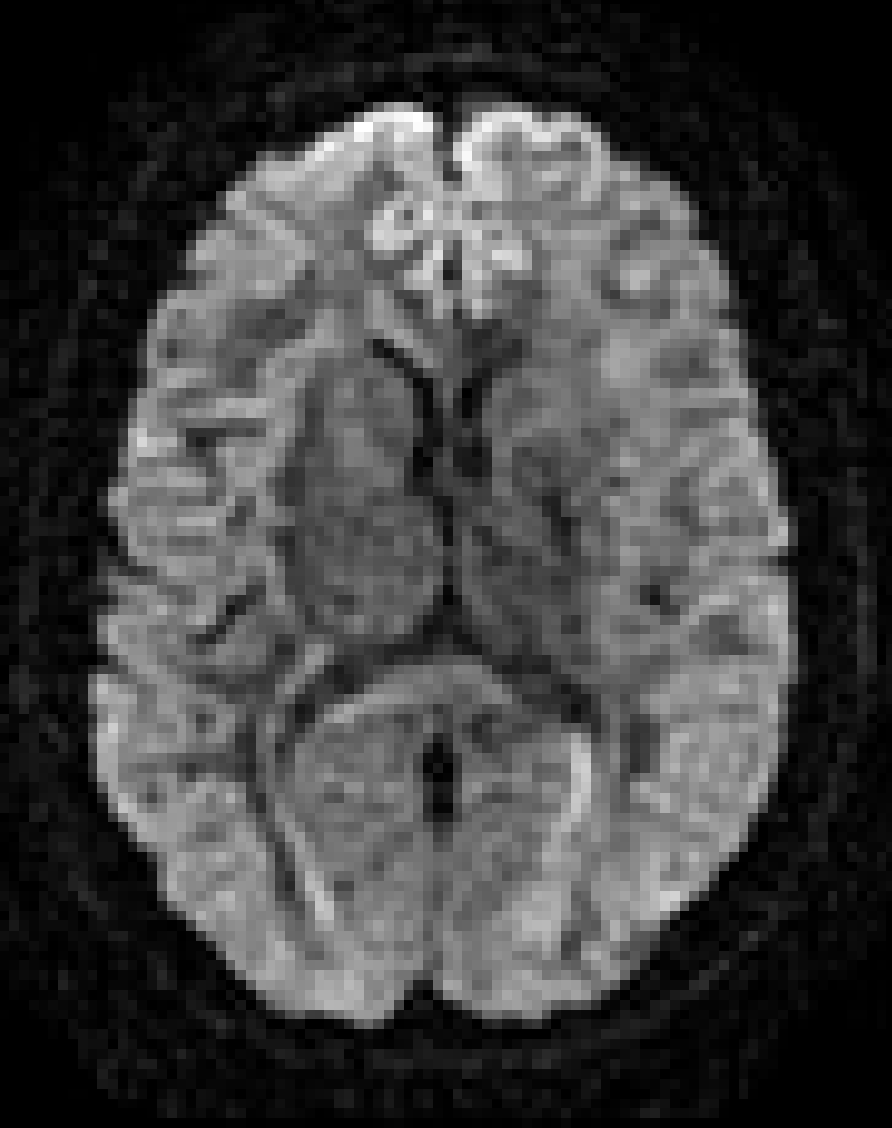
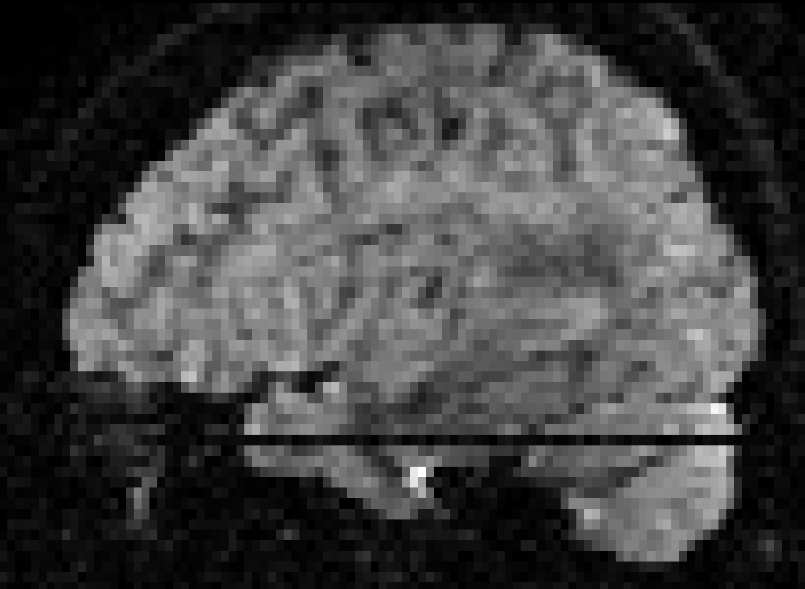
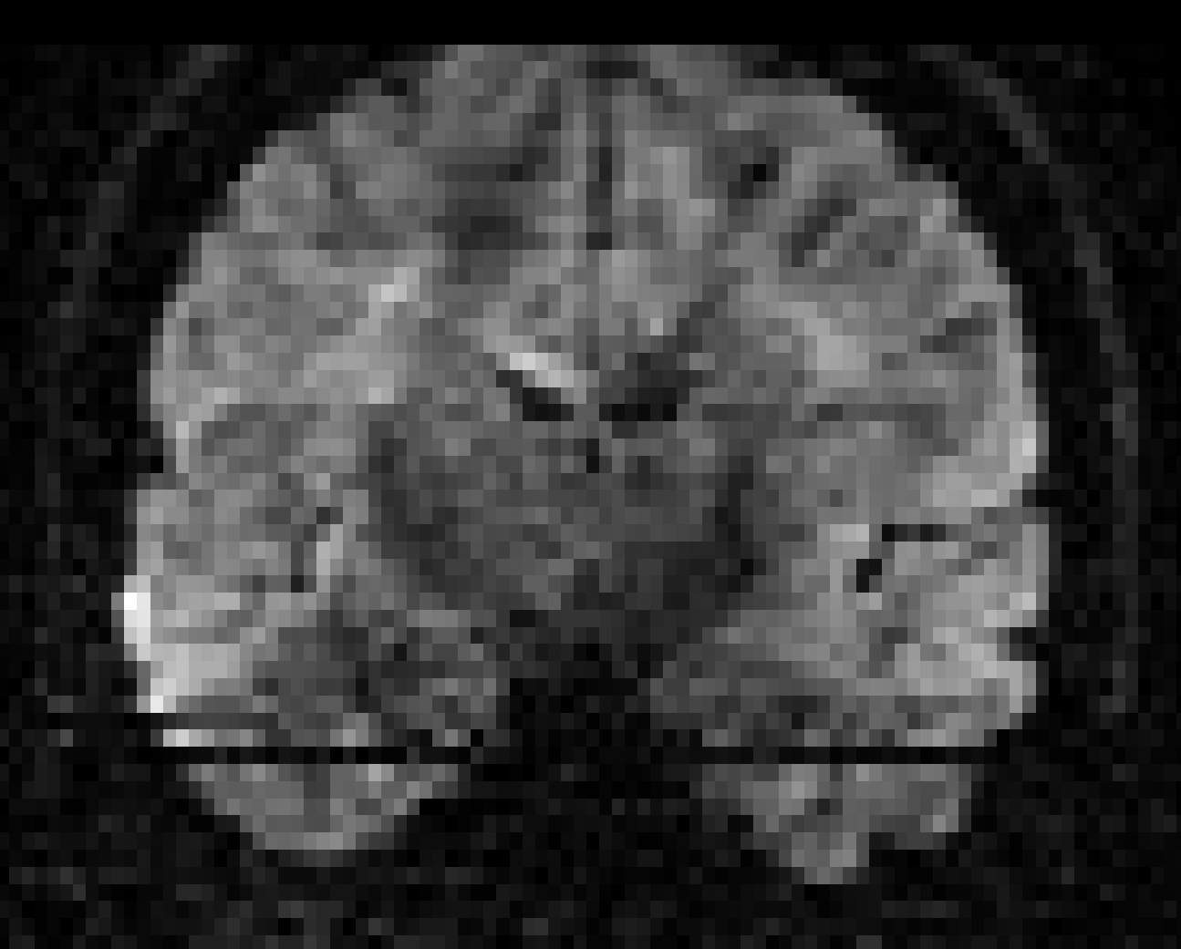
Data quality assessment ...
Different views!
Axial
Sagittal
Coronal
Tournier J.-D. et al, Magn Reson Med (2011)

Slide 20
Data quality assessment ...
Tournier J.-D. et al, Magn Reson Med (2011)

Slide 21
Data quality assessment ...

Slide 22
Data quality assessment ...
“Physically Implausible Signals” (PIS)
$$S=S_{0}e^{−b∙D}$$
$S$ = diffusion weighted signal
$S_{0}$ = non-diffusion weighted signal
$b$ = diffusion weighting
$D$ = diffusion coefficient
Perrone D. et al, NeuroImage (2015)

Slide 23
Data quality assessment ...
“Physically Implausible Signals” (PIS)
$$S=S_{0}e^{−b∙D}$$
$$<1$$
$$→{S<S}_{0}$$
$S$ = diffusion weighted signal
$S_{0}$ = non-diffusion weighted signal
$b$ = diffusion weighting
$D$ = diffusion coefficient
Perrone D. et al, NeuroImage (2015)

Slide 24
Data quality assessment ...
“Physically Implausible Signals” (PIS)
The painful reality …
$$S>S_{0}$$
$S$ = diffusion weighted signal
$S_{0}$ = non-diffusion weighted signal
$b$ = diffusion weighting
$D$ = diffusion coefficient
Perrone D. et al, NeuroImage (2015)

Slide 25
Data quality assessment ...
“Physically Implausible Signals” (PIS)
Color-coded fractional anisotropy (FA)
Perrone D. et al, NeuroImage (2015)

Slide 26
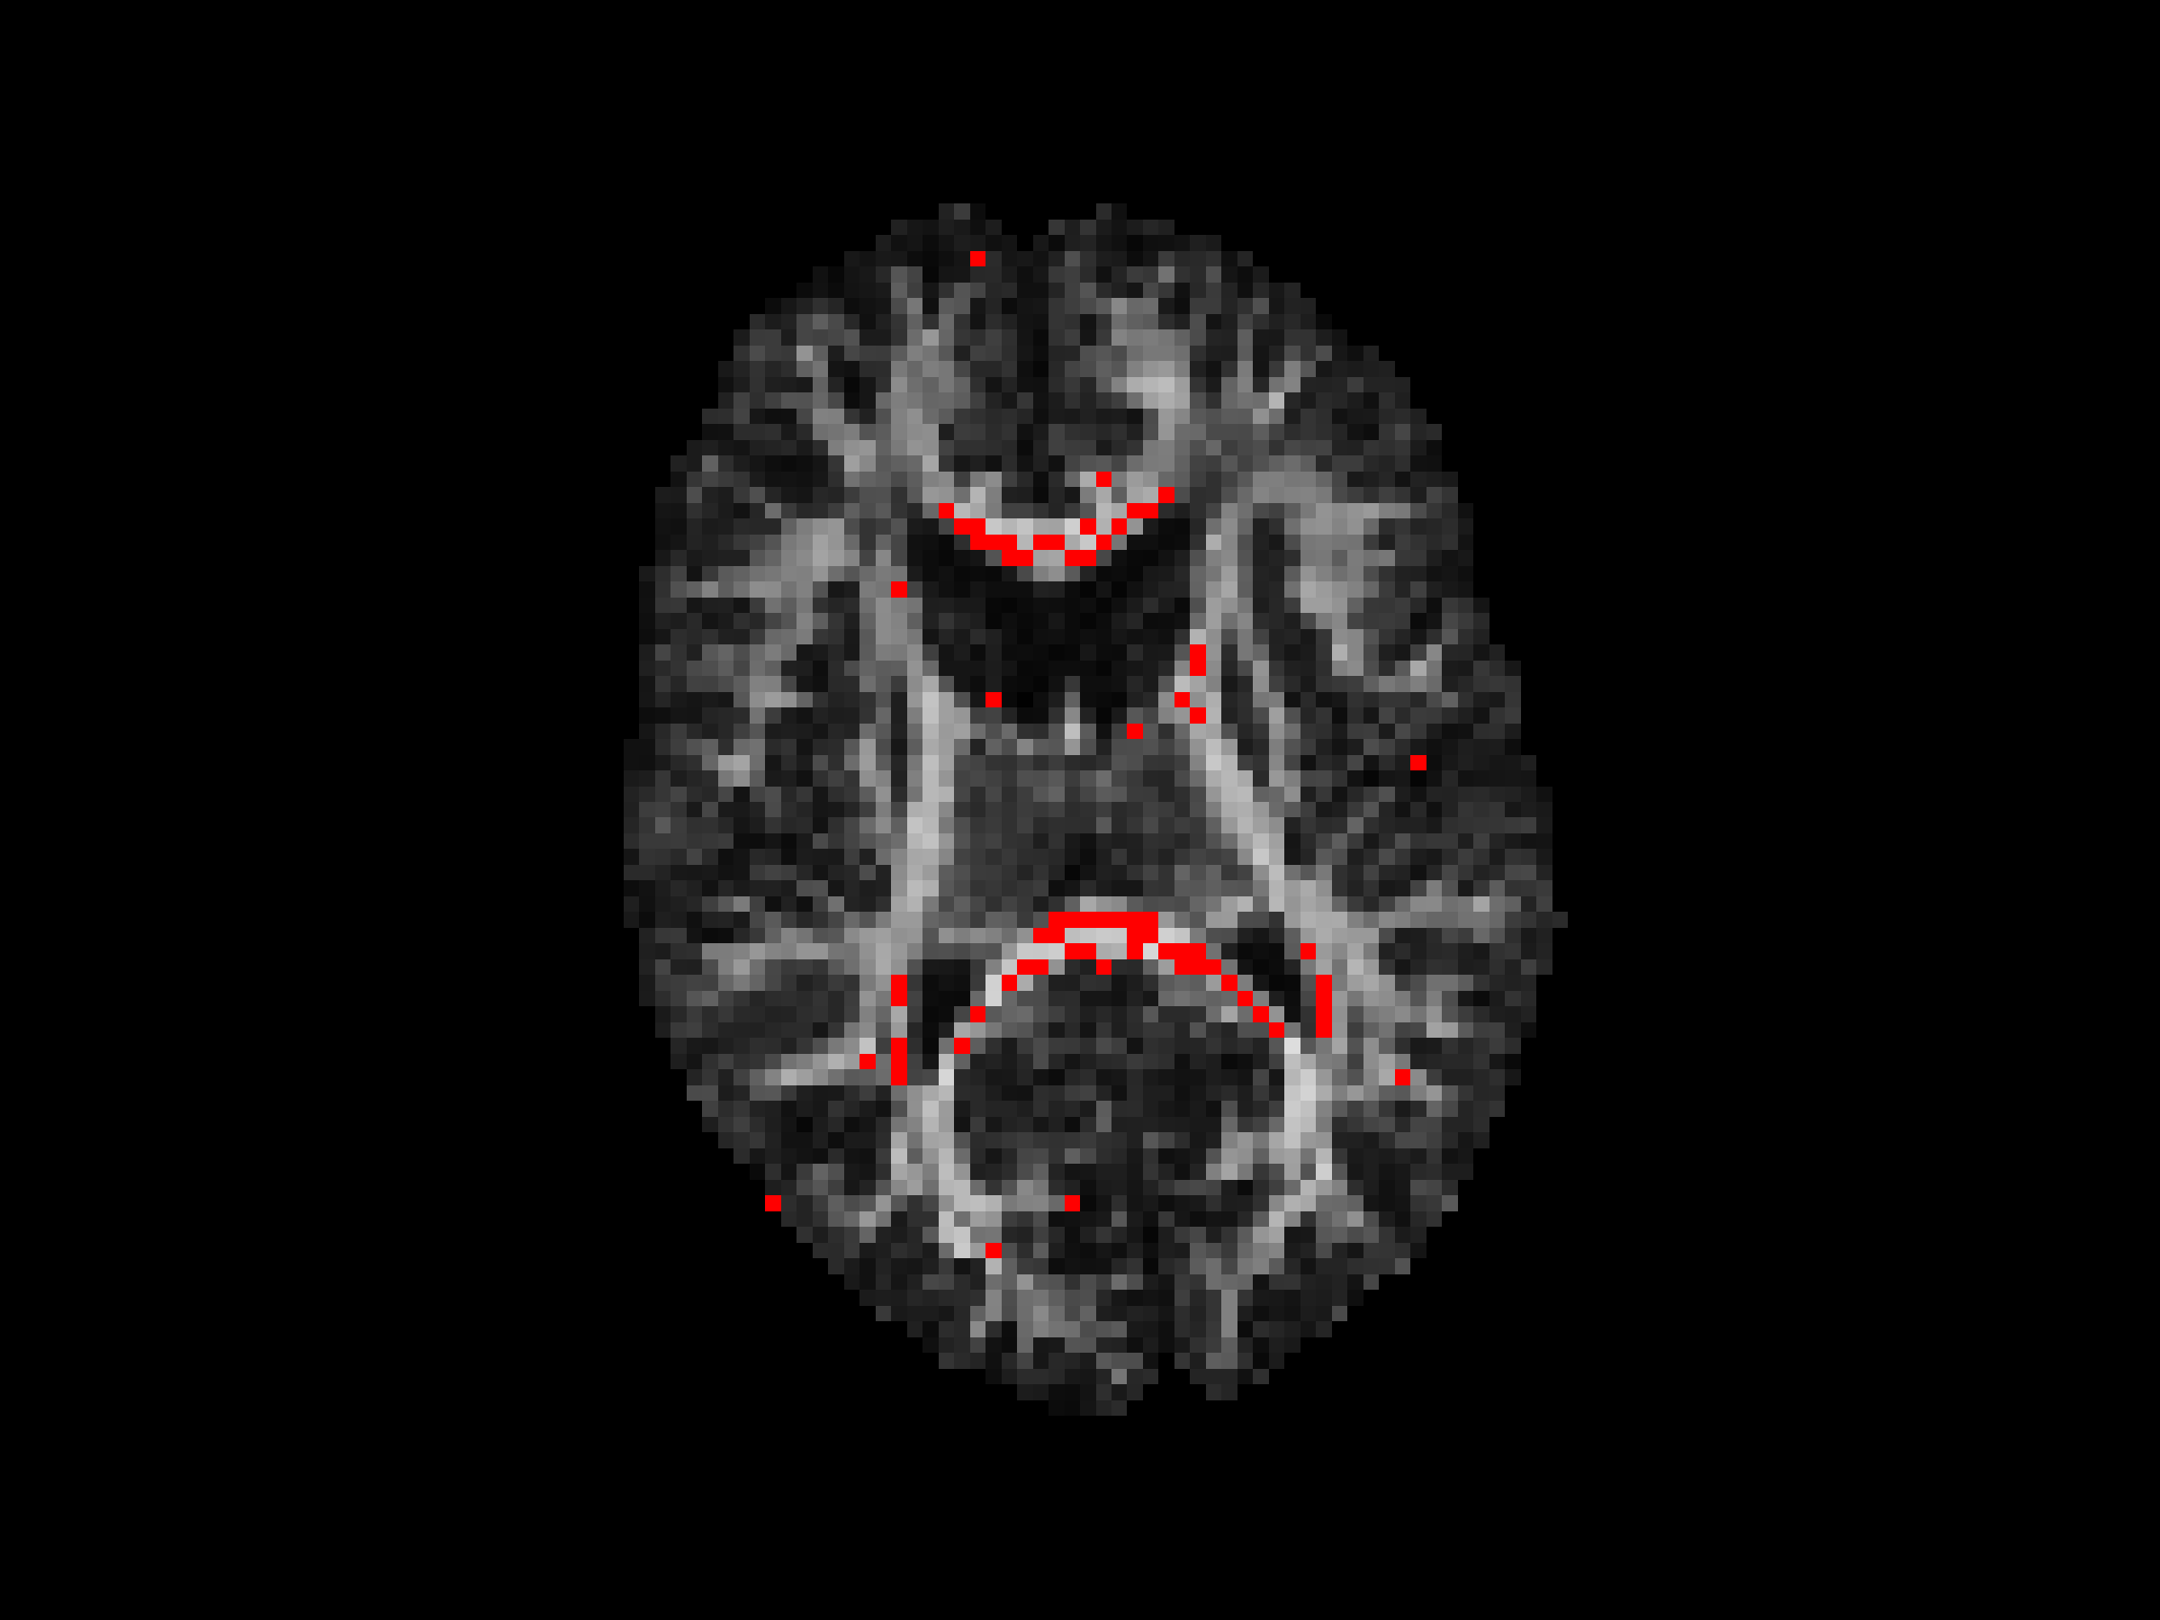
Data quality assessment ...
“Physically Implausible Signals” (PIS)
Regions with “PIS” ($S>S_{0}$) overlaid on FA!!!
Perrone D. et al, NeuroImage (2015)

Slide 27
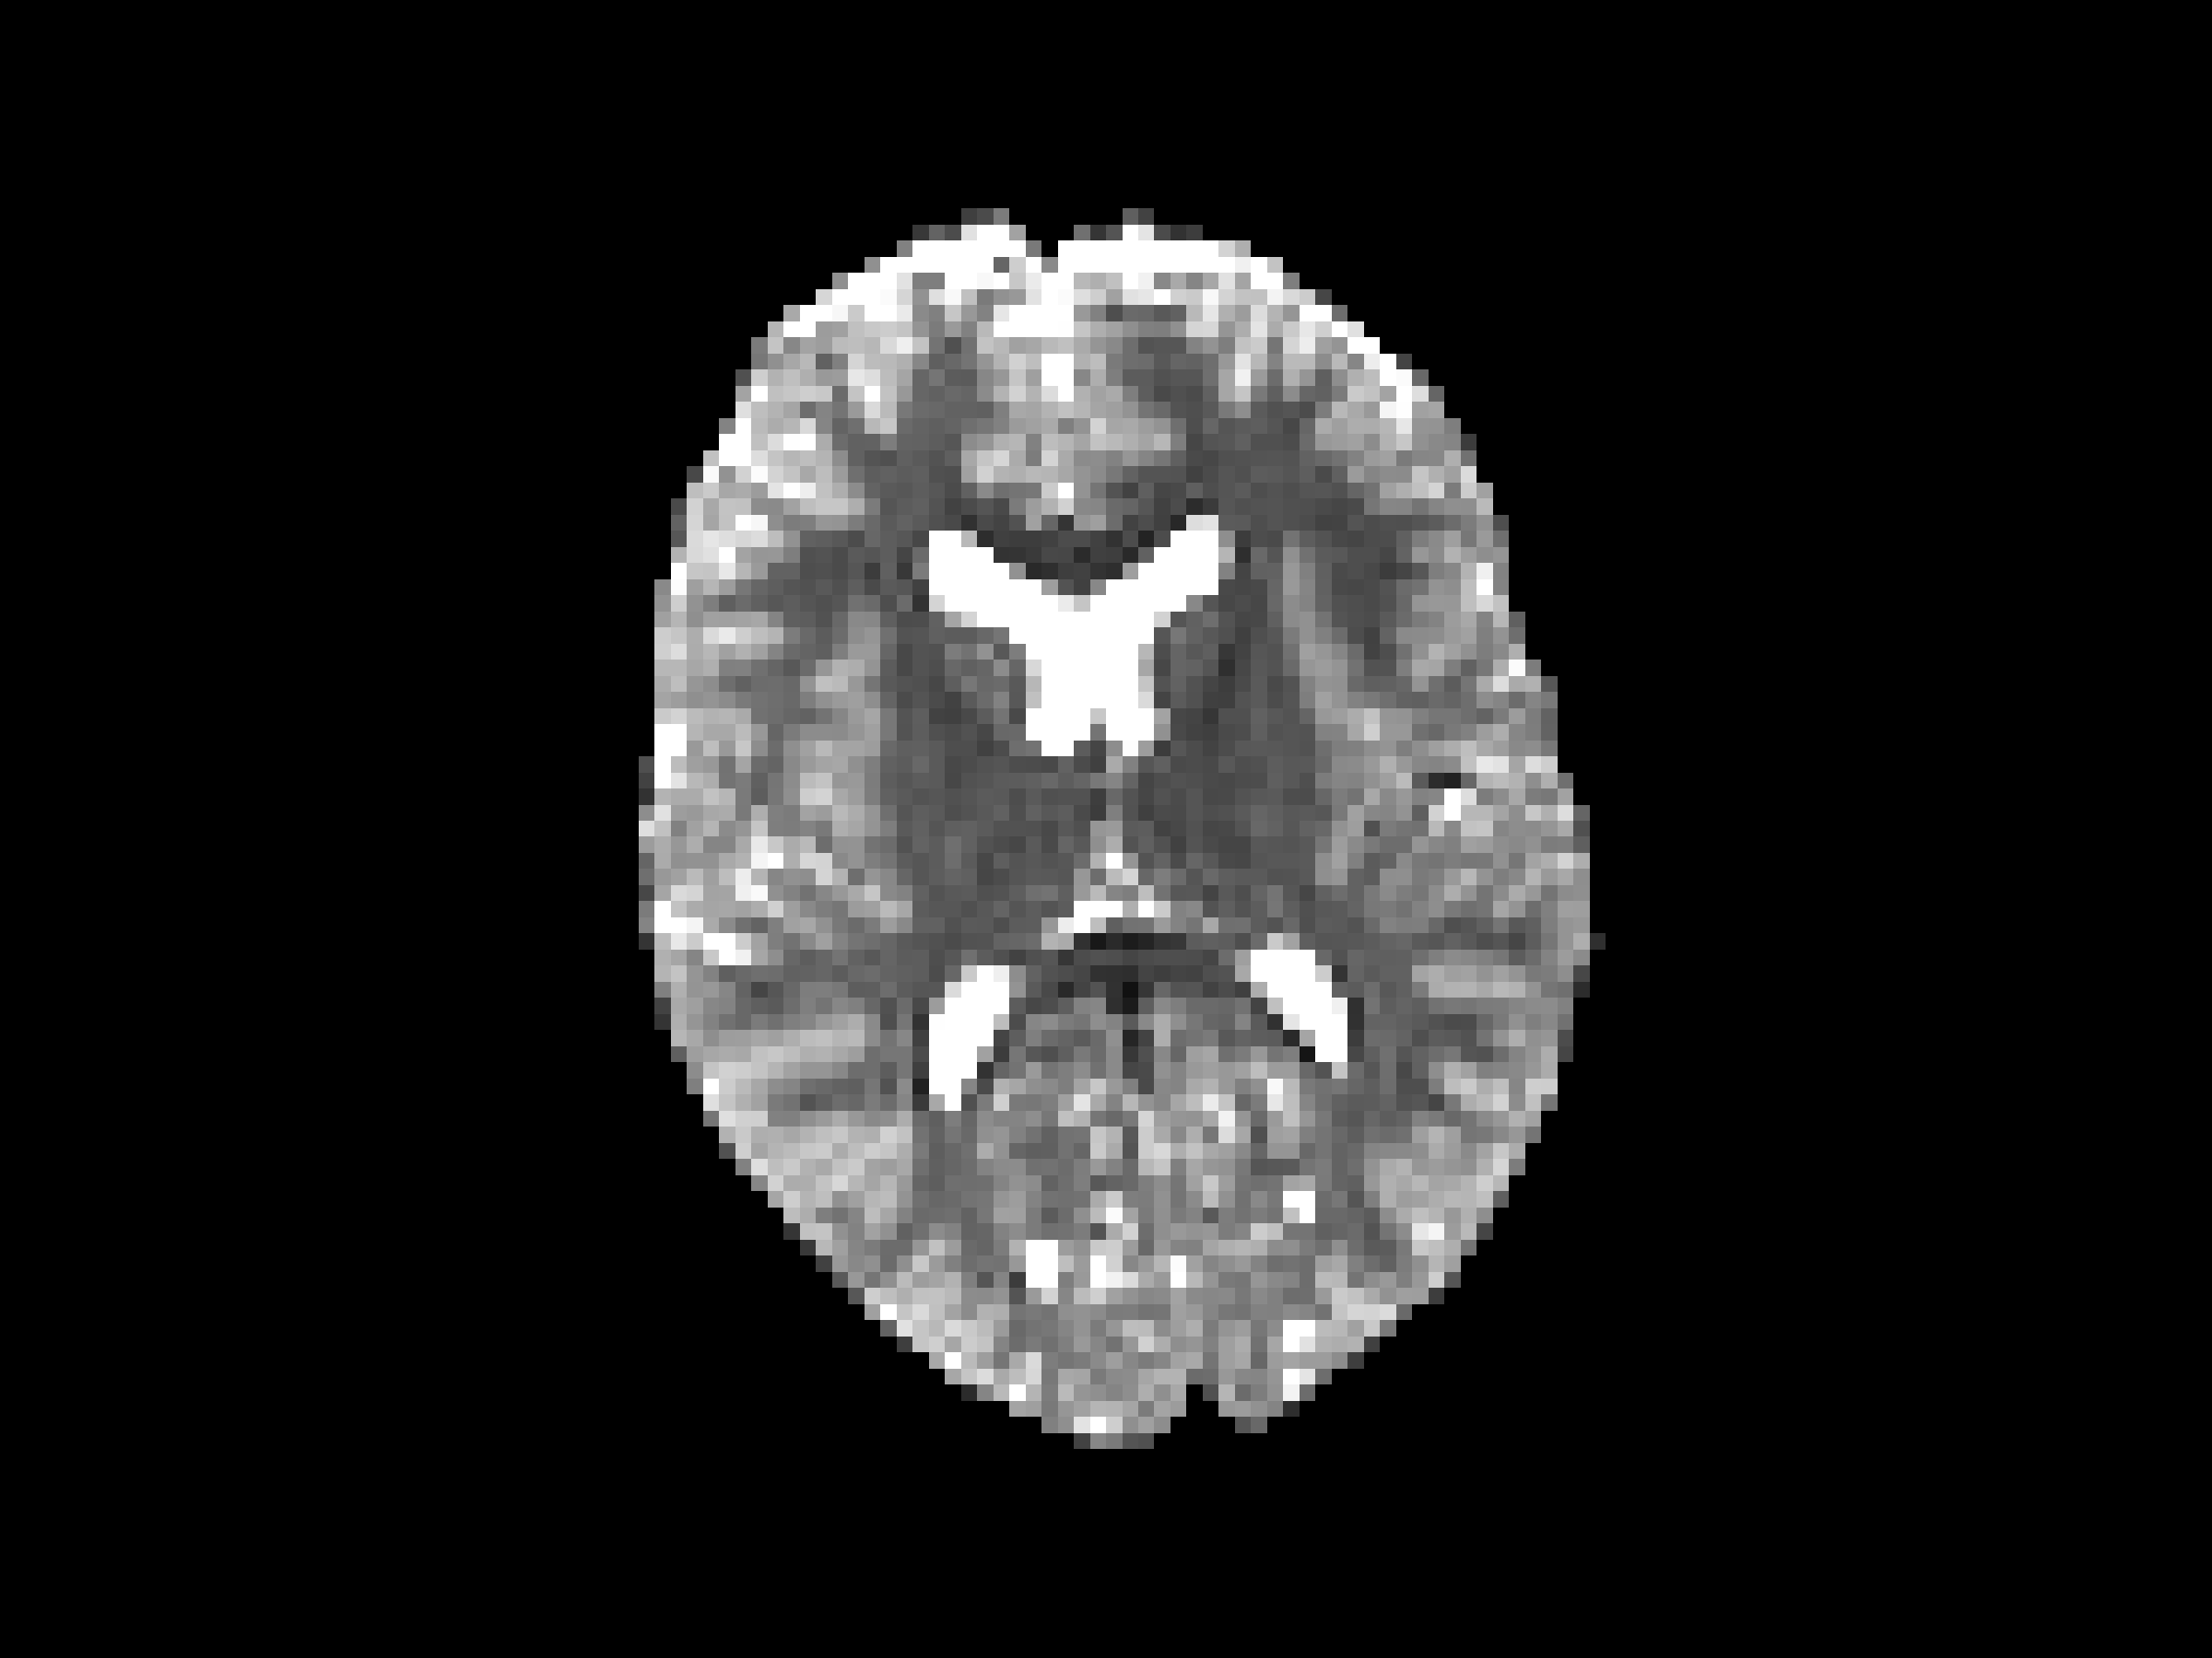
Data quality assessment ...
“Physically Implausible Signals” (PIS)
“PIS” → in regions with low $S_{0}$ values
Perrone D. et al, NeuroImage (2015)

Slide 28
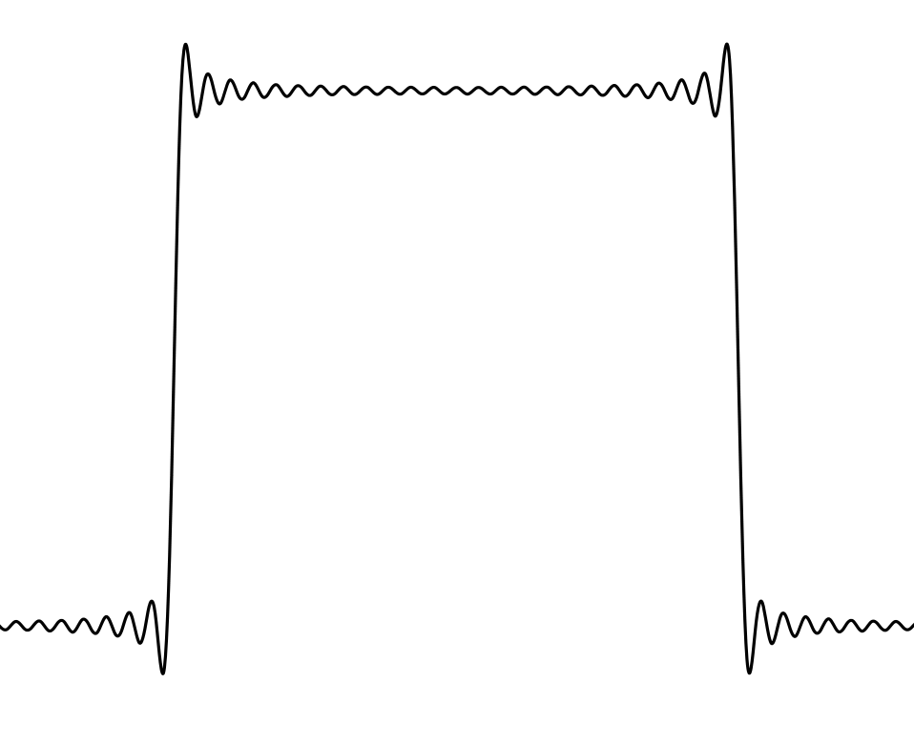
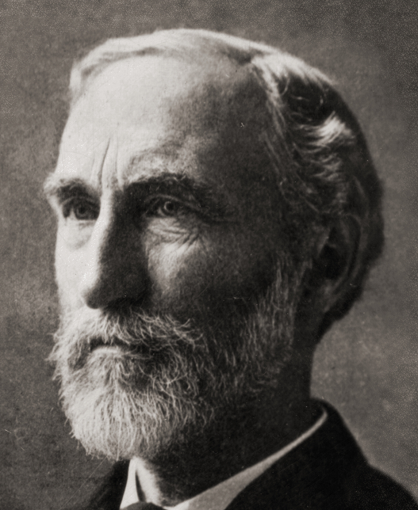
Data quality assessment ...
“Physically Implausible Signals” (PIS)
Josiah W. Gibbs
Perrone D. et al, NeuroImage (2015)

Slide 29
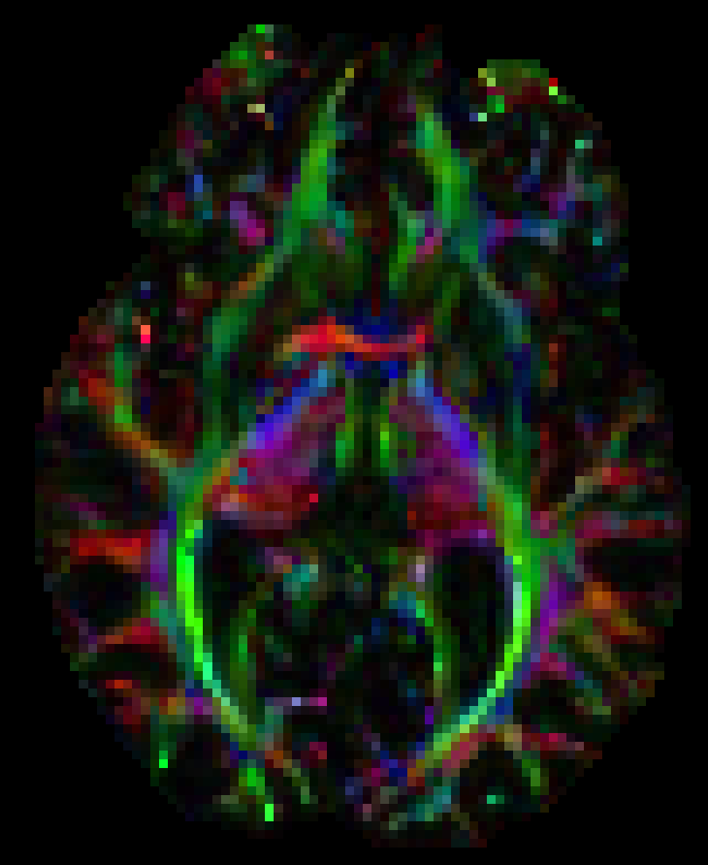
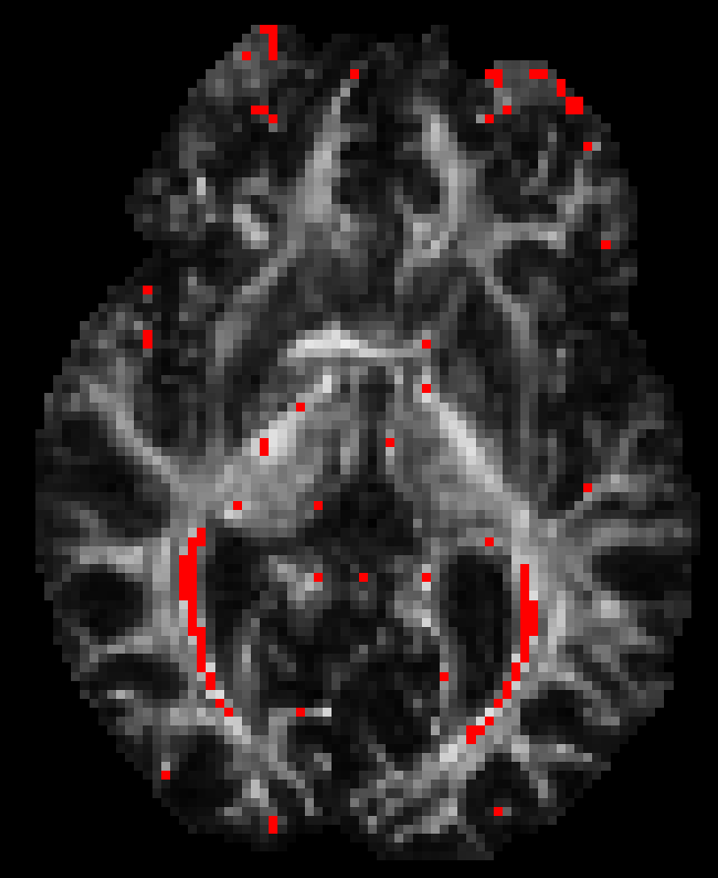
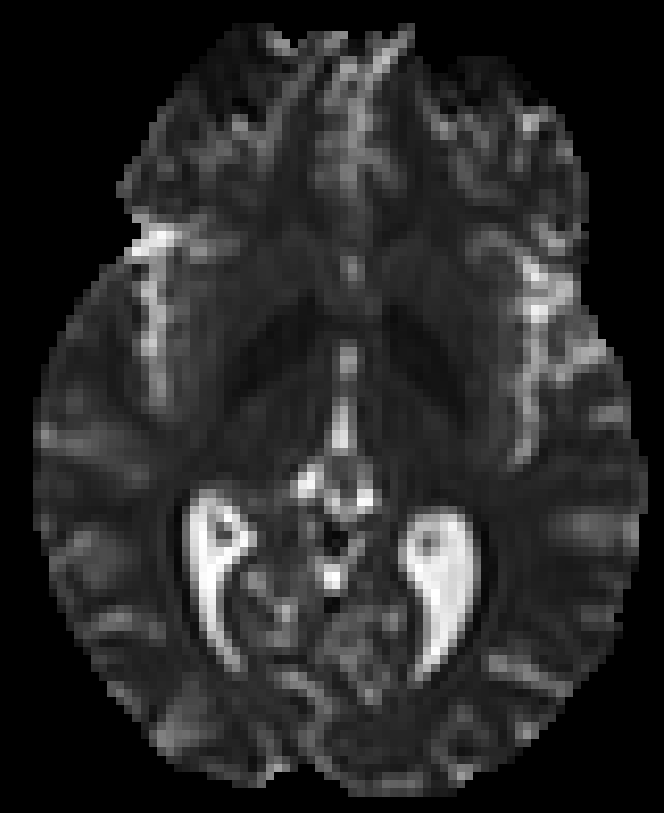
Data quality assessment ...
“Physically Implausible Signals” (PIS)
Color-coded FA
“PIS” on FA
$$S_{0}$$
Perrone D. et al, NeuroImage (2015)

Slide 30
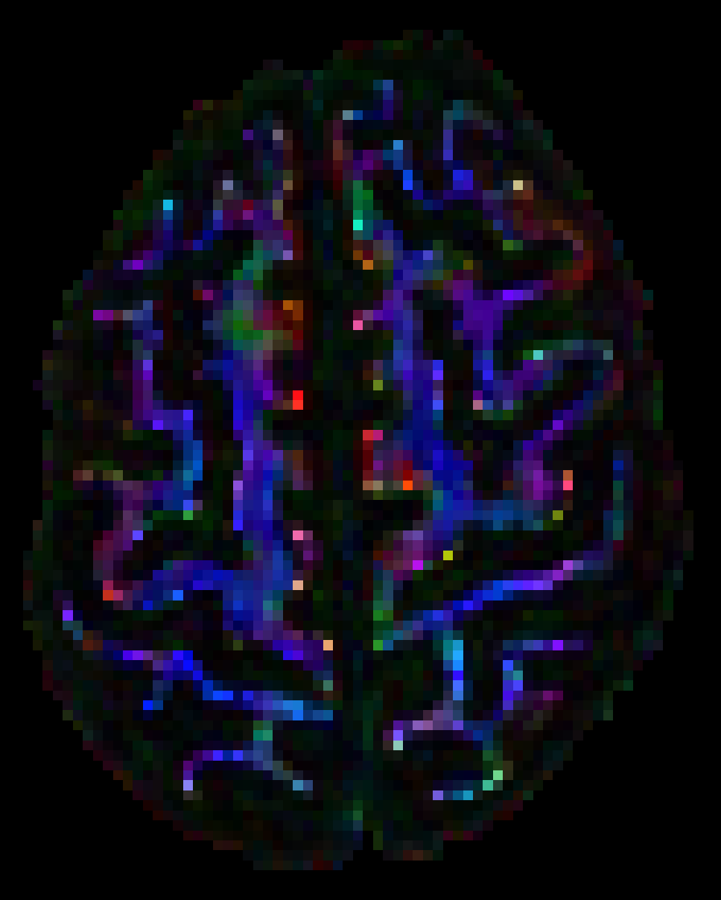
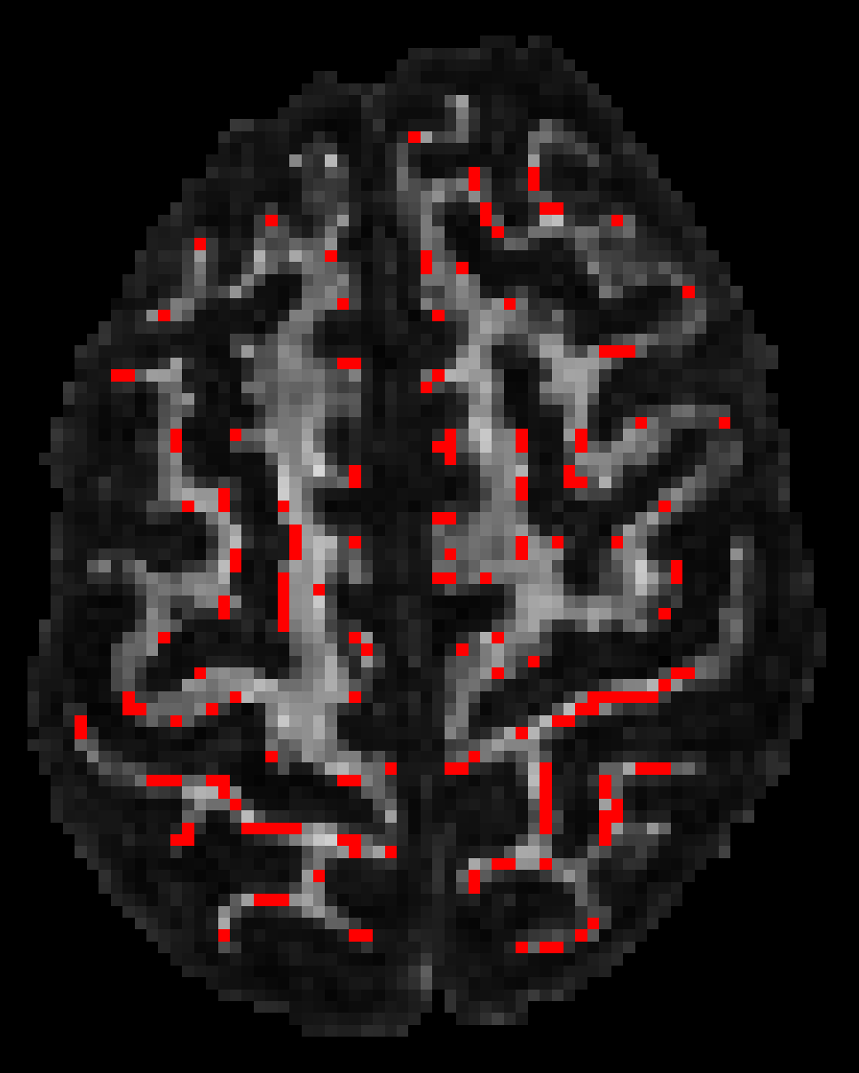

Data quality assessment ...
“Physically Implausible Signals” (PIS)
Color-coded FA
“PIS” on FA
$$S_{0}$$
Perrone D. et al, NeuroImage (2015)

Slide 31


Data quality assessment ...
“Physically Implausible Signals” (PIS)
Before correcting for Gibbs ringing artifacts
Perrone D. et al, NeuroImage (2015)

Slide 32


Data quality assessment ...
“Physically Implausible Signals” (PIS)
After correcting for Gibbs ringing artifacts
Perrone D. et al, NeuroImage (2015)

Slide 33
Data quality assessment ...
Tournier J.-D. et al, Magn Reson Med (2011)

Slide 34

Data quality assessment ...
Residuals from the model estimation
Tournier J.-D. et al, Magn Reson Med (2011)

Slide 35
Data quality assessment ...
Residuals from the model estimation
Tournier J.-D. et al, Magn Reson Med (2011)

Slide 36
Data quality assessment ...
Residuals from the model estimation
y
y = ax+b
x
Tournier J.-D. et al, Magn Reson Med (2011)

Slide 37
Data quality assessment ...
Residuals from the model estimation
residual = y_{measured} - y_{estimated}
y
y = ax+b
x
Tournier J.-D. et al, Magn Reson Med (2011)

Slide 38



Data quality assessment ...
Residuals from the model estimation
max
R
min
Good quality
Low values / uniformity
Tournier J.-D. et al, Magn Reson Med (2011)

Slide 39


Data quality assessment ...
Residuals from the model estimation
max
R
min
Tournier J.-D. et al, Magn Reson Med (2011)

Slide 40


Data quality assessment ...
Residuals from the model estimation
max
R
min
Tournier J.-D. et al, Magn Reson Med (2011)

Slide 41


Data quality assessment ...
Residuals from the model estimation
max
R
min
Tournier J.-D. et al, Magn Reson Med (2011)

Slide 42
Data quality assessment ...
Residuals from the model estimation
y
Good model (low residuals)
x
Tournier J.-D. et al, Magn Reson Med (2011)

Slide 43
Data quality assessment ...
Residuals from the model estimation
y
Bad model (high residuals)
x
Tournier J.-D. et al, Magn Reson Med (2011)

Slide 44


Data quality assessment ...
Residuals from the model estimation
max
R
min
Poldrack R.A. et al, Nature Communications (2015)

Slide 45

Tournier J.-D. et al, Magn Reson Med (2011)

Slide 46
Data processing steps
1. Correction for signal intensity drift
2. Correction for subject motion and eddy current induced distortions
3. Correction for EPI deformations
4. Diffusion model estimation approaches
S. Deprez et al, Brain Imaging and Behavior (2013)

Slide 47

1. Correction for signal intensity drift
Vos S.B. et al, Magnetic Resonance in Medicine, 2017

Slide 48

1. Correction for signal intensity drift
Vos S.B. et al, Magnetic Resonance in Medicine, 2017

Slide 49

1. Correction for signal intensity drift
Vos S.B. et al, Magnetic Resonance in Medicine, 2017

Slide 50

1. Correction for signal intensity drift
Vos S.B. et al, Magnetic Resonance in Medicine, 2017

Slide 51

1. Correction for signal intensity drift
Vos S.B. et al, Magnetic Resonance in Medicine, 2017

Slide 52


1. Correction for signal intensity drift
Before correcting for signal intensity drift
Vos S.B. et al, Magnetic Resonance in Medicine, 2017

Slide 53


1. Correction for signal intensity drift
After correcting for signal intensity drift
Vos S.B. et al, Magnetic Resonance in Medicine, 2017

Slide 54



1. Correction for signal intensity drift
0
FA difference
0.04
Vos S.B. et al, Magnetic Resonance in Medicine, 2017

Slide 55
1. Correction for signal intensity drift
Frequency
0
FA difference
0.04
FA difference (%)
Vos S.B. et al, Magnetic Resonance in Medicine, 2017

Slide 56

2. Correction for subject motion and eddy current induced distortions
Not corrected for subject motion
Leemans A. & Jones D.K., Magn Reson Med (2009)

Slide 57

2. Correction for subject motion and eddy current induced distortions
Corrected for subject motion
Leemans A. & Jones D.K., Magn Reson Med (2009)

Slide 58
2. Correction for subject motion and eddy current induced distortions
“Reference image”
“Image with subject motion”
Leemans A. & Jones D.K., Magn Reson Med (2009)

Slide 59
2. Correction for subject motion and eddy current induced distortions
“Corrected image” (no B-matrix rotation)
“Reference image”
Leemans A. & Jones D.K., Magn Reson Med (2009)

Slide 60
2. Correction for subject motion and eddy current induced distortions
“Corrected image” (with B-matrix rotation)
“Reference image”
Leemans A. & Jones D.K., Magn Reson Med (2009)

Slide 61

2. Correction for subject motion and eddy current induced distortions
“Eddy currents”
Leemans A. & Jones D.K., Magn Reson Med (2009)

Slide 62


2. Correction for subject motion and eddy current induced distortions
Without eddy currents correction
Leemans A. & Jones D.K., Magn Reson Med (2009)

Slide 63


2. Correction for subject motion and eddy current induced distortions
With eddy currents correction
Leemans A. & Jones D.K., Magn Reson Med (2009)

Slide 64



3. Correction for EPI deformations
EPI distortions
Huang et al, MRI 2008; Tournier et al, MRM 2011; Irfanoglu et al, NeuroImage 2012

Slide 65

3. Correction for EPI deformations
EPI distortions
Huang et al, MRI 2008; Tournier et al, MRM 2011; Irfanoglu et al, NeuroImage 2012

Slide 66


3. Correction for EPI deformations
Huang et al, MRI 2008; Tournier et al, MRM 2011; Irfanoglu et al, NeuroImage 2012

Slide 67


3. Correction for EPI deformations
Without EPI distortion correction
Huang et al, MRI 2008; Tournier et al, MRM 2011; Irfanoglu et al, NeuroImage 2012

Slide 68
3. Correction for EPI deformations
With EPI distortion correction
Huang et al, MRI 2008; Tournier et al, MRM 2011; Irfanoglu et al, NeuroImage 2012

Slide 69


3. Correction for EPI deformations
Without EPI distortion correction
Huang et al, MRI 2008; Tournier et al, MRM 2011; Irfanoglu et al, NeuroImage 2012

Slide 70


3. Correction for EPI deformations
With EPI distortion correction
Huang et al, MRI 2008; Tournier et al, MRM 2011; Irfanoglu et al, NeuroImage 2012

Slide 71

3. Correction for EPI deformations
Without EPI distortion correction
Huang et al, MRI 2008; Tournier et al, MRM 2011; Irfanoglu et al, NeuroImage 2012

Slide 72

3. Correction for EPI deformations
With EPI distortion correction
Huang et al, MRI 2008; Tournier et al, MRM 2011; Irfanoglu et al, NeuroImage 2012

Slide 73
4. Diffusion model estimation approaches
y
x
Reference
y
y
x
x
Ordinary least squares estimation
Robust estimation
Tax C.M.W. et al, MRM (2015); Chang et al, MRM (2005)

Slide 74






4. Diffusion model estimation approaches
Ordinary least squares estimation
Data courtesy by Dr. Niek van der Aa

Slide 75
4. Diffusion model estimation approaches
Robust estimation
Data courtesy by Dr. Niek van der Aa

Slide 76

Partial volume effect (PVE)
R
S.B. Vos, NeuroImage, (2011); F. Szczepankiewicz, NeuroImage (2013)

Slide 77


Partial volume effect (PVE)
S.B. Vos, NeuroImage, (2011); F. Szczepankiewicz, NeuroImage (2013)

Slide 78





Partial volume effect (PVE)
max
FA
min
Thickness (mm)
S.B. Vos, NeuroImage, (2011); F. Szczepankiewicz, NeuroImage (2013)

Slide 79
Fiber tractography is far from perfect!
Many false positive reconstructions!!!
Maier-Hein K. et al, Nature Communications, 2017

Slide 80

Fiber tractography is far from perfect!
Ben Jeurissen et al. (in press)
Jeurissen B. et al, NMR in Biomedicine, (in press)

Slide 81

Acknowledgements
www.ExploreDTI.com
Stefan Sunaert
Christian Beaulieu
Donald Tournier
Tomas Paus
Susumu Mori
Russ Poldrack
Derek Jones
Niek van der Aa
Yael Reijmer
Karen Caeyenberghs
Martijn Froeling
Next workshop: 27-29 May 2019 in Budapest, Hungary Details: www.ExploreDTI.com/workshop

Slide 82























PROVIDI Lab (http://www.providi-lab.org)
J. Kok
H.M. Hulshof
H. Mesri
S. Dávid
O. Odish
E. O’Hanlon
B. Robalo
D. Aquino
A. De Luca
F. Guo
U. Roine
S. St-Jean
Alumni who moved on to bigger & better…
W. Haakma
W. Van Hecke
B. Jeurissen
S.B. Vos
J.-L. Hsu
J. Gooijers
C.M.W. Tax
D. Perrone
A. Heemskerk
T. Roine

Slide 83
Thank you for your attention!

