Slide 1
Highlights from the Focused Ultrasound
Foundation Symposium
Reston, Virginia
October 21-25, 2018
Allison Payne, Ph.D.

Slide 2

Neurological applications
  movement, psychiatric, neurodegenerative disorders
  Blood brain barrier opening
  Epilepsy, stroke, neuropathic pain
  Neuromodulation
  Tumors
  Technological advances

Slide 3
Cancer
  Immunotherapy
  Kidney, liver, pancreas
  Bone
Women’s health: Breast & gynecological
Musculoskeletal
Cardiovascular

Slide 4
Highlights covered today
Developments in transcranial MRI guided focused ultrasound
  MR thermometry – brain and bone
  Imaging for treatment planning and assessment
  Neuromodulation
Clinical trials and treatment
  Prostate
  Bone metastases
  Osteoid Osteoma
Hyperthermia applications
Notes:
This excellent meeting had both clinical and technical sessions as well as plenary talks from thought leaders in the industry.

Slide 5
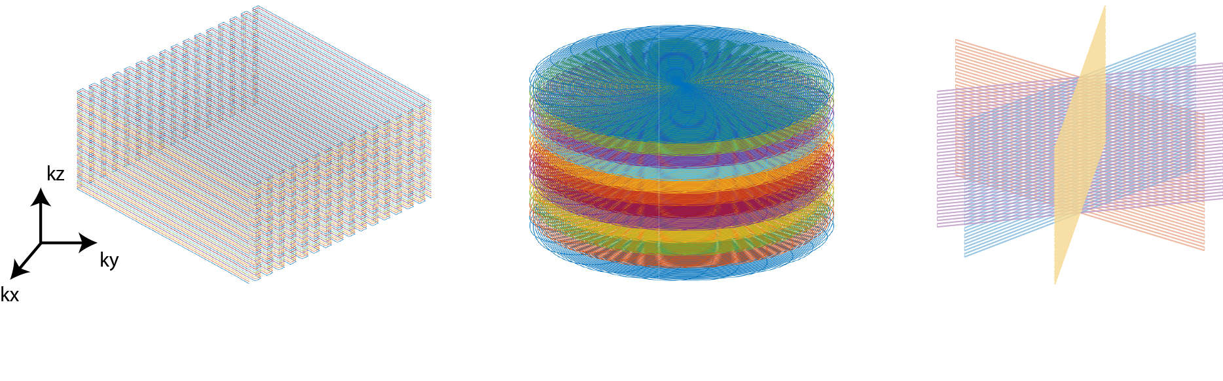
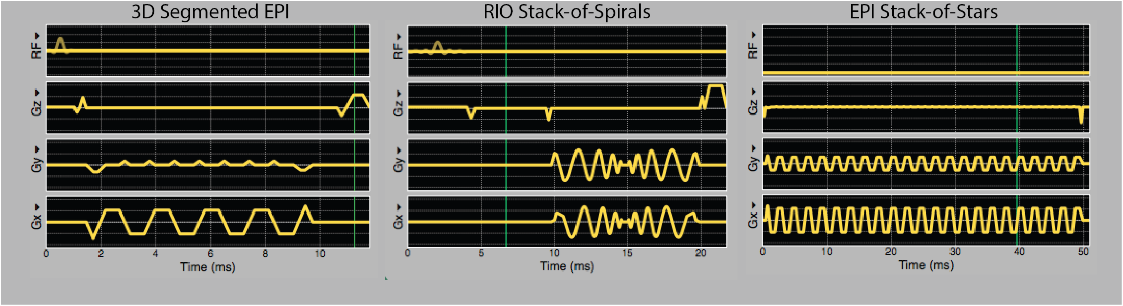
Volumetric mr thermometry
W. Grissom, H. Odeen, S. Jonathan, X. Feng, D. Parker, C. Meyer, K. Butts-Pauly, J. Snell
3D Segmented EPI:
Todd, MRM 2012
3D Retraced In-Out Stack-of-Spirals:
Fielden, MRM 2018
3D Stack-of-Stars EPI:
Jonathan, MRM 2018
Notes:
Thermometry: MR thermometry pulse sequences are essential for treatment monitoring during MR-guided focused ultrasound therapies. Typical clinical implementations of MR thermometry use a single 2D slice in order to maintain an adequate frame rate and temperature precision for temperature monitoring.
Recently, several volumetric thermometry pulse sequences have been proposed that use 3D k-space trajectories and/or constrained temperature reconstruction strategies to produce temperature maps without sacrificing volume coverage. The goal of this study is to implement and evaluate three of these sequences (3D segmented EPI, 3D stack of spirals, and 3D stack of stars) on the same therapeutic platform at the UVA Focused Ultrasound Center.
The sequences will be robustly compared with respect to their temperature precision and hot spot quality as a function of their achievable volume coverage and frame rate. This effort is supported by the Focused Ultrasound Foundation.

Slide 6
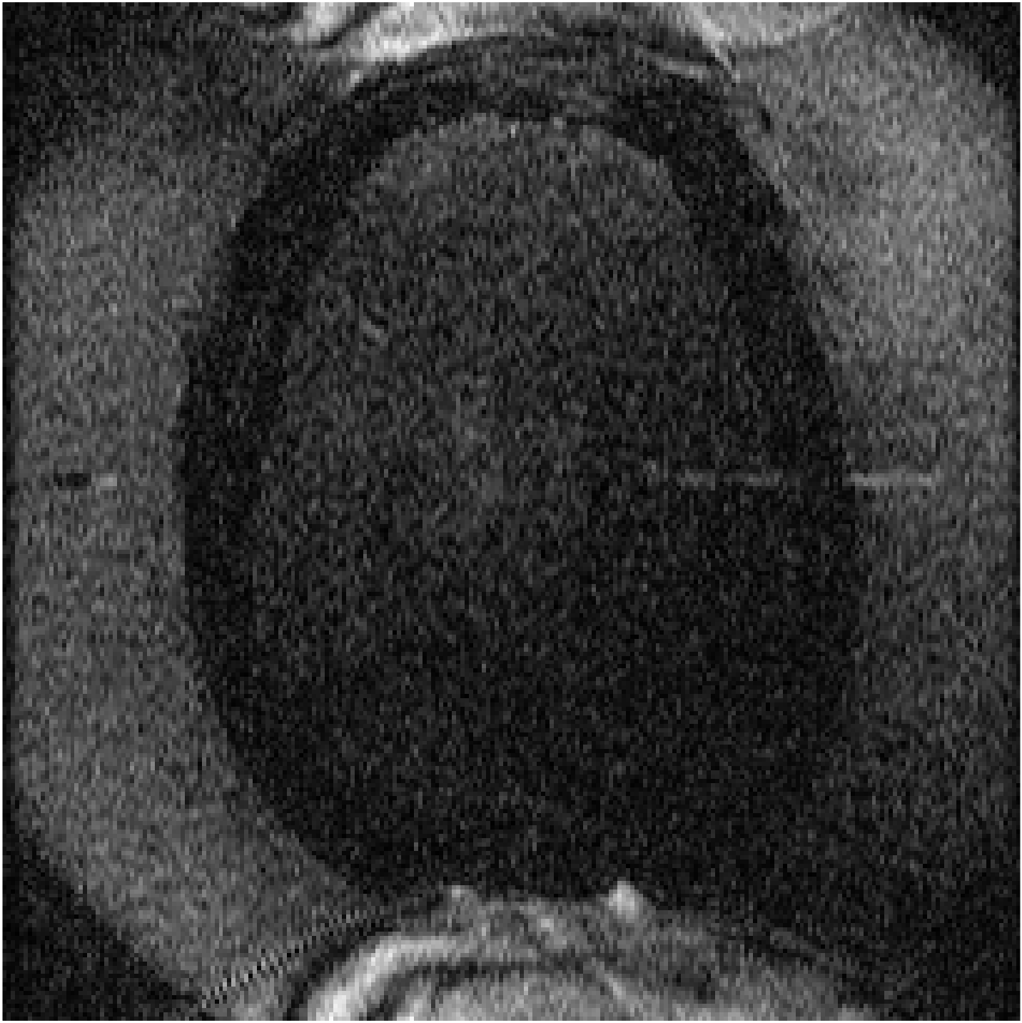
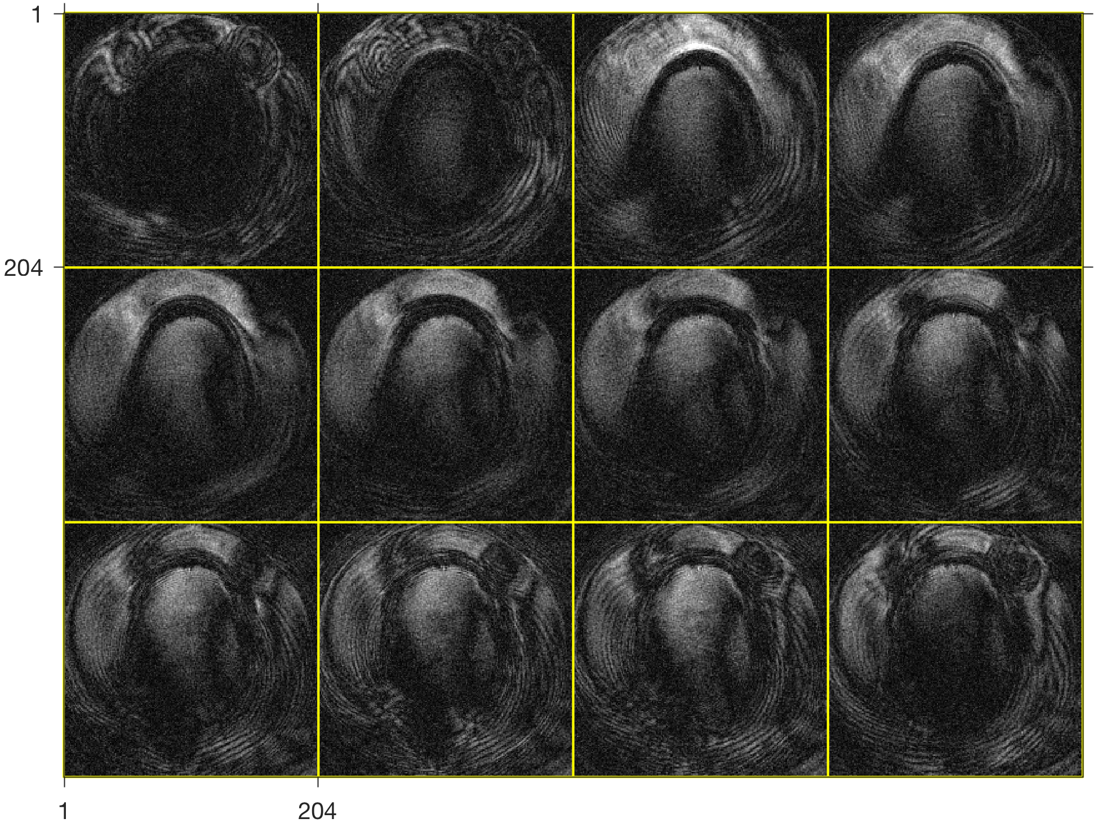
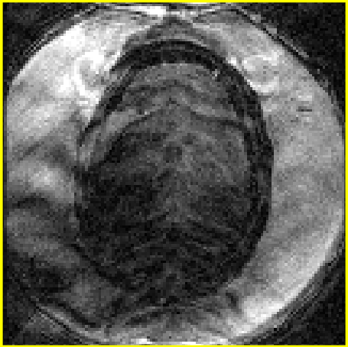
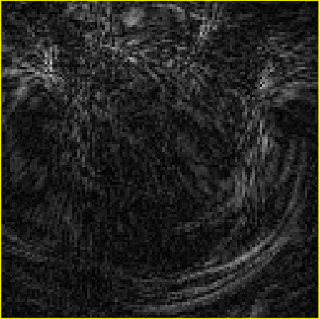
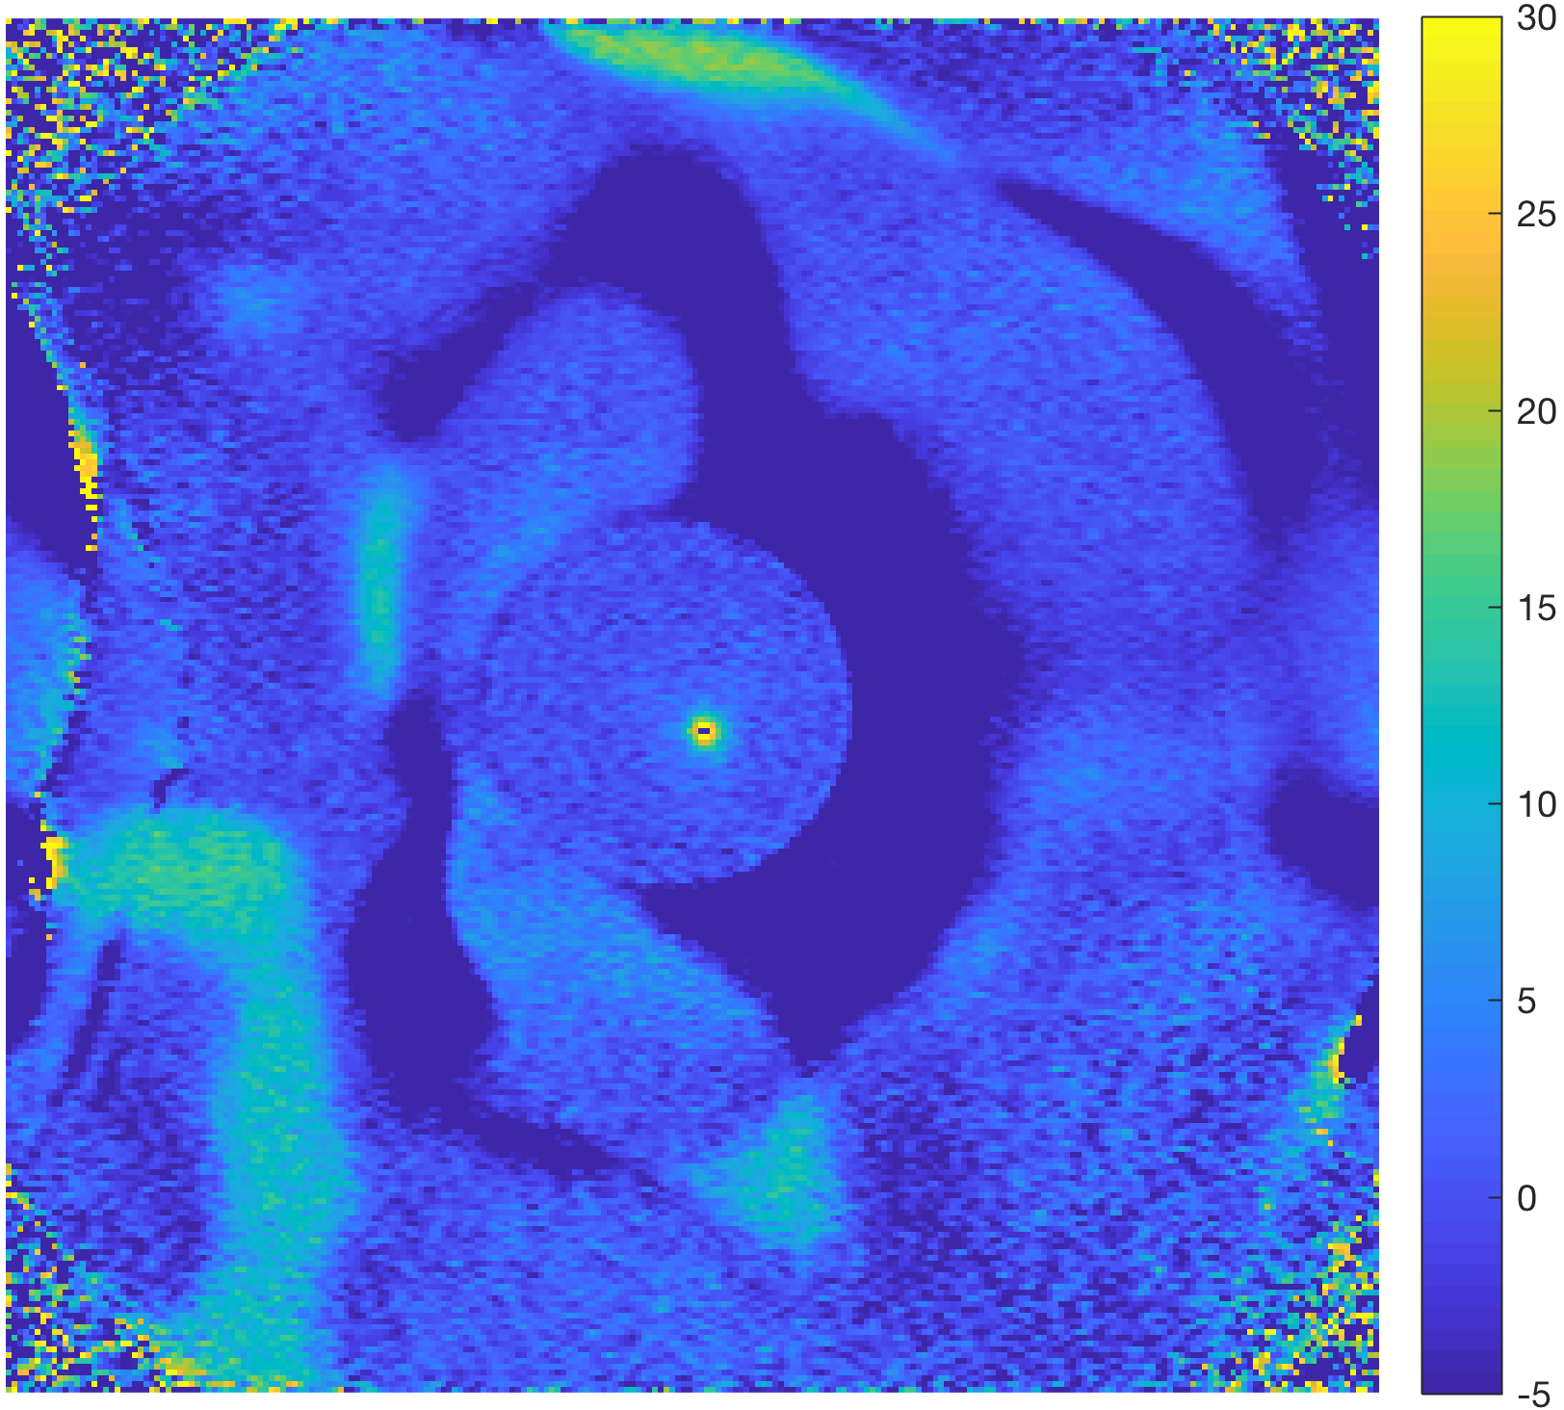
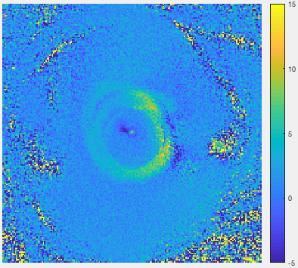
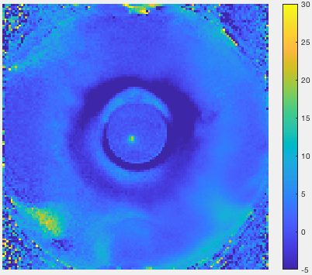
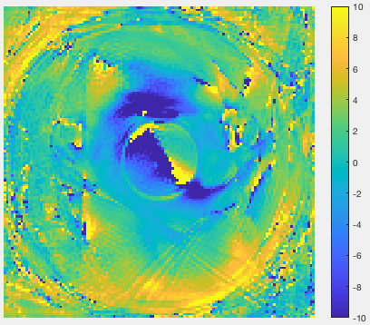
Volumetric mr thermometry
2DFT
RIO Stack-of-Spirals
Segmented EPI
EPI Stack-of-Stars
Very low SNR: likely Tx/Rx gain problem
Phase errors & delays changed versus no H₂O
Large off-resonance due to air pockets in swim cap
Segmented EPI acceptable
RIO SoSpirals & EPI SoStars contain large errors
More work is needed to improve image quality with water bath filled
Notes:
These sequences were all evaluated in an Exablate Neuro system. In general, all sequences had very low SNR, which was noted to be likely caused by Tx/Rx problems.
The results were variable depending on whether the transducer was filled with water.
It was also noted that some of the issues were due to the experimental setup. In the normal volunteer, a swim cap was used to get the system sealed.
In general while the segEPI had reasonable results, there was room for improvement in all cases. This project is ongoing.

Slide 7
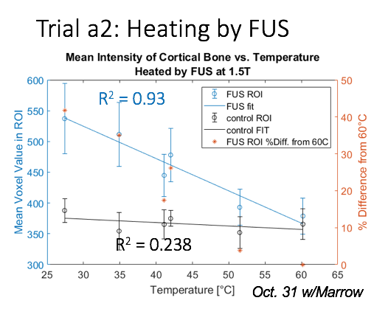
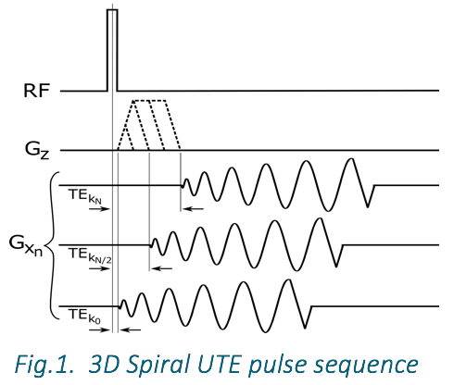
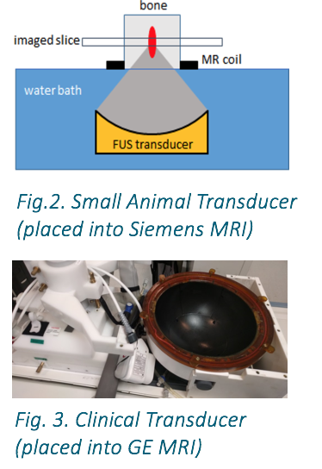
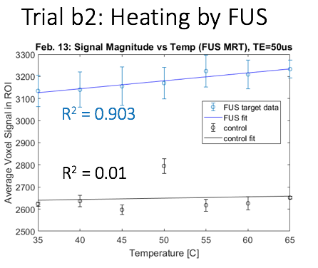
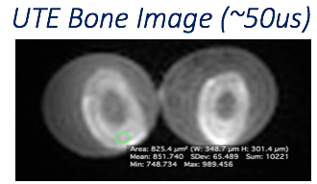
T1-based MR thermometry in bone
Y. Gilbo*, H. Sporkin, S. Fielden, J. Mugler, G. Miller, S. Allen, J. Pfeuffer, B. Kiefer, C. Meyer*
University of Virginia
SPIRAL UTE SEQUENCE:
Water bath heating
Heating with FUS
Notes:
Katya Gilbo worked with Craig Meyer’s lab at UVA and developed a spiral UTE sequence to measure T1 relaxation in bone as a measure of temperature, with the ultimate goal of imaging the entire skull in < 2 minutes.
Testing was performed at both 1.5 and 3T. 63% of the trials demonstrated a negative linear trend. The remainder did not have this same trend. Likely due to low SNR or changing bone properties. This result has been seen by other groups and indicates the need to continue this investigation.

Slide 8
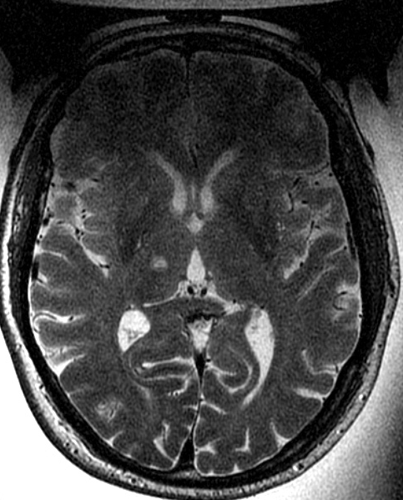
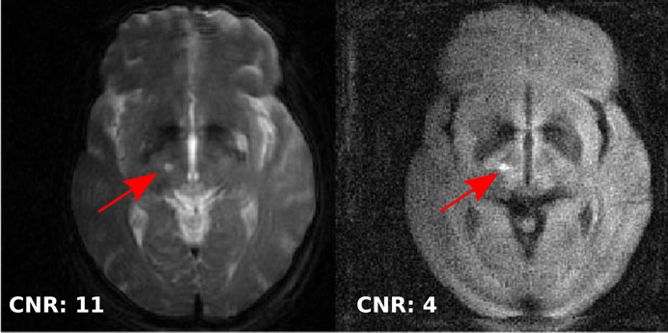
Transcranial MRgFUS imaging
S. Allen, H. Sporkin, S. Fielden, J. Mugler, G. Miller, S. Allen, J. Pfeuffer, B. Kiefer, C. Meyer*
University of Virginia
Notes:
Patient feedback and thermometry can be ambiguous. While T2w images are often used, the contrast can take some time to evolve and this includes any edema present, not offering an acute assessment of the treatment.
Due to the hardware and water bath required for tcMRgFUS treatments, there is severe RF field inhomogeneity present and low SNR, making imaging very challenging.
Intra-procedure DWI has yet to be performed.
There are some workarounds, including draining the water bath. This study demonstrated that the DWI contrast was significantly larger than the T2w contrast.
It was indicated by those at the conference though that it may be difficult to retreat after the water bath refilling due to the need to degas the water as well as the potential of different imaging parameters. Other groups have investigated this. Kim Butts-Pauly’s lab demonstrated that the strategic placement of high permittivity pads can perform RF shimming improving signal dropout.

Slide 9
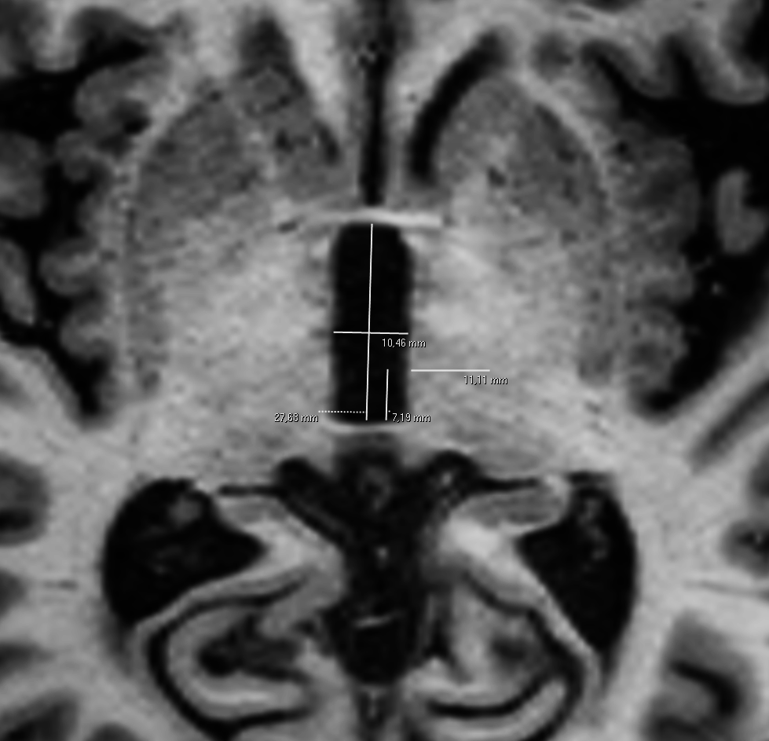
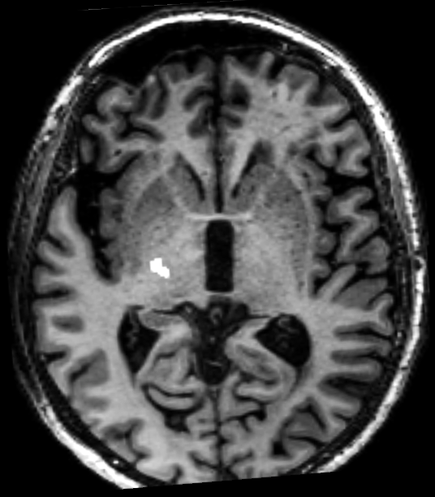
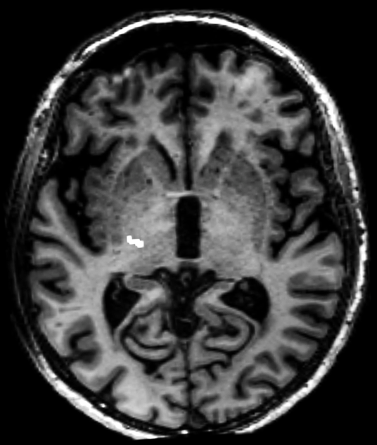
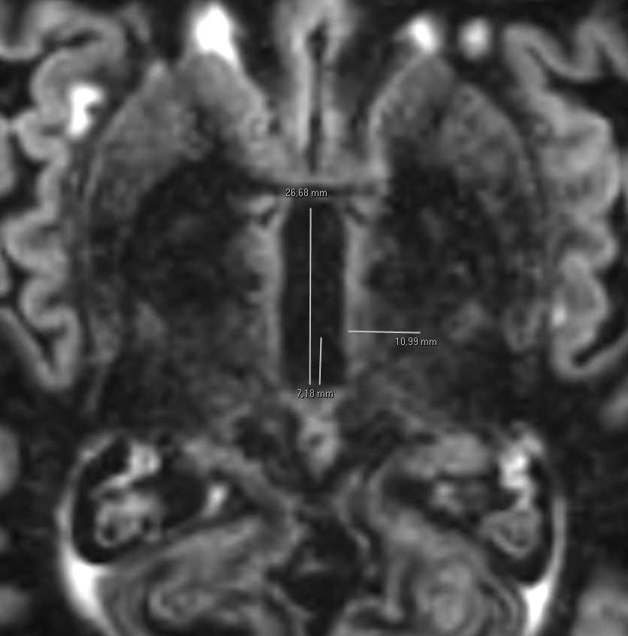


Cortico-spinal tract visualization in Dir sequences for vim targeting
Ricciardi, Ciceri, Foroni, Tamburin, Longhi, Bovi, Nicolato, Tinazzi, Cavedon, Montemezzi
Neuroradiology Unit, Verona University Hospital, Director: E. Ciceri
CST not readily visible on conventional MRI
DTI-tractography proposed for CST identification
  Time consuming, operator dependent, distortion
DIR at level of the internal capsule, CST is readily visible
T1
DTI-T
DIR
CST not visible
Variable results
Reproducible results
Notes:
The cortico spinal tract is not readily visualized using conventional MRI. While Diffusion tensor imaging tractography has been shown to be useful for CST identification, it can be quite time consuming, be operator dependent and has issues with distortion. This work demonstrated that using a double inversion recovery sequence at the level of the internal capsule allowed the reproducible visualization of the cortico spinal tract which has been very useful clinically at Verona University Hospital.

Slide 10
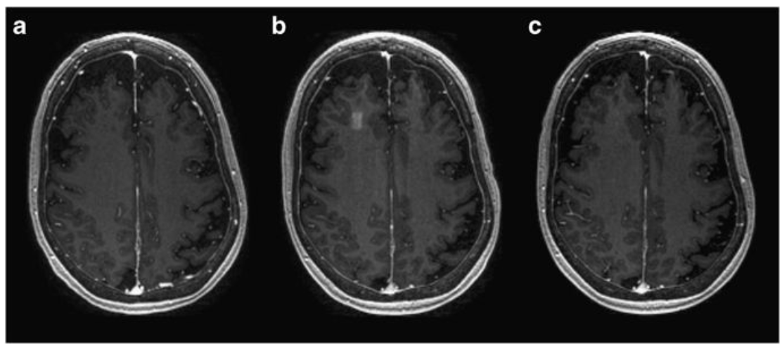
Blood brain barrier opening with MRgFUS
N. Lipsman, Y. Meng, A. Bethune, Y. Huang, B. Lam, M. Masellis, N. Herrmann, C. Heyn, I. Aubert, A. Boutet, G. Smith, K. Hynynen, S. Black
Sunnybrook Research Institute, Sunnybrook Health Sciences Center, University of Toronto
Early to moderate AD patients (N=5)
3T, 220 kHz Exablate Neuro system
9x9 mm, 3x3 grid of points
BBB studies in glioblastoma patients ongoing
Nature Communications (2018) 9:2336
Notes:
Several groups presented their efforts in using MRgFUS to open the BBB in humans. This example, from the group at the Sunnybrook Research Institute successfully opened the BBB in 5 early to moderate AD patients using the 220 kHz Exablate Neuro system. The image shows a T1w baseline image, evidence of the BBB opening immediately after the procedure and evidence of the closed BBB 24 hours after treatment. They have additional studies underway and at the meeting demonstrated successful BBB opening in GBM patients.

Slide 11
Neuromodulation targeting
S. Jonathan, M. Phipps, V. Chaplin, A. Singh, P-F Yang, A. Newton, J. Gore, L. Chen, C. Caskey, W. Grissom
Vanderbilt University
Single element transducer manually targeted
Clinical optical tracking system tracks transducer coordinates
Prescribe MR-ARFI scan parallel to ultrasound beam and visualize focus
In vivo macaque demonstration
Notes:
Will Grissom’s and Charles Caskey’s group at Vanderbilt U has been developing techniques for neuromodulation targeting. They seek to use MR-ARFI pulse sequences to enable localization of the ultrasound beam for targeting MR-guided focused ultrasound therapies. These techniques have largely been developed using large phased array transducers that are fixed in place and steer the beam electronically.
They have developed an optical tracking-guided MR-ARFI pulse sequence workflow optimized for single-element transducers that are manually targeted over the region of interest. They use a clinical optical tracking system (Polaris Vicra) to track the transducer's coordinates and project the ultrasound beam over pre-acquired images of the targeted region in real-time.
Then, with knowledge of the ultrasound beam's estimated location, they can prescribe our MR-ARFI scan parallel to the beam and localize the acoustic focus. We used our MR-ARFI sequence to acquire transcranial displacement images in living macaque brain observing the acoustic focus with a peak displacement of 1.2 microns at 802 kHz/3609 cycles/2.89 MPa free-field pressure (0.76 MPa is our estimate of skull-derated pressure).

Slide 12

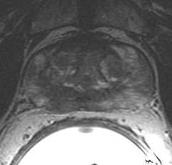
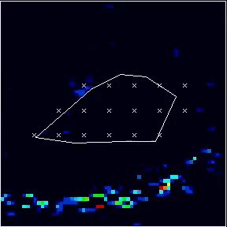
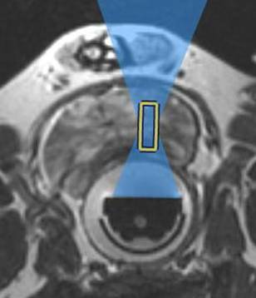
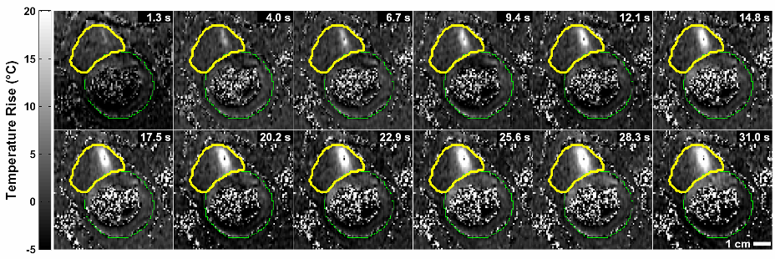
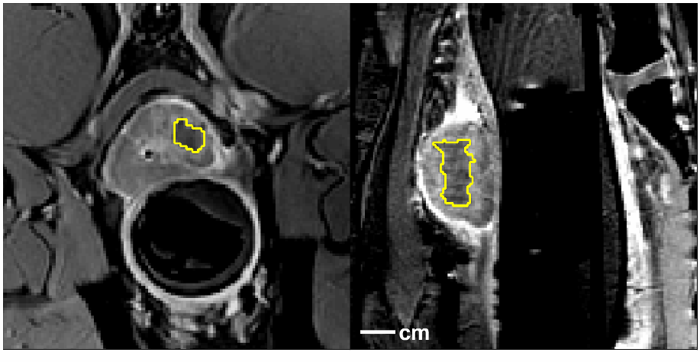
Multi-center trial for focal treatment of prostate cancer
C. Tempany, N. McDannold, (BWH), P. Ghanouni, G. Sonn (Stanford), D. Woodrum, L. Mynderse (Mayo), J. Wong (City of Hope), T. Showalter (UVA), M. Schiffman, T. McClure (Cornell), B. Edhaie (MSKCC)
NCT 01657942, Study sponsor: InSightec, Haifa, Israel
Safety: evaluate incidence and severity of adverse events associated with ExAblate's MRgFUS focal treatment of intermediate risk organ confined prostate lesions.
Effectiveness: determine the lesion control effect of ExAblate's MRgFUS focal treatment of intermediate risk organ-confined prostate lesions (confirmed by image guided mapping biopsy results).
Cohort 1: 11/14/2013 – 7/7/2017
Outpatient transrectal MRgFUS under general anesthesia
Insightec MRgFUS 3T ExAblate 2100
Pre-procedure device function test
Neuro-vascular
bundle
Urethra
Patient prep: in room GA, catheter, rectal probe positioned
Rectum
Imaging/Planning
Beam path
Sonications
Sonication
Post-procedure IV gadolinium
Transducer

Slide 13
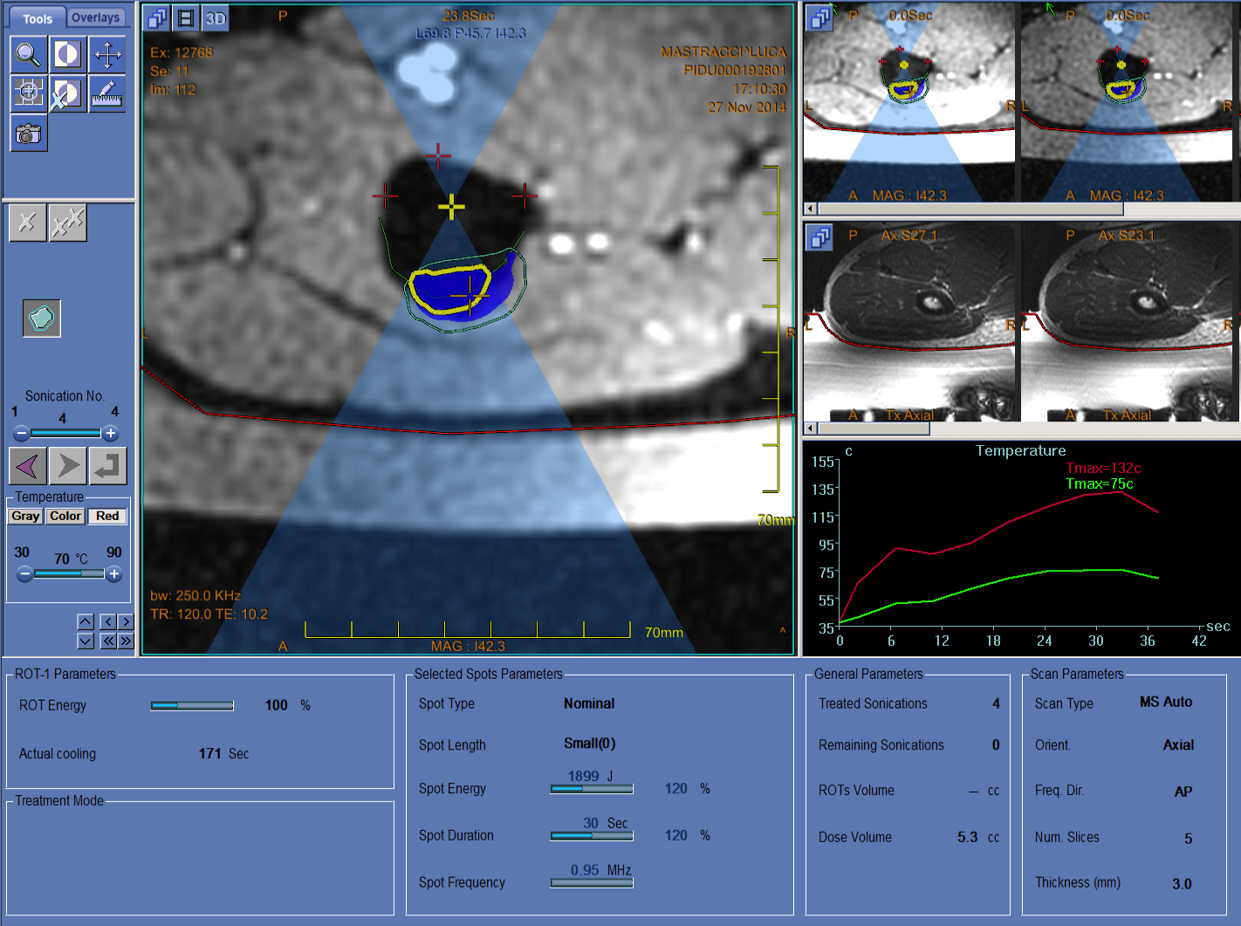
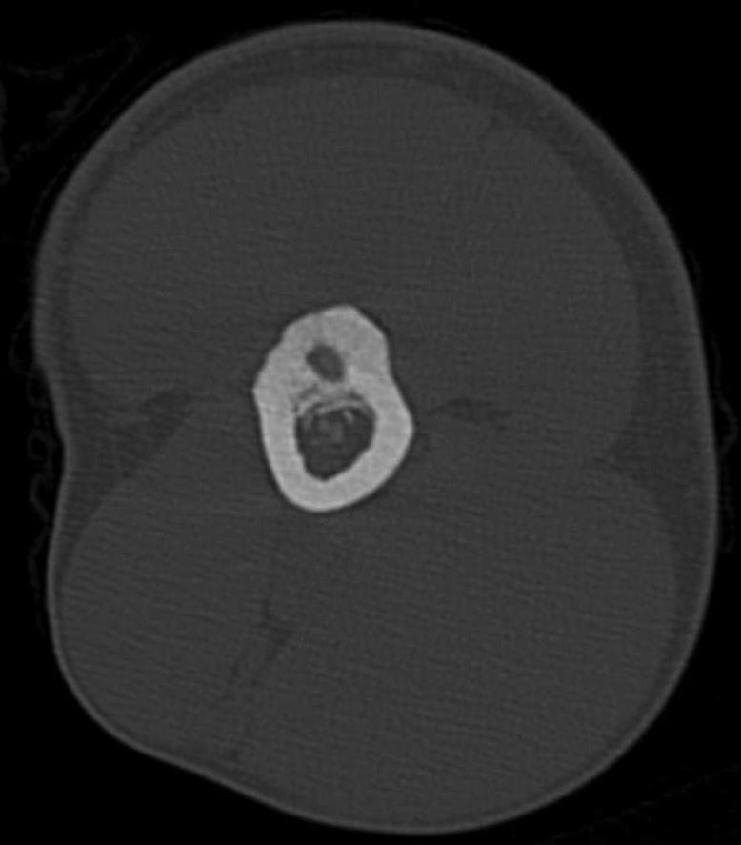
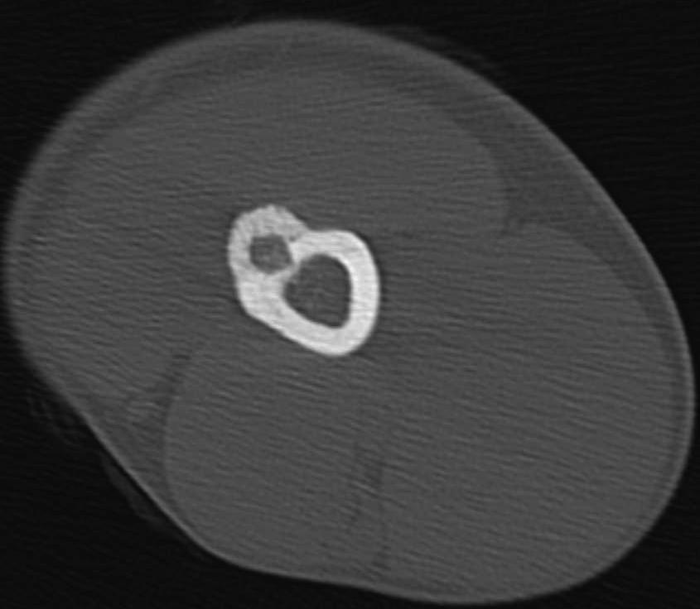
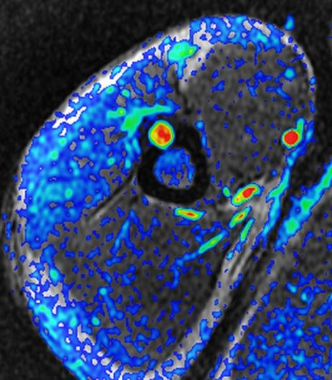
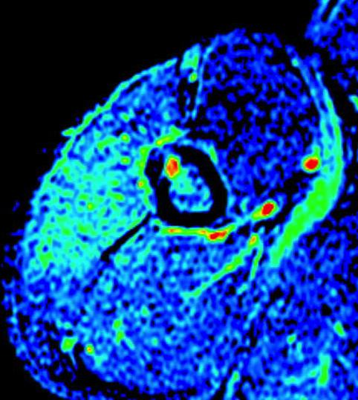
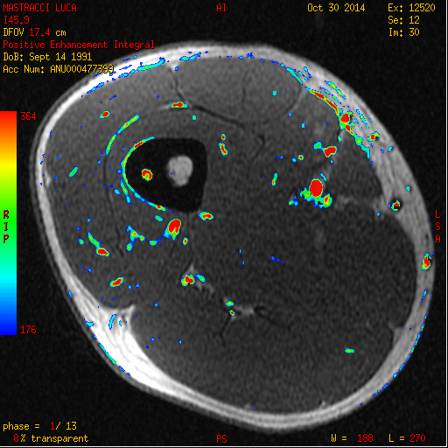
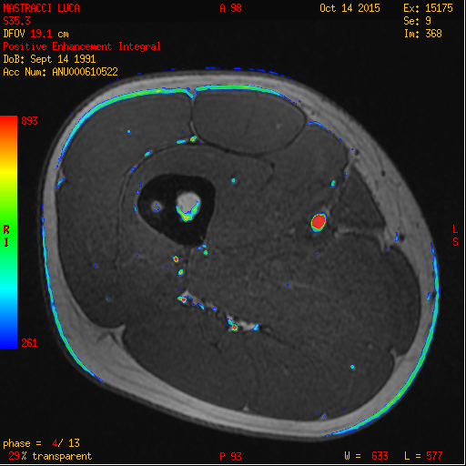
Treating Osteoid osteomas with MRgFUS
A. Napoli, H-P. Erasmus, C. Catalano
University of Roma
M; 22 yo
VAS: 8
18 months follow up
VAS: 0
Benign bone tumors with a perfused center
Thermometry with PRF in soft tissues only
Perfusion measurements with gadolinium techniques
A single sonication is enough for a stable, successful treatment
M; 19 yo
VAS: 8
12 months follow up
VAS: 0
The bottom line: what does MRI guidance offer?
MRI wish list:
Temperature monitoring in bone
Non-contrast perfusion assessment techniques
Good spatial resolution
Real-time temperature monitoring
No radiation involved
Perfusion data for vascularized lesions
Notes:
Image legend:
LEFT FIGURE: Red box around thermometry. Temperature is raised sufficiently high for a certain period of time to cause necrosis. MR thermometry takes up information from adjacent soft tissue, which we use as an indicator for in-bone temperature rise.
RIGHT FIGURE –
Humeral osteoid osteoma (OO) in 22yo male, pain visual analog score (VAS) of 8 out of 10; right from the day after the treatment VAS dropped to 0
Right of dotted line: at 18 month follow-up, VAS remained 0, perfusion is reduced, CT scan shows size reduction and bone remodeling.
Red box highlights reduction of perfusion
Below dashed line
Left: Femoral OO in 19yo male, VAS 8;
Right: at 12 month follow-up, VAS remained 0, nidus completely non-perfused.
Red box highlights reduction of perfusion
“Any discussion on future needs that would further this clinical usage would be welcome.” →
Noted that temperature monitoring in the bone would allow for more precise dosing, improving treatment efficacy. Currently, they estimate heating by means of surrounding soft tissue thermometry.
Also noted that being able to study lesion perfusion without the use of gadolinium would also be useful, as re-treating an area shortly after Gd administration is not approved under current Gd safety profile

Slide 14
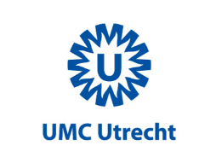









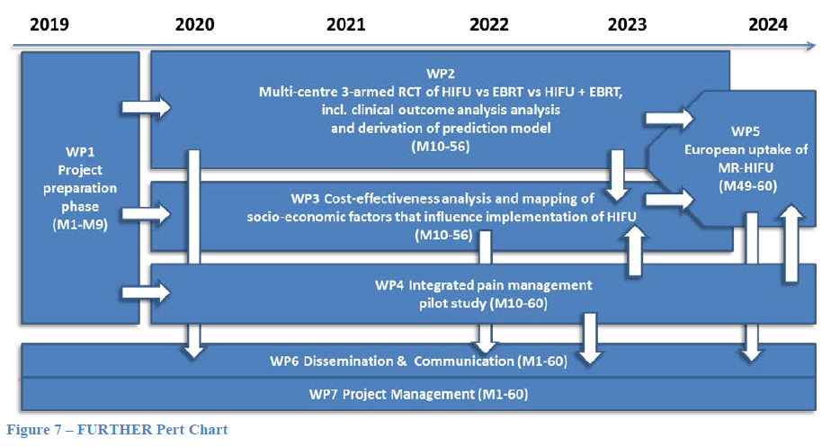
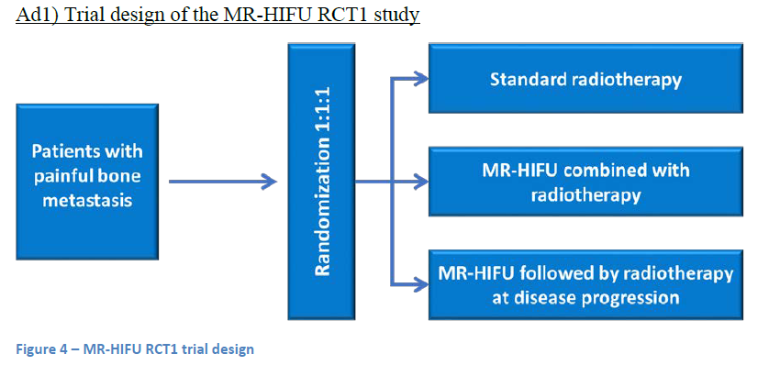
FURTHER: Focused Ultrasound and radioTHERapy for noninvasive palliative pain treatment in patients with bone metastasis
C. Moonen, L. Verkooijen
Several studies have indicated efficacy of MR-HIFU for pain palliation in patients with bone metastases. Hurwitz et al, (JNCI, 106 (5), 2014) demonstrated in a multicenter randomized trial that MR-HIFU is a safe and effective, non-invasive treatment for alleviating pain caused by bone metastases.
Response to MR-HIFU was typically rapid, with about two-thirds of responses seen within days after treatment.
This study was however performed in patients who were ineligible, or who failed or declined radiation.
Notes:
FYI, the FURTHER project is a 4 Meuros European project, lasting 5 year project starting beginning 2019.

Slide 15
summary
More than 100 clinical indications for focused ultrasound, and MRI plays a pivotal role
Emphasis of academic and industrial partnerships to move the technology forward
Specialized symposium allows dissemination of clinical and technical advances
Technical solutions from the MRI community are still needed
Notes:
As members of the ISMRM study group, we are uniquely situated to be able to provide solutions to these clinical problems.

