Slide 1
Diffusion Weighted MRS Numerical Simulation & Experimental Design for Microstructural Modeling
ISMRM Virtual Meeting: Diffusion Weighted MRS
9th August 2018
Marco Palombo, Ph.D.
Dep. of Computer Science and Centre for Medical Image Computing
University College London
UK

Slide 2
Outline
Motivation for measuring the diffusion properties of brain metabolites
Tuning the DW-MRS experiment to measure cell morphology
Example 1: estimating cell morphology in vivo by DW-MRS
Example II: estimating brain cell fibres in vivo by DW-MRS
Example III: monitoring astrocytes reactivity in vivo by DW-MRS
Summary
ISMRM Virtual Meeting: Diffusion Weighted MRS
9th August 2018

Slide 3
Non-invasive brain microstructure imaging by DW-MRI
Water diffusion-weighted MRI (DW-MRI) is a very powerful tool to characterize brain microstructure in vivo and non-invasively
ISMRM Virtual Meeting: Diffusion Weighted MRS, 9th August 2018

Slide 4
Non-invasive brain microstructure imaging by DW-MRI
Water diffusion-weighted MRI (DW-MRI) is a very powerful tool to characterize brain microstructure in vivo and non-invasively
The patterns of diffusion displacement are sensitive to tissue microstructure
ISMRM Virtual Meeting: Diffusion Weighted MRS, 9th August 2018

Slide 5
Non-invasive brain microstructure imaging by DW-MRI
Water diffusion-weighted MRI (DW-MRI) is a very powerful tool to characterize brain microstructure in vivo and non-invasively
DTI (Basser et al. 1994)
Tractography
ISMRM Virtual Meeting: Diffusion Weighted MRS, 9th August 2018

Slide 6
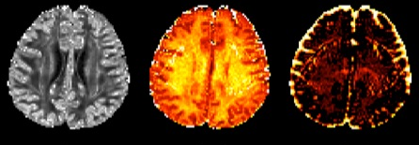
Non-invasive brain microstructure imaging by DW-MRI
Water diffusion-weighted MRI (DW-MRI) is a very powerful tool to characterize brain microstructure in vivo and non-invasively
DTI (Basser et al. 1994)
NODDI (Zhang et al. 2012)
Orientation
Dispersion
Neurite
Density
CSF
Tractography
ISMRM Virtual Meeting: Diffusion Weighted MRS, 9th August 2018

Slide 7
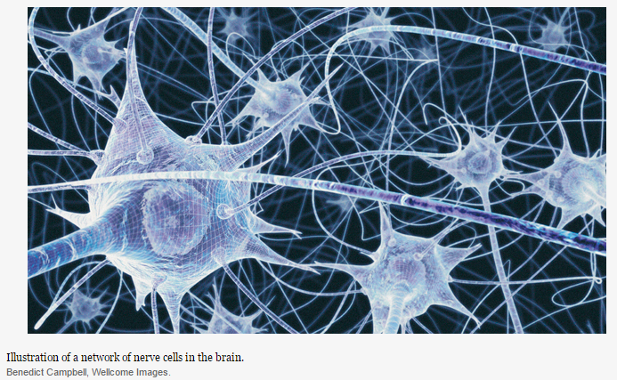
However brain tissue is very complex
Water is an aboundant but not specific probe of tissue microstructure
Extra- and intra-cellular space
Different cell types
Complex medium (organelles and macromolecules)
Exchange among compartments
ISMRM Virtual Meeting: Diffusion Weighted MRS, 9th August 2018

Slide 8
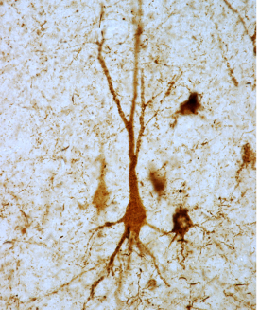

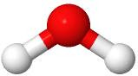
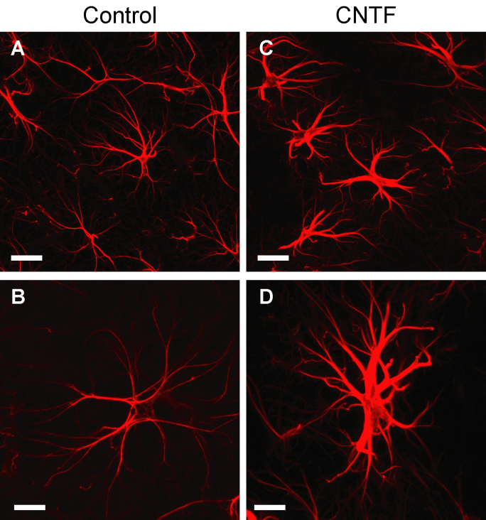
Water: a not cell-specific probe of tissue microstructure
Variations in cell morphology
Neuron atrophy
Water ADC
40 µm
Control
Alzheimer
Astrocyte reactivity
Water ADC
20 µm
ISMRM Virtual Meeting: Diffusion Weighted MRS, 9th August 2018

Slide 9
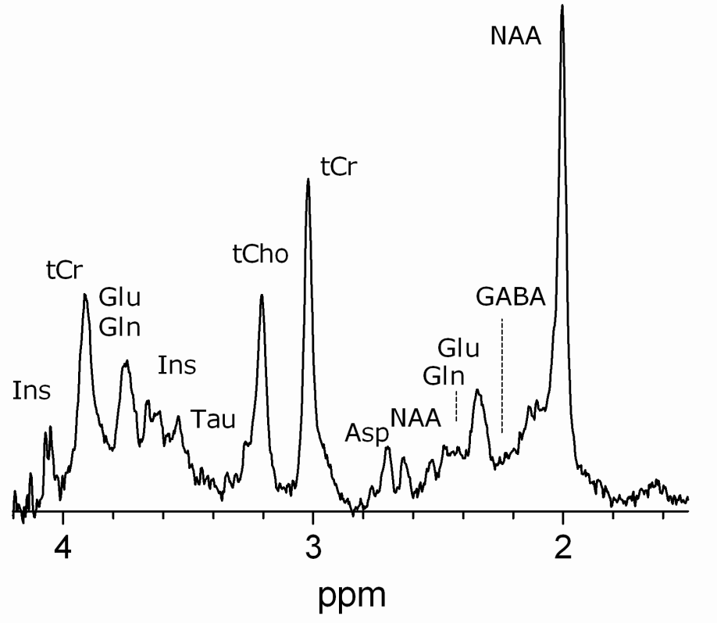
Brain metabolites are cell specific molecules
Magnetic Resonance Spectroscopy (MRS) enables to quantify the concentration of brain metabolites
Metabolites are mainly located in the intra-cellular space
NAA – neuronal marker
tCr – energy metabolism
Glu, Gln – neurotransmitters
Cho, Ins – glial marker
GABA – neurotransmitter
Lac – anaerobic metabolism
ISMRM Virtual Meeting: Diffusion Weighted MRS, 9th August 2018

Slide 10
Brain metabolites are cell specific molecules
DW-MRS is a unique tool to investigate the motion of brain metabolites in vivo.
ISMRM Virtual Meeting: Diffusion Weighted MRS, 9th August 2018

Slide 11
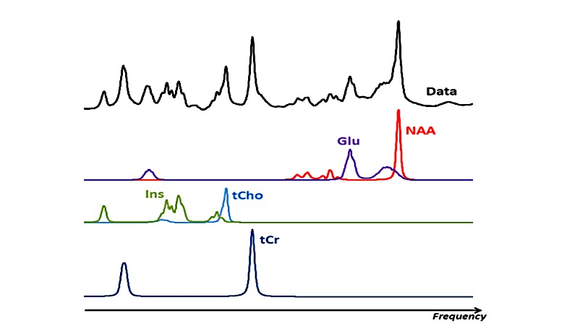
Brain metabolites are cell specific molecules
DW-MRS is a unique tool to investigate the motion of brain metabolites in vivo.
Compartment specificity
No extra-cellular space
18 different studies suggest¹
[Ins] in neurons (except NT2-N) < 4 mM
[Ins] in astrocytes ~ 12-15 mM
[Ins] ~ 3x higher in astrocytes compared to neurons
[tCho] ~ 2.5x higher in glia compared to neurons²
[tCho] ~ 10x higher in glia compared to neurons³
[tCho] ~ 6x higher in glia compared to neurons
[NAA] & [Glu], large consensus mostly in neurons
Fisher S et al., J Neurochem 2002
Urenjak J et al., J Neurosci. 1993
Le Belle JE et al. NMR Biomed. 2002
ISMRM Virtual Meeting: Diffusion Weighted MRS, 9th August 2018

Slide 12
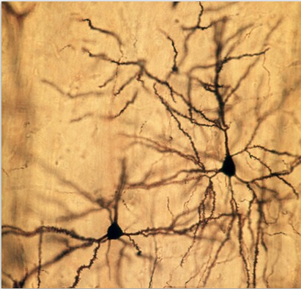
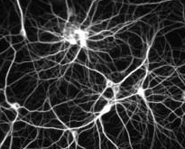
Brain metabolites are cell specific molecules
DW-MRS is a unique tool to investigate the motion of brain metabolites in vivo.
Compartment specificity
No extra-cellular space
Cellular morphology
Cytosol viscosity
Tortuosity
Changes in intra-cellular structures
Chemical reactions
Palombo M. et al. Neuroimage (2017)
ISMRM Virtual Meeting: Diffusion Weighted MRS, 9th August 2018

Slide 13
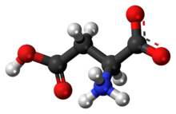
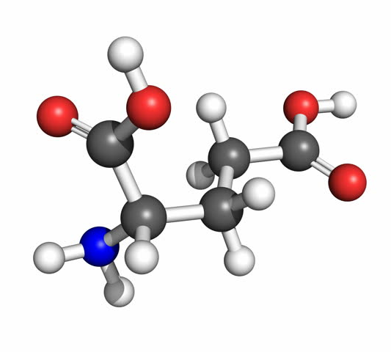
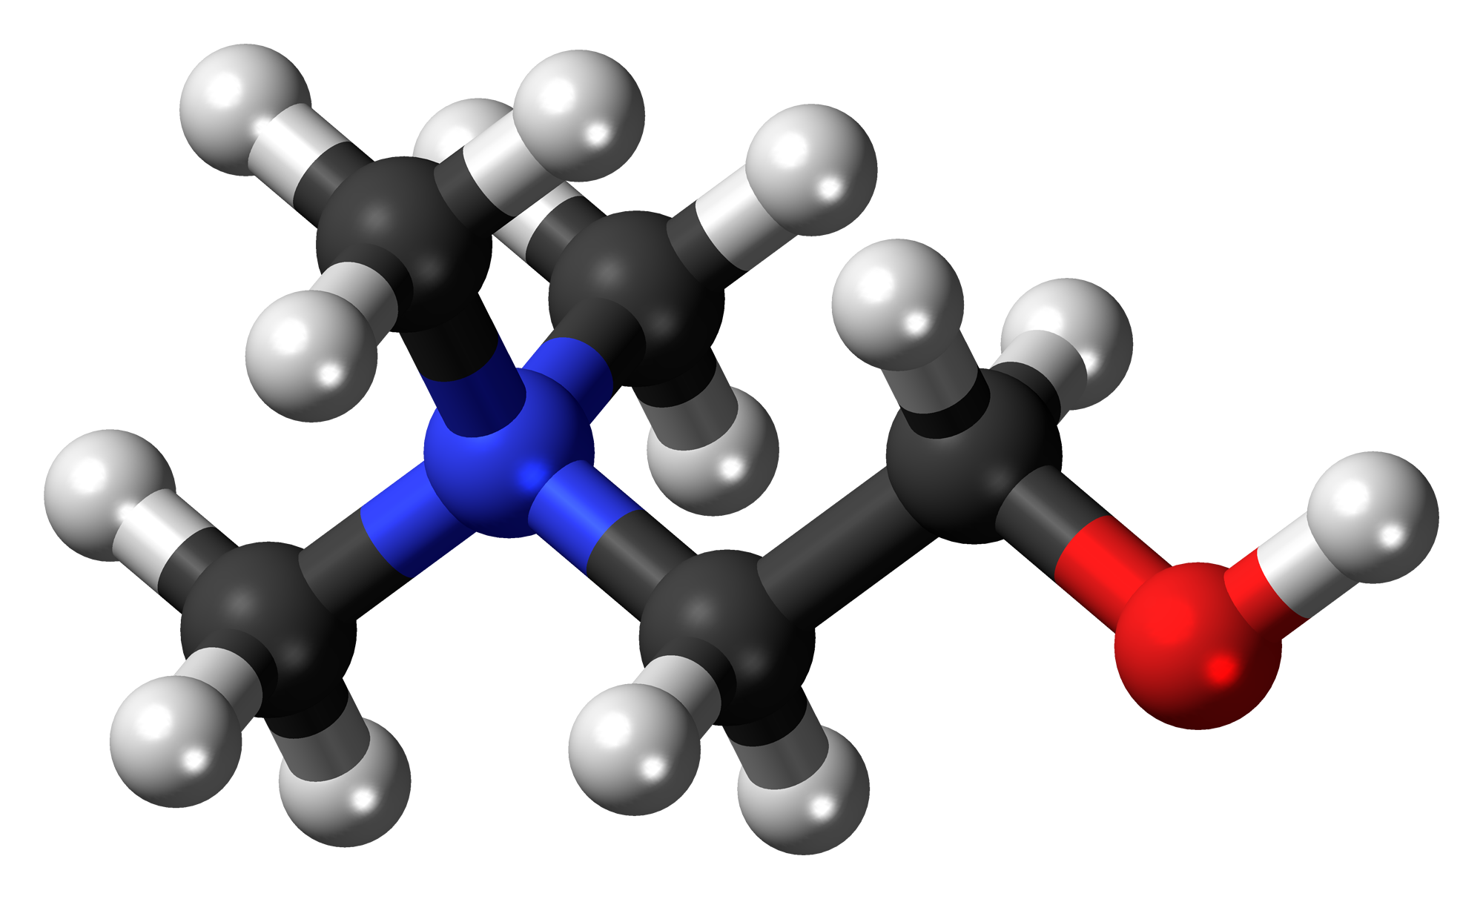
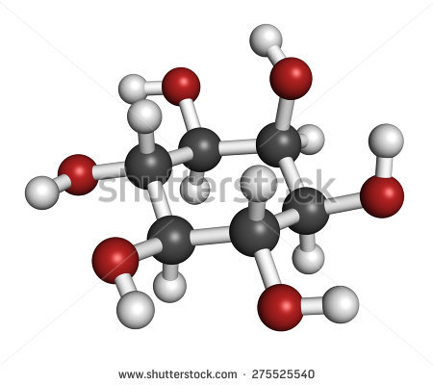
Metabolites: cell-specific probes of tissue microstructure
Variations in cell morphology
NAA
Neuron atrophy
NAA ADC
Glu
40 µm
Control
Alzheimer
Cho
Astrocyte reactivity
Ins
Ins ADC
20 µm
ISMRM Virtual Meeting: Diffusion Weighted MRS, 9th August 2018

Slide 14
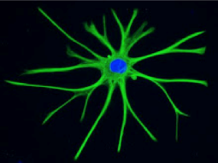
Diffusion weighted MRS can use metabolites as probe molecules
Brain intracellular metabolites mainly diffuse across length scales comparable with the whole cell structure¹⁻⁵
We can use brain metabolites as probes of the brain cell morphology and intracellular space.
Marchadour C et al. Journal of Cerebral Blood Flow & Metabolism (2012)
Najac C et al. Neuroimage (2014)
Najac C et al. Brain Structure and Function (2014)
Ligneul C et al. Magnetic Resonance in Medicine (2017)
Palombo M. et al. Neuroimage (2017)
ISMRM Virtual Meeting: Diffusion Weighted MRS, 9th August 2018

Slide 15
Magnetic Field Gradients to investigate molecular diffusion
Homogeneous spatial distribution of Magnetic Field B
In-Homogeneous spatial distribution of Magnetic Field B
x
x
y
y
B(x)
B(x)
x
x
ISMRM Virtual Meeting: Diffusion Weighted MRS, 9th August 2018

Slide 16
Magnetic Field Gradients to investigate molecular diffusion
Homogeneous spatial distribution of Magnetic Field B
In-Homogeneous spatial distribution of Magnetic Field B
x
x
y
B*
B*
y
B(a)
B(b)
B*
B*
B(a)
B(b)
B*
B*
B(a)
B(b)
B*
B*
B(a)
B(b)
B*
B*
B(a)
B(b)
B(x)
B(x)
B*
B(b)
B(a)
x
a
x
b
→ It is possible to induce specific magnetic field in-homogeneities to investigate probe molecules diffusion processes
ISMRM Virtual Meeting: Diffusion Weighted MRS, 9th August 2018

Slide 17
Magnetic Field Gradients to investigate molecular diffusion
Homogeneous spatial distribution of Magnetic Field B
In-Homogeneous spatial distribution of Magnetic Field B
x
x
y
B*
B*
y
B(a)
B(b)
B*
B*
B(a)
B(b)
B*
B*
B(a)
B(b)
B*
B*
B(a)
B(b)
B*
B*
B(a)
B(b)
B(x)
B(x)
B*
g=0
B(b)
g≠0
B(a)
x(t_{i}) = ???
x
x(t_{f}) = ???
x(t_{i}) = a
x(t_{f}) = b
x
DISPLACEMENT in time interval t_{d}=t_{f}-t_{i}
??????
DISPLACEMENT in time interval t_{d}=t_{f}-t_{i}
x(t_{f}) – x(t_{i}) = b-a
→ In diffusion MR we use specific magnetic field gradient pulses to spatially label probe molecules and follow them during their diffusion process
ISMRM Virtual Meeting: Diffusion Weighted MRS, 9th August 2018

Slide 18
Magnetic Field Gradients to investigate molecular diffusion
Homogeneous spatial distribution of Magnetic Field B
In-Homogeneous spatial distribution of Magnetic Field B
x
x
y
B*
B*
y
B(a)
B(b)
B*
B*
B(a)
B(b)
B*
B*
B(a)
B(b)
B*
B*
B(a)
B(b)
B*
B*
B(a)
B(b)
B(x)
B(x)
g*
B*
B(b)
g=0
g
B(a)
x(t_{i}) = ???
x
x(t_{f}) = ???
x(t_{i}) = a
x(t_{f}) = b
x
DISPLACEMENT in time interval t_{d}=t_{f}-t_{i}
??????
DISPLACEMENT in time interval t_{d}=t_{f}-t_{i}
x(t_{f}) – x(t_{i}) = b-a
→ strong g (short t_{d}) to be more sensitive to small molecules’ displacements
→ long t_{d} (weak g) to be more sensitive to large molecules’ displacements
ISMRM Virtual Meeting: Diffusion Weighted MRS, 9th August 2018

Slide 19
Magnetic Field Gradients to investigate molecular diffusion
x
y
d
d
Weak g
qd < 1
L
q ~ Gradient Strength x Gradient Duration
x
z
y
x
Strong g
qd ≥ 1
y
Long t_{d}
D₀t_{d} > L²
Short t_{d}
D₀t_{d} < L²
→ strong g (short t_{d}) to be more sensitive to small molecules’ displacements
→ long t_{d} (weak g) to be more sensitive to large molecules’ displacements
ISMRM Virtual Meeting: Diffusion Weighted MRS, 9th August 2018

Slide 20
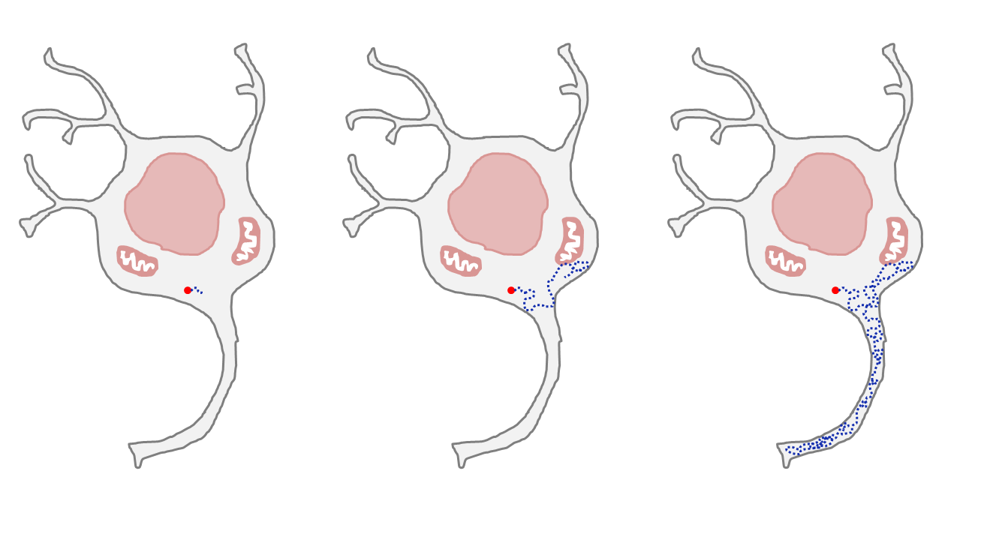
Molecular diffusion: a multi-scale approach
Diffusion time T_{d}
0.1 ms
1 ms
10 ms
100 ms
1 000 ms
10 000 ms
Distance traveled Δx
0.3 µm
1 µm
2 µm
5 µm
15 µm
50 µm
Parameters affecting apparent diffusion
Fiber diameter (axons, dendrites…)
Organelles
Cell size
Long-range structural features
Intracellular viscosity
ISMRM Virtual Meeting: Diffusion Weighted MRS, 9th August 2018

Slide 21
Short diffusion time: cytosol characteristics
Diffusion time T_{d}
0.1 ms
1 ms
10 ms
100 ms
1 000 ms
10 000 ms
Distance traveled Δx
0.3 µm
1 µm
2 µm
5 µm
15 µm
50 µm
Parameters affecting apparent diffusion
Fiber diameter (axons, dendrites…)
Organelles
Cell size
Long-range structural features
Intracellular viscosity
ISMRM Virtual Meeting: Diffusion Weighted MRS, 9th August 2018

Slide 22
Intermediate diffusion time: cell fibers and soma size
Diffusion time T_{d}
0.1 ms
1 ms
10 ms
100 ms
1 000 ms
10 000 ms
Distance traveled Δx
0.3 µm
1 µm
2 µm
5 µm
15 µm
50 µm
Parameters affecting apparent diffusion
Fiber diameter (axons, dendrites…)
Organelles
Cell size
Long-range structural features
Intracellular viscosity
ISMRM Virtual Meeting: Diffusion Weighted MRS, 9th August 2018

Slide 23
Long diffusion time: cell long-range morphology
Diffusion time T_{d}
0.1 ms
1 ms
10 ms
100 ms
1 000 ms
10 000 ms
Distance traveled Δx
0.3 µm
1 µm
2 µm
5 µm
15 µm
50 µm
Parameters affecting apparent diffusion
Fiber diameter (axons, dendrites…)
Organelles
Cell size
Long-range structural features
Intracellular viscosity
ISMRM Virtual Meeting: Diffusion Weighted MRS, 9th August 2018

Slide 24
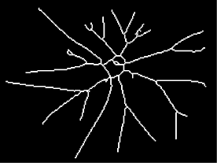
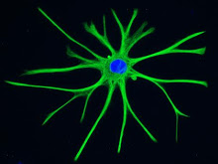
Tuning the DW-MRS experiment to measure cell morphology
Long t_{d} (weak g)
→ Segments length
→ Number of consecutive bifurcation
× Segments and soma diameter
long-range
cell morphology
ISMRM Virtual Meeting: Diffusion Weighted MRS, 9th August 2018

Slide 25
Tuning the DW-MRS experiment to measure cell morphology
Long t_{d} (weak g)
→ Segments length
→ Number of consecutive bifurcation
× Segments and soma diameter
long-range
cell morphology
Strong g (short t_{d})
× Segments length
× Number of consecutive bifurcation
→ Segments and soma diameter
short-range
cell morphology
ISMRM Virtual Meeting: Diffusion Weighted MRS, 9th August 2018

Slide 26
Measuring molecular diffusion with DW-MRS
Many possible sequences…but, which one to use?
STEAM
echo
π/2
π/2
π/2
RF
TE/2
TM
TE/2
δ
g
Δ
Advantages
Allows for long diffusion times keeping short the TE
Small chemical shift displacement
Limitations
Strong cross-terms with background gradients
Loss of 50% of the signal
Palombo M. et al. Neuroimage (2017)
ISMRM Virtual Meeting: Diffusion Weighted MRS, 9th August 2018

Slide 27
Measuring molecular diffusion with DW-MRS
Many possible sequences…but, which one to use?
STEAM
PRESS
echo
echo
π/2
π/2
π/2
π/2
π
π
RF
RF
TE/2
TM
TE/2
(TE1)/2
(TE1)/2
(TE2)/2
(TE2)/2
δ
δ/2
g
g
Δ
τ
Δ
Advantages
Advantages
Allows for long diffusion times keeping short the TE
Small chemical shift displacement
Bipolar diffusion gradients → minimize eddy currents and background gradients
TE coupled to the diffusion times
Severe chemical shift displacement
Limitations
Limitations
Strong cross-terms with background gradients
Loss of 50% of the signal
Palombo M. et al. Neuroimage (2017)
ISMRM Virtual Meeting: Diffusion Weighted MRS, 9th August 2018

Slide 28
Tuning the DW-MRS experiment to measure cell morphology
Long t_{d} (weak g)
→ Segments length
→ Number of consecutive bifurcation
× Segments and soma diameter
STEAM
long-range
cell morphology
Strong g (short t_{d})
× Segments length
× Number of consecutive bifurcation
→ Segments and soma diameter
PRESS
short-range
cell morphology
ISMRM Virtual Meeting: Diffusion Weighted MRS, 9th August 2018

Slide 29
Measuring molecular diffusion with DW-MRS
Diffusion Weighted NMR
π/2
π/2
π/2
_{τ}
_{TM}
_{τ}
ECHO
→ b = q² t_{d} ~ g² δ² t_{d}
g
δ
t_{d}
δ
t_{d}≈60 ms
ISMRM Virtual Meeting: Diffusion Weighted MRS, 9th August 2018

Slide 30
Measuring molecular diffusion with DW-MRS
Diffusion Weighted NMR
π/2
π/2
π/2
_{τ}
_{TM}
_{τ}
ECHO
→ b = q² t_{d} ~ g² δ² t_{d}
g
δ
t_{d}
δ
NAA
t_{d}≈60 ms
ISMRM Virtual Meeting: Diffusion Weighted MRS, 9th August 2018

Slide 31
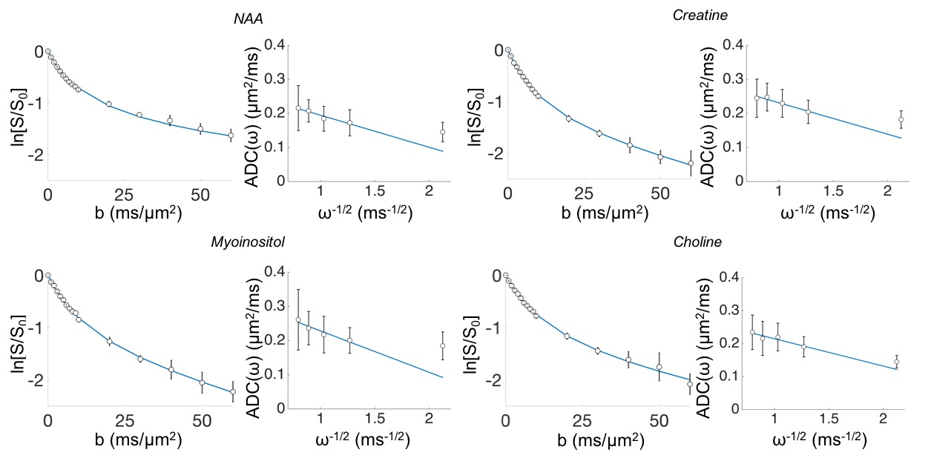
Measuring molecular diffusion with DW-MRS
Diffusion Weighted NMR
π/2
π/2
π/2
_{τ}
_{TM}
_{τ}
ECHO
→ b = q² t_{d} ~ g² δ² t_{d}
→ S(b) = diffusion weighted signal attenuation
g
δ
t_{d}
δ
NAA
How to estimate microstructural features from DW-MRS data?
ISMRM Virtual Meeting: Diffusion Weighted MRS, 9th August 2018

Slide 32
Simulating intra-cellular diffusion to characterize cell morphology
Diffusion Weighted NMR
→ ~10⁶ spin trajectories & phases
π/2
π/2
π/2
_{τ}
_{TM}
_{τ}
ECHO
g
δ
t_{d}
δ
ISMRM Virtual Meeting: Diffusion Weighted MRS, 9th August 2018

Slide 33
Simulating intra-cellular diffusion to characterize cell morphology
Diffusion Weighted NMR
Palombo M. et al. ArXiv preprint (2018) arXiv:1806.07125
→ ~10⁶ spin trajectories & phases
→ S(b) ≈ exp[ -b ADC(t_{d}) ];
π/2
π/2
π/2
_{τ}
_{TM}
_{τ}
ECHO
g
δ
t_{d}
δ
Numerical simulations can help us to identify the relevant microstructural features
ISMRM Virtual Meeting: Diffusion Weighted MRS, 9th August 2018

Slide 34
Tuning the DW-MRS experiment to measure cell morphology
Long t_{d} (weak g)
t_{d} ≳ 100 ms; b ≲ 5 ms/μm²
→ Segments length
→ Number of consecutive bifurcation
× Segments and soma diameter
STEAM
long-range
cell morphology
Strong g (short t_{d})
t_{d} ≲ 80 ms; b >> 1 ms/μm²
× Segments length
× Number of consecutive bifurcation
→ Segments and soma diameter
PRESS
short-range
cell morphology
ISMRM Virtual Meeting: Diffusion Weighted MRS, 9th August 2018

Slide 35
Tuning the DW-MRS experiment to measure long-range cell morphology
t_{d} ≳ 100 ms; b ≲ 5 ms/μm²
→ Segments length
→ Number of consecutive bifurcation
× Segments and soma diameter
ISMRM Virtual Meeting: Diffusion Weighted MRS, 9th August 2018

Slide 36
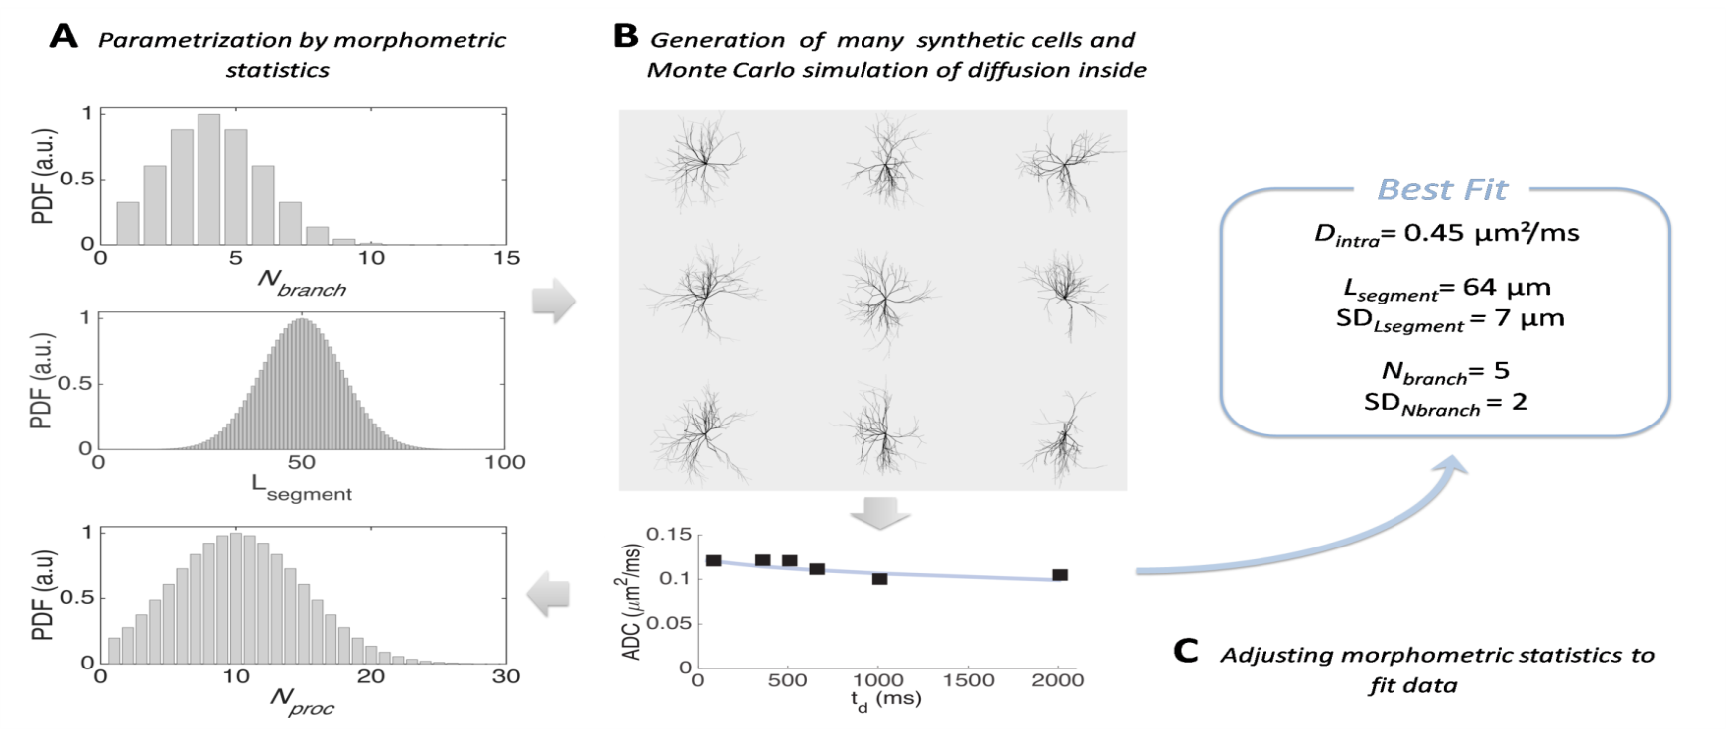
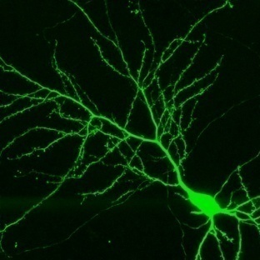
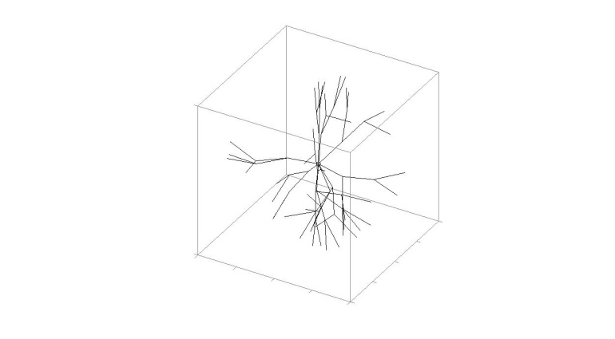
Statistical Model of brain cell morphology
Astrocyte
Neuron
Palombo M. et al. PNAS (2016)
5 model parameters
D_{intra} = effective medium diffusivity (organelles and macromolecular crowding, spines, cytoplasm viscosity, etc…)
L_{segment}, N_{branch} = long-range topological characteristics
SD_{Lsegment}, SD_{Nbranch} = metabolites compartments complexity and heterogeneity.
D_{intra}
L_{segment} = 50 ± 15 μm
N_{branch} = 2 ± 2
ISMRM Virtual Meeting: Diffusion Weighted MRS, 9th August 2018

Slide 37
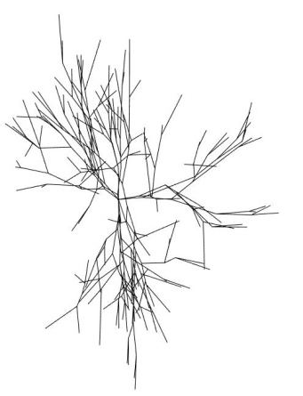
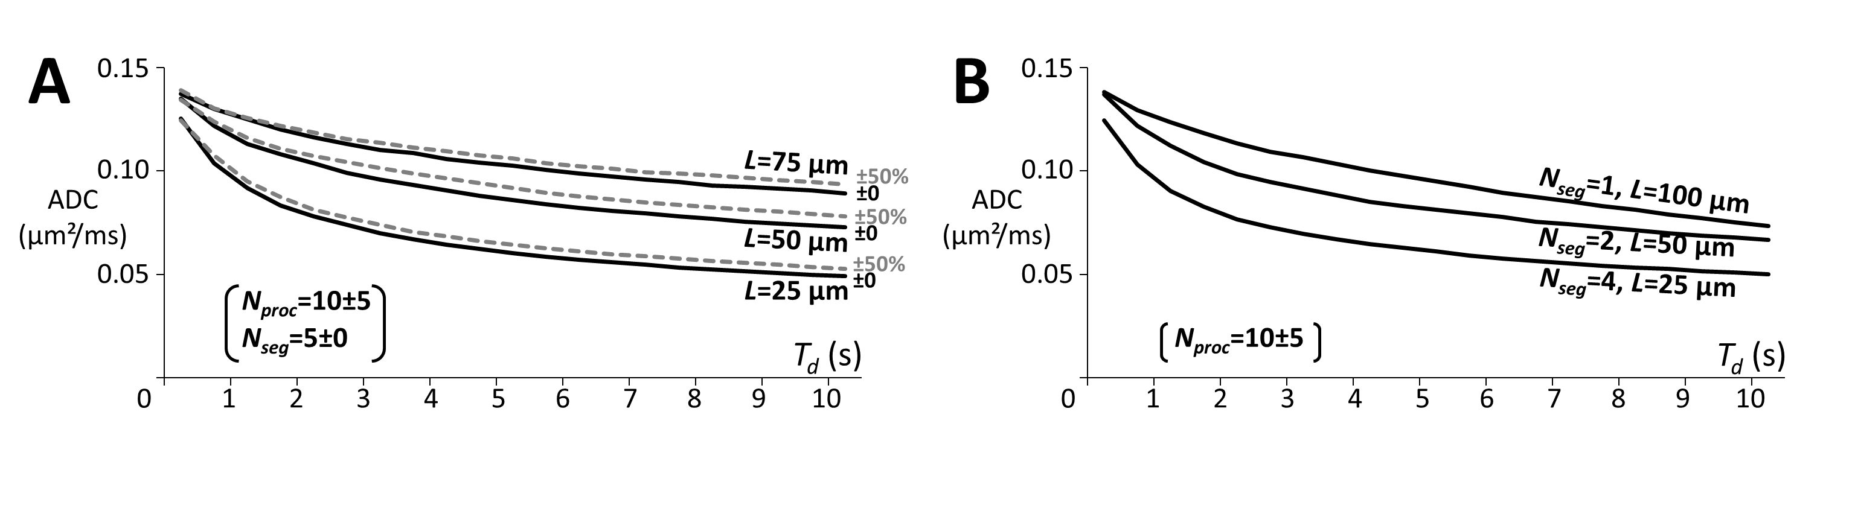
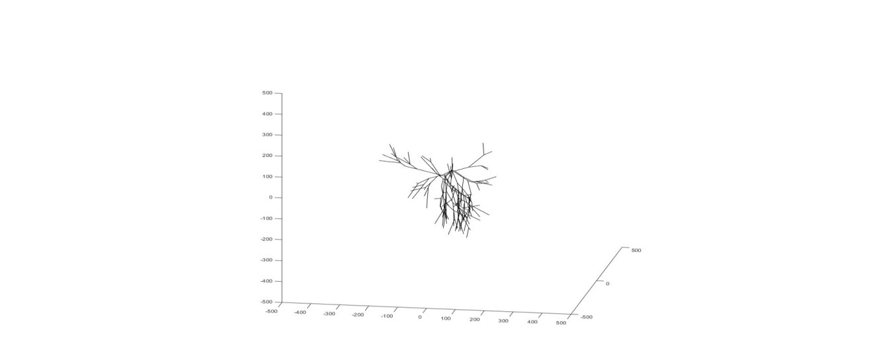
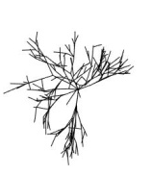
Effect of L_{segment} (at constant N_{branch})
Palombo M. et al. PNAS (2016)
L_{segment} = 75 µm
L_{segment} = 50 µm
L_{segment} = 25 µm
ISMRM Virtual Meeting: Diffusion Weighted MRS, 9th August 2018

Slide 38
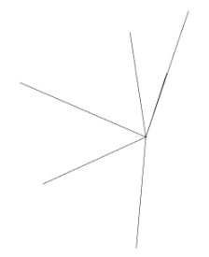
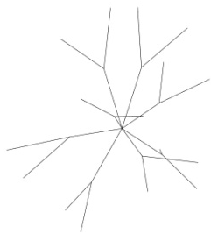
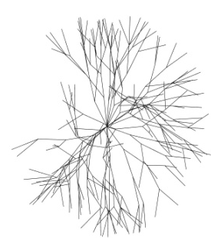
Effect of N_{branch} (at constant N_{branch} x L_{segment})
Palombo M. et al. PNAS (2016)
N_{branch} = 1; L_{segment} = 100 µm
N_{branch} = 2; L_{segment} = 50 µm
N_{branch} = 4; L_{segment} = 25 µm
ISMRM Virtual Meeting: Diffusion Weighted MRS, 9th August 2018

Slide 39

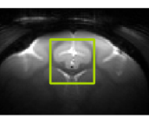
Computational approach to estimate cell morphology
ISMRM Virtual Meeting: Diffusion Weighted MRS, 9th August 2018
Palombo M. et al. PNAS (2016)

Slide 40
Computational approach to estimate cell morphology
Parallel Tempering Initialization
+
Levenberg-Marquardt optimization
Accuracy ▲
Precision ▲
Stability ▲
Speed ▼
ISMRM Virtual Meeting: Diffusion Weighted MRS, 9th August 2018
Palombo M. et al. PNAS (2016)

Slide 41
Computational approach to estimate cell morphology
Parallel Tempering Initialization
+
Levenberg-Marquardt optimization
Accuracy ▲
Precision ▲
Stability ▲
Speed ▼
Black box NOMAD
optimization
Accuracy ▲
Precision ▲
Stability ▼
Speed ▲
ISMRM Virtual Meeting: Diffusion Weighted MRS, 9th August 2018
Palombo M. et al. PNAS (2016)

Slide 42
Computational approach to estimate cell morphology
Parallel Tempering Initialization
+
Levenberg-Marquardt optimization
Accuracy ▲
Precision ▲
Stability ▲
Speed ▼
Black box NOMAD
optimization
Accuracy ▲
Precision ▲
Stability ▼
Speed ▲
Machine Learning
Random Forest regressor
Accuracy ▲
Precision ▲
Stability ▲
Speed ▲
ISMRM Virtual Meeting: Diffusion Weighted MRS, 9th August 2018
Palombo M. et al. PNAS (2016)

Slide 43
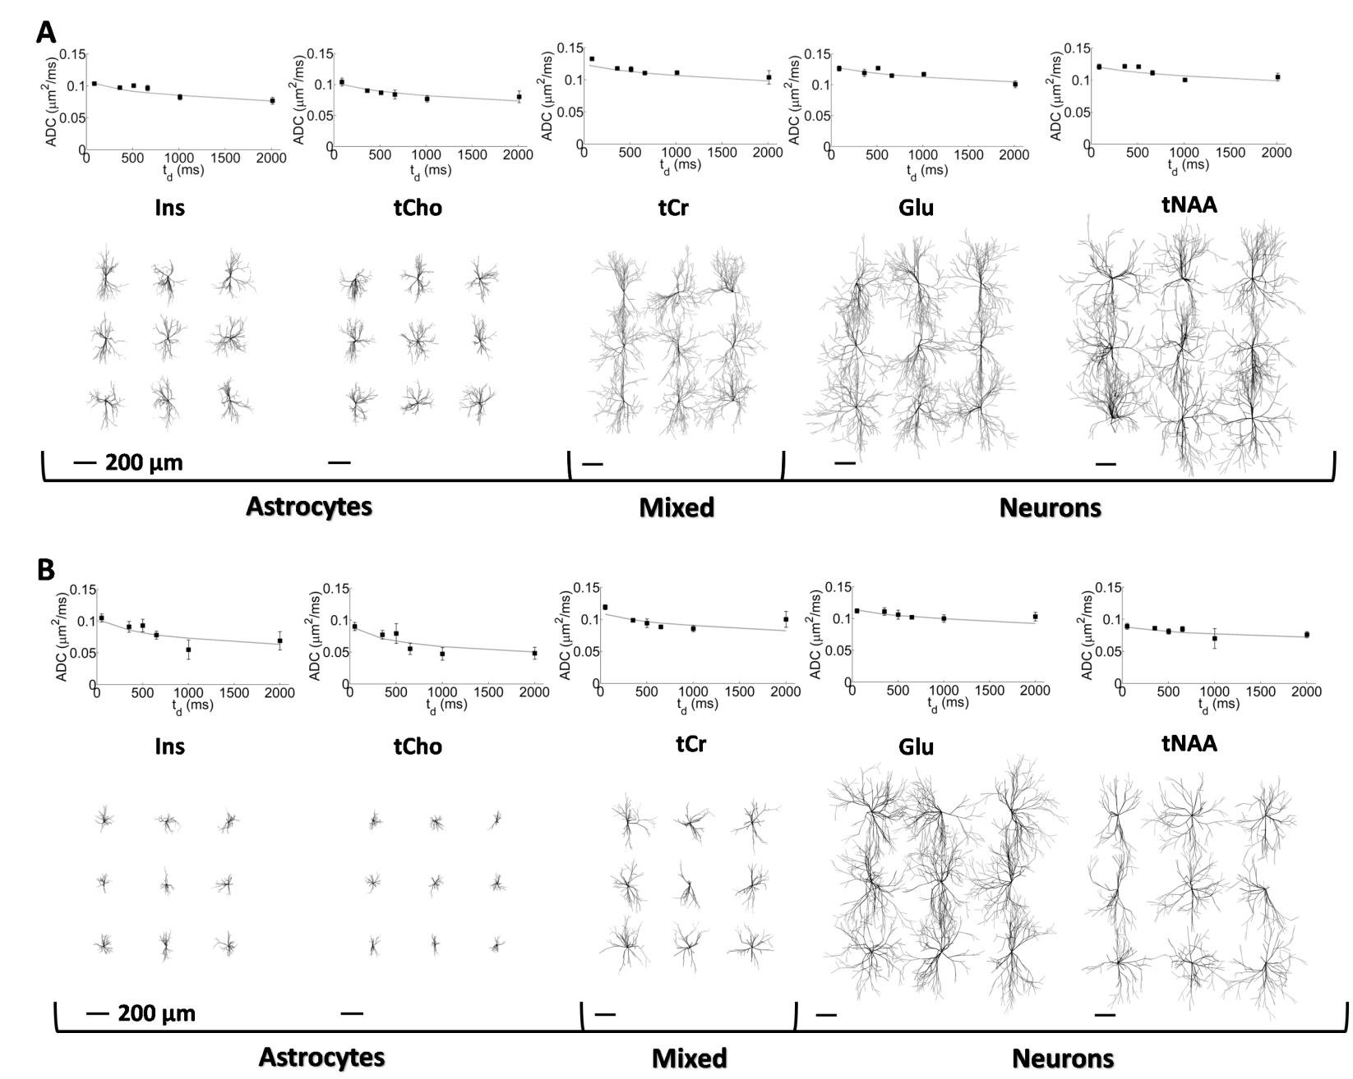

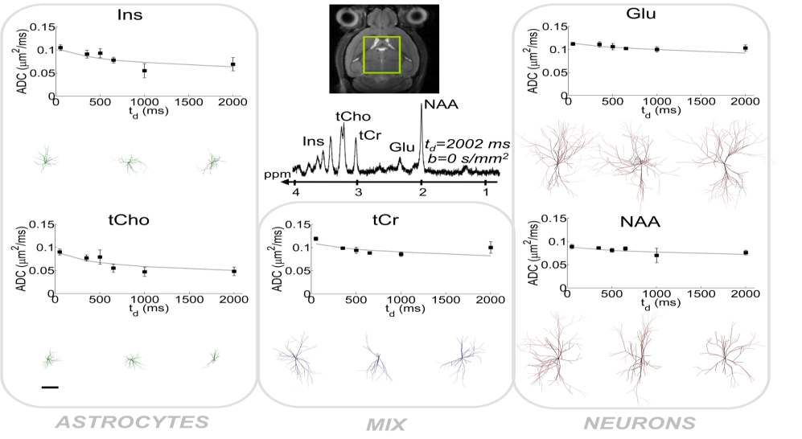
Interspecies Validation
Palombo M. et al. PNAS (2016)
Macaque
@ 7 T
Overall astrocytes diameter 2.52 ± 0.10 times larger in macaque (2.55 ± 0.05 from histology$)
Neuronal overall diameter (~ 500 µm) agrees very well with typical extension of dendritic tree of many neurons
Mouse
@ 11.7 T
($) Oberheim N.A. et al. Journal of Neuroscience (2009) 29(10): 3276-3287

Slide 44
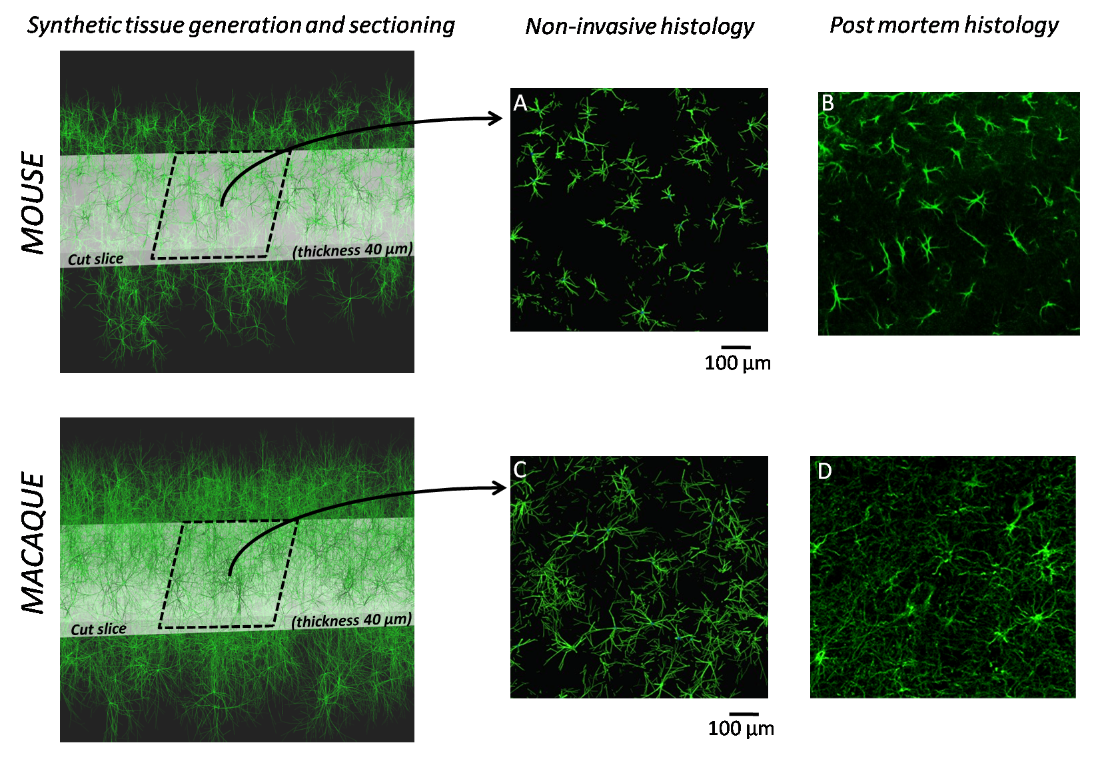
Histological Validation
(tCho and Ins)
(GFAP staining)
Palombo M. et al. PNAS (2016)

Slide 45
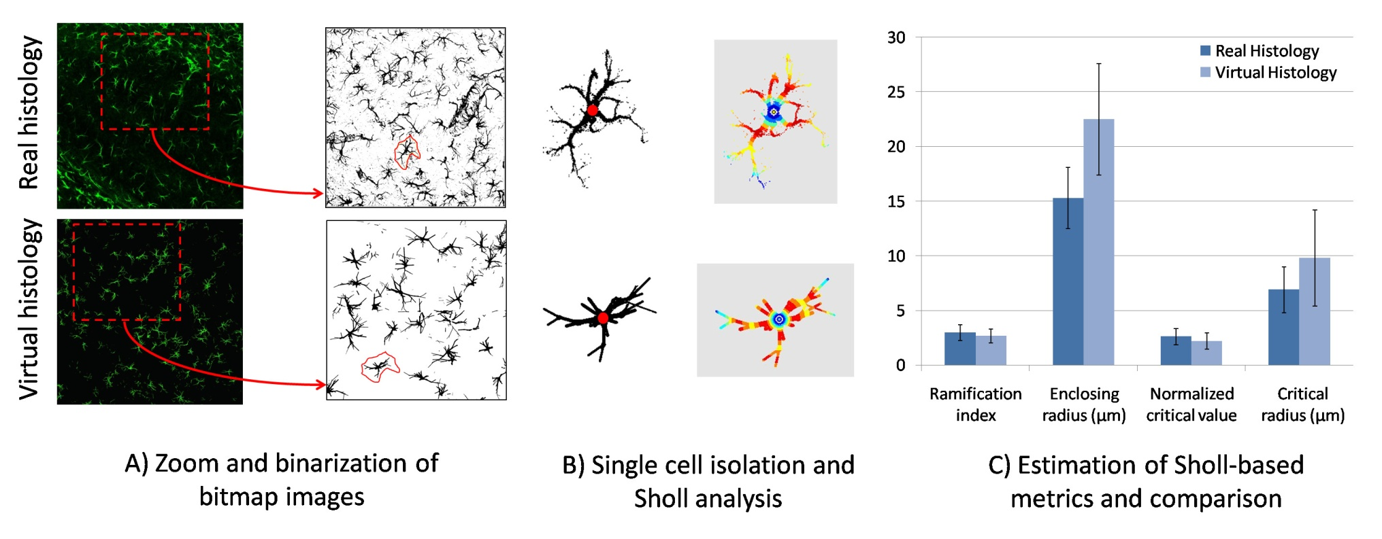
Histological Validation
(GFAP staining)
(tC ho and Ins)
ISMRM Virtual Meeting: Diffusion Weighted MRS, 9th August 2018
Palombo M. et al. PNAS (2016)

Slide 46
Tuning the DW-MRS experiment to measure short-range cell morphology
t_{d} ≲ 80 ms; b >> 1 ms/μm²
× Segments length
× Number of consecutive bifurcation
→ Segments and soma diameter
ISMRM Virtual Meeting: Diffusion Weighted MRS, 9th August 2018

Slide 47
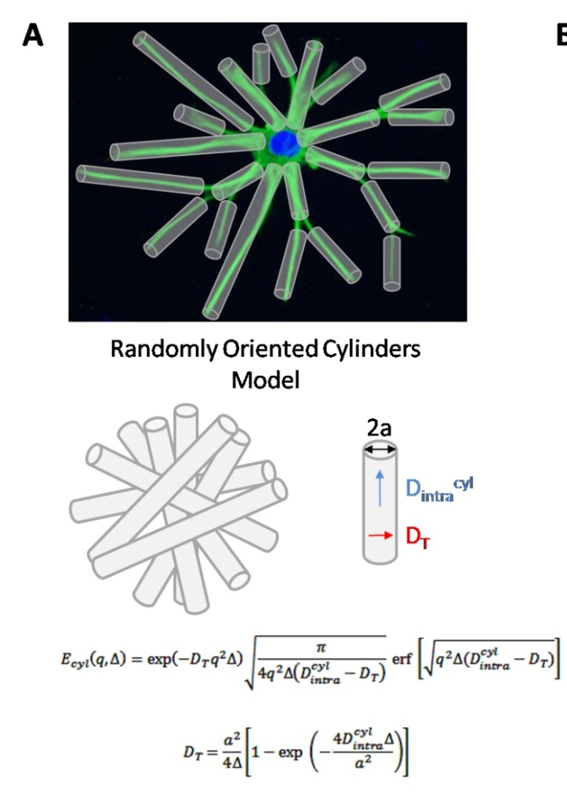
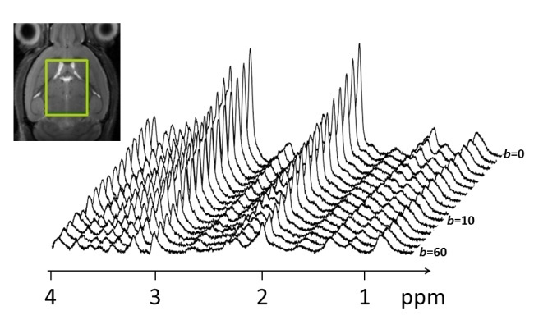
A geometrical model for brain cell fibers
Diffusion Weighted NMR
π/2
π/2
π/2
_{τ}
_{TM}
_{τ}
ECHO
g
t_{d}
δ
δ
In-vivo mouse at 11.7 T
Palombo M. et al. MRM (2017)
ISMRM Virtual Meeting: Diffusion Weighted MRS, 9th August 2018

Slide 48

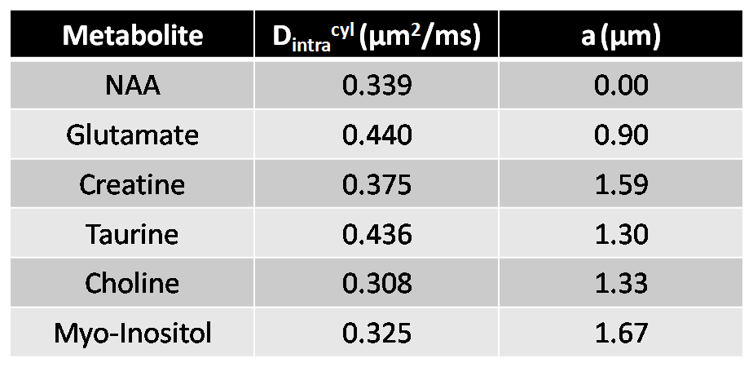
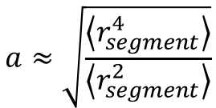
A geometrical model for brain cell fibers
Diffusion Weighted NMR
Palombo M. et al. MRM (2017)
π/2
π/2
π/2
DDE in-vivo rat (21.1 T)
NAA: a ≲ 0.75 μm
Myo-Inositol: 1.0 ≲ a ≲ 2.0 μm
Shemesh N. et al. PLOS One (2017)
_{τ}
_{TM}
_{τ}
ECHO
g
t_{d}
δ
δ
In-vivo mouse at 11.7 T
PRESS in-vivo human (7 T)
NAA:
0.011 ≲ D_{T} ≲ 0.025 μm²/ms
0.55 ≲ a ≲ 0.95 μm
Lundell H. et al. ISMRM (2017)
$$a≈\sqrt{\frac{\left\langle r_{segment}^{4}\right\rangle }{\left\langle r_{segment}^{2}\right\rangle }}$$
0.62
Burcaw L. et al. Neuroimage (2015)
Palombo M. et al. MRM (2017)
ISMRM Virtual Meeting: Diffusion Weighted MRS, 9th August 2018

Slide 49
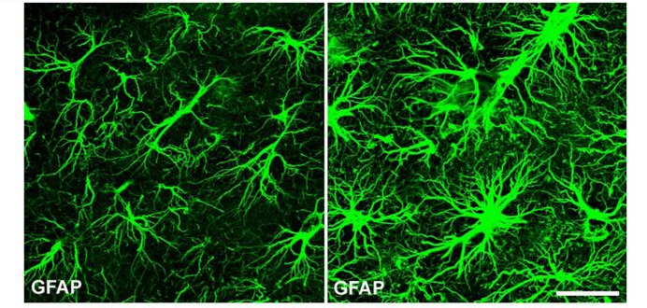
Why is the estimation of cell fibers size important?
Injury and inflammation → Astrocytes reactivity
Astrocyte
‘Reactive’ Astrocyte
ISMRM Virtual Meeting: Diffusion Weighted MRS, 9th August 2018

Slide 50
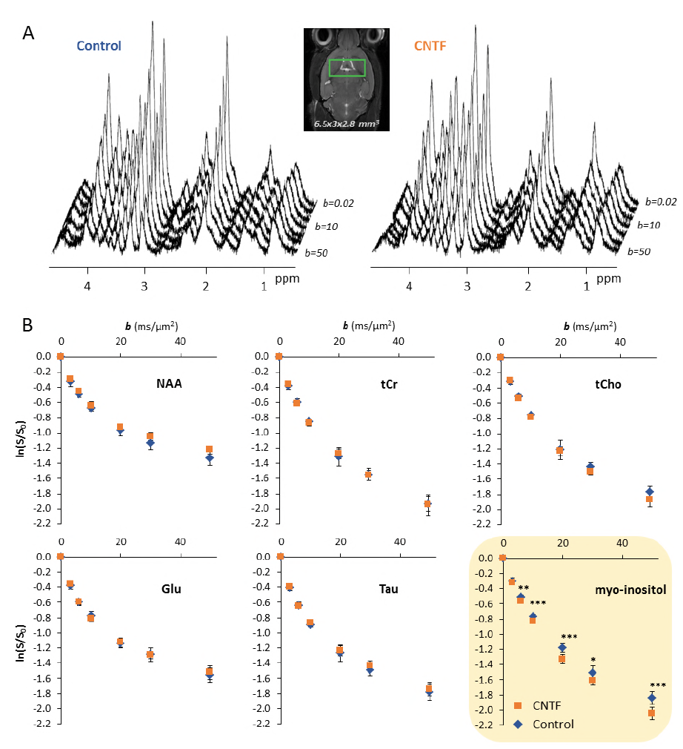
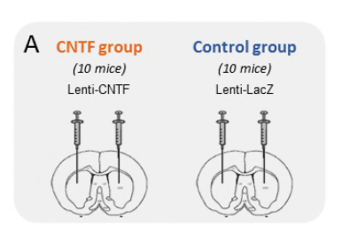
Validation on mouse disease model : CNTF model
Experiment 1: t_{d} ≲ 80 ms; b >> 1 ms/μm² → Segments and soma diameter
CNTF animal model of astrocytes activation
Astrocyte reactivity
20 µm
Ligneul C. et al. bioRxiv (2018)

Slide 51
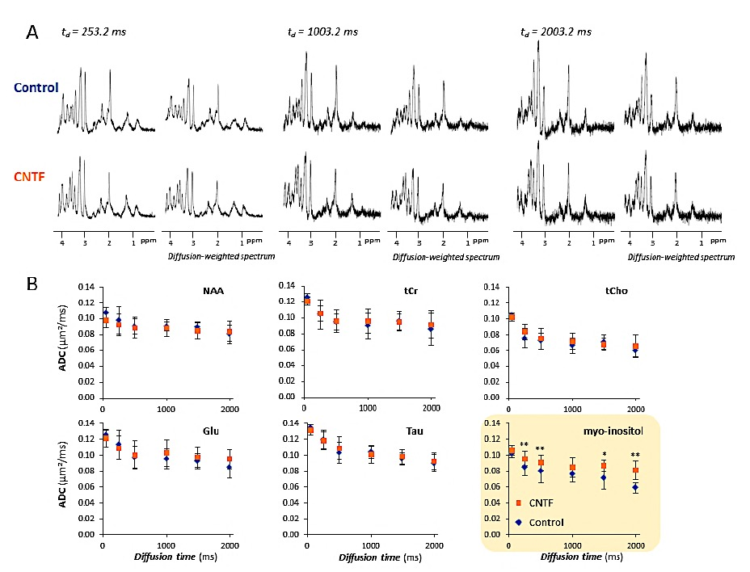
Validation on mouse disease model : CNTF model
Experiment 2: t_{d} >> 10 ms; b ≲ 5 ms/μm² → Segments length and branching
CNTF animal model of astrocytes activation
Astrocyte reactivity
20 µm
Ligneul C. et al. bioRxiv (2018)

Slide 52
Validation on mouse disease model: CNTF model
Quantifying astrocytes reactivity in vivo
Ins
Ligneul C. et al. bioRxiv (2018)
 |  | R_{soma} (μm) | Variation (%) | R_{fiber} (μm) | Variation (%) | D_{intra} (μm²/ms) | Variation (%)
Histology | LacZ | 3.7 (±1.2) | +29 [**] | 0.50 (±0.08) | +20 [**] | n.a. | n.a.
 | CNTF | 4.9 (±0.9) |  | 0.60 (±0.13) |  | n.a.
Synthetic (from Ins) | LacZ | 3.80 (±0.06) | +23 [***] | 0.58 (±0.02) | +47 [***] | 0.375 (±0.006) | -1 [n.s.]
 | CNTF | 4.66 (±0.07) |  | 0.85 (±0.02) |  | 0.372 (±0.005)
 |  | L_{segment} (μm) | Variation (%) | Branch Order | Variation (%) | D_{intra} (μm²/ms) | Variation (%)
Histology | LacZ | 15 (±5) | +67 [***] | 6 (±4) | -33 [n.s.] | n.a. | n.a.
 | CNTF | 25 (±7) |  | 4 (±2) |  | n.a.
Synthetic (from Ins) | LacZ | 29 (±10) | +103 [***] | 6 (±5) | -17 [n.s.] | 0.376 (±0.008) | -2 [n.s.]
 | CNTF | 59 (±10) |  | 5 (±5) |  | 0.369 (±0.005)

Slide 53
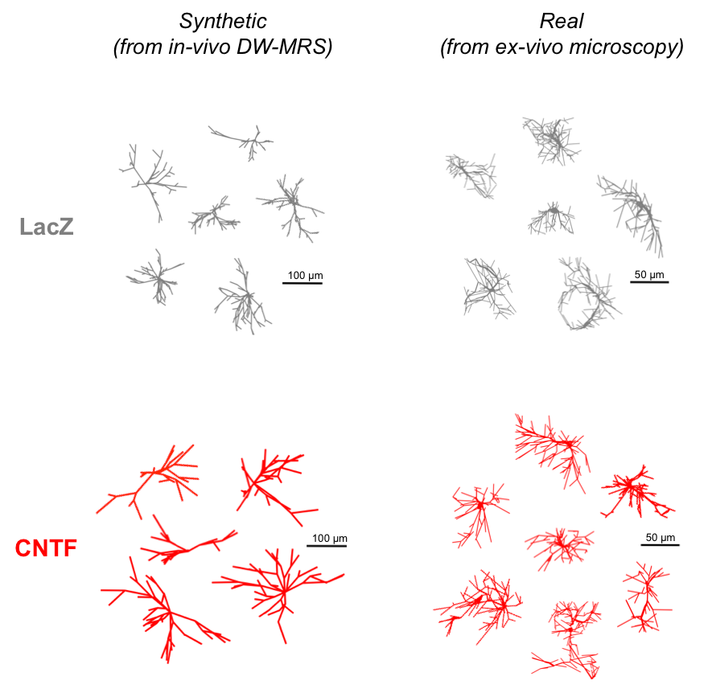
Validation on mouse disease model: CNTF model
Quantifying astrocytes reactivity in vivo
Ins
Ligneul C. et al. bioRxiv (2018)
ISMRM Virtual Meeting: Diffusion Weighted MRS, 9th August 2018

Slide 54
Summary
DW-MRS provides unique microstructural information, complementary to DW-MRI
Detect neuron-specific microstructural alterations (NAA, Glu).
Detect glial-specific microstructural alterations (Ins, tCho).
Investigate changes in energy metabolism related to neuronal activation (tCr).
Experimental design is crucial: advanced numerical simulations help to identify the relevant microstructural features
Data analysis is challenging: requires complex computational tools, appropriate biophysical modelling, histological reference
ISMRM Virtual Meeting: Diffusion Weighted MRS, 9th August 2018

Slide 55
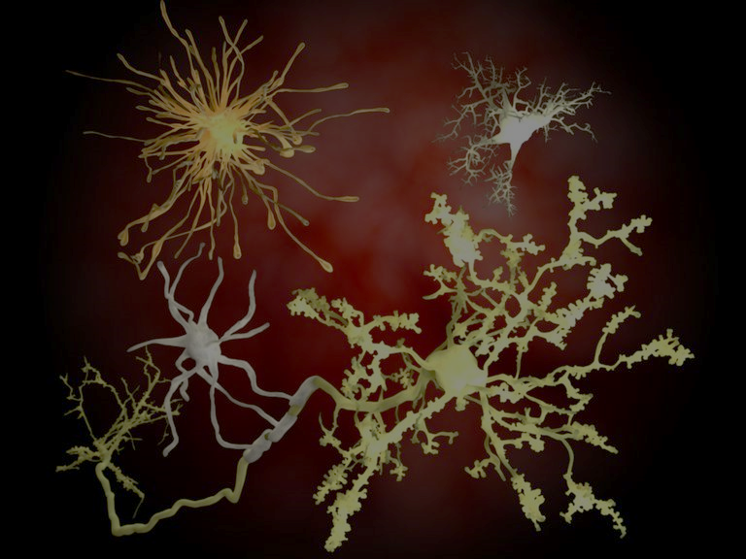
ESMRMB Lectures on MR: Diffusion weighted MRS
ESMRMB Lectures on MR: Diffusion weighted MRS
October 10-12, 2018 Paris/FR Course Venue ICM - Institut du Cerveau et de la Moelle épinière Hôpital Pitié-Salpêtrière Paris/FR
Course Organisers
Francesca Branzoli Center for neuroimaging research (CENIR) – ICM Paris/FR Itamar Ronen C.J. Gorter Center for High Field MRI Leiden University Medical Center Leiden/NL Julien Valette Molecular Imaging Research Center Commissariat à l'énergie atomique et aux énergies alternatives (CEA) Fontenay-aux-Roses/FR

Slide 56







Acknowledgments
Thank you for your attention
MIRCen, CEA, France
Dr. Julien Valette
Dr. Edwin Hernandez-Garzon
Dr. Chloe Najac
Dr. Clemence Ligneul
MIG/CMIC, UCL, UK
Prof. Daniel Alexander
Dr. (Gary) Hui Zhang
INCELL project
ICM, France
Prof. Stephane Lehericy
Dr. Francesca Branzoli

Slide 57
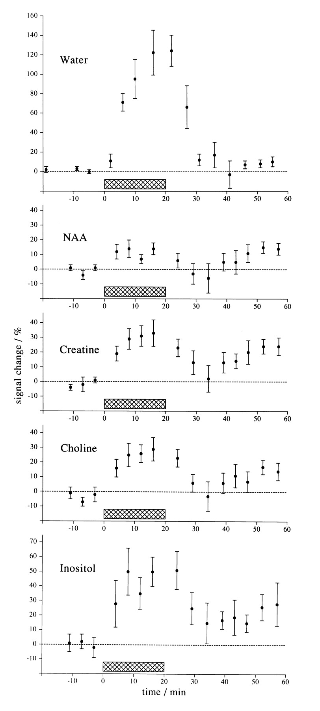
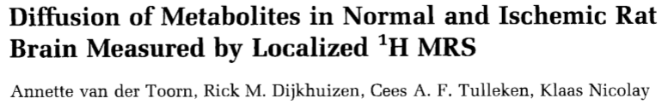
DW-MRS in cerebral ischemia
Some applications on Human
Understanding the mechanism of drop of water ADC in acute stroke.
The restriction in the extracellular space is not enough to explain the drop in ADC of water.

Slide 58
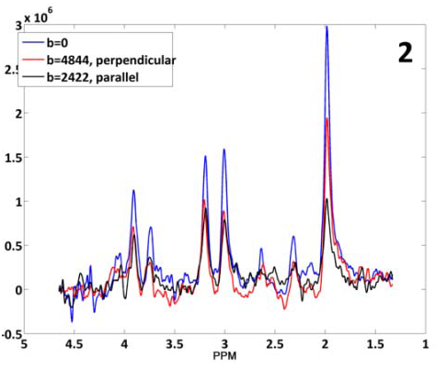
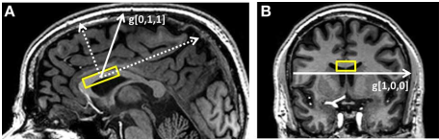
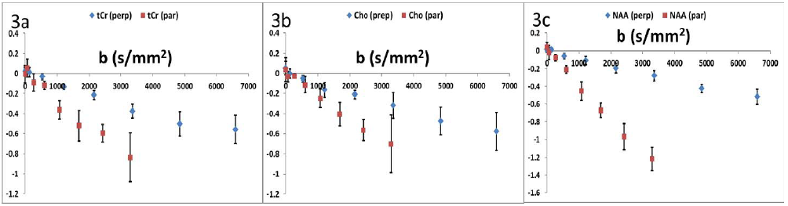
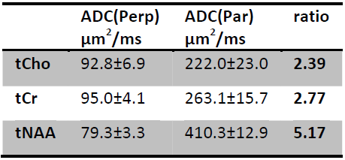
Differentiating axonal and glial information with DW-MRS
Some applications on Human
7 Tesla
VOI = 15 x 8 x 25 mm³
The ratio ADC(par)/ADC(perp) is consistent with the different compartmentalization of tNAA, tCr and tCho in axons and glial cells
I. Ronen et al, Front Integr Neurosci. 7:13, 2013

Slide 59
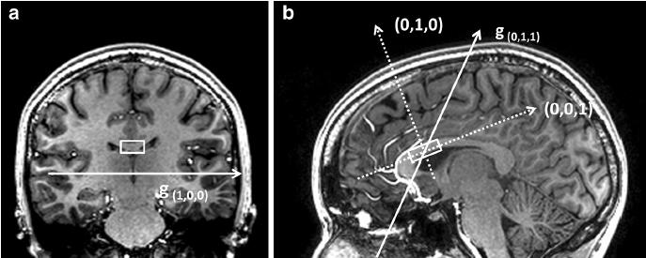



Microstructural organization of axons quantified by DW-MRS
Some applications on Human
(1,0,0)
Main eigenvectors ê₁ overlaid on a FA map
tNAA
ê₁
θ₁
θ₂
θ₂
θ₁
g[0,1,1]
g[1,0,0]
Distribution of the angles θ_{1,2} between the main eigenvector ê₁ and the two diffusion gradient directions g[0,1,1] and g[1,0,0].
I. Ronen et al, Brain Struct Func, 219,1773, 2013
Notes:
Main eigenvectors e₁ overlaid on a FA map

Slide 60




Modeling DW-MRS data in the corpus callosum
Some applications on Human
Model of diffusion in parallel cylinders, including macroscopic axonal dispersion and microscopic misalignment.
σ_{ϕ} ∼ 18°
D_{model}(tNAA) ∼ 0.51
┴
Histologic image and FODs
∕ ∕
Macroscopic curvature
+ Microscopic misalignment
ê₁
ê₁
θ₁
θ₁
(1,0,0)
(1,0,0)
I Ronen et al, Brain Struct Func, 219,1773, 2013; P van Gelderen et al, J Magn Reson B, 103,255, 1994.

Slide 61





Reproducibility and optimization of DW-MRS data at 3T and 7T
Some applications on Human
Inter- and intra-subject variability
Optimized acquisition scheme of ∼13 minutes at 3T
Power calculation for clinical studies
E Ercan et al, NMR Biomed, 28, 976, 2015

Slide 62



tNAA diffusion in healthy aging
Some applications on Human
Subjects: 13 healthy elderly subjects (64 ± 3 yrs), 17 young controls (27 ± 5 yrs).
Scanner: Philips 7T whole body, Volume Tx/32ch Rx.
MRI/MRS protocol
3D T1-weighted, DTI sequence
DW-MRS: - VOI 2.5cm (AP) x 1.5 cm (RL) x 0.8 cm (FH), 32 averages,
- PRESS sequence, TE/TR= 121ms/3 cardiac cycles,
- b = 600, 1920, 3800, 6200 s/mm² (radial direction),
- b = 330, 960,1900, 3100 s/mm² (axial direction).
- Scan time = 15 min.
F Branzoli et al, submitted to Neurobiol Aging

Slide 63

Differentiating between axonal damage and demyelination in healthy aging
Some applications on Human
decrease
increase
TBSS analysis
DW-MRS
FA
MD
RD
tNAA | Young | Elderly | P value
D_{model}(μm²/ms) | 0.53 ± 0.04 | 0.51 ± 0.04 | 0.21
D//(μm²/ms) | 0.39 ± 0.04 | 0.37 ± 0.03 | 0.12
D┴ (μm²/ms) | 0.08 ± 0.01 | 0.08 ± 0.02 | 0.79
σ_{φ} (deg) | 12 ± 5 | 12 ± 5 | 0.77
The intra-axonal damage in healthy elderly in this age range is negligible or even absent
Do water AD changes reflect intra-axonal damage?
The differences in water FA, MD and RD are consistent with the onset of demyelination processes
F Branzoli et al, submitted to Neurobiol Aging

Slide 64


Some applications on Human
Diffusion tensor spectroscopy in multiple sclerosis
NAA axial diffusivity decrease possibly reflects an early neuroaxonal damage.
Water axial diffusivity cannot be used as a marker for intra axonal damage, since it is also susceptible to demyelination.
→ Presentation of Benedetta Bodini, today at 14:30
ET Wood et al, J Neurosci, 32(19) 6665, (2012).

Slide 65


Glial and axonal changes in SLE measured with metabolite diffusion
Some applications on Human
Systemic lupus erythematosus (SLE) is an inflammatory autoimmune disease with multi-organ involvement.
Subjects: 29 patients with SLE (19 with NPSLE), 19 age- and sex-matched controls.
Scanner: Philips 7T whole body, Volume Tx/32ch Rx.
MRI/MRS protocol
3D T1-weighted, DTI sequence
DW-MRS
E Ercan et al, Brain, 2016
Notes:
In this study diffusion tensor imaging and diffusion spectroscopy were combined in order to investigate cell-specific microstructural changes in patients with SLE and neuro-psychiatric SLE.

Slide 66





Glial and axonal changes in SLE measured with metabolite diffusion
Some applications on Human
decrease
increase
FA
MD
RD
Diffusion of tCho and tCr are potentially unique markers of glial reactivity in response to inflammation.
E Ercan et al, Brain, 2016

Slide 67



Functional DW-MRS
Some applications on Human
Investigate compartment-specific microstructural and/or metabolic changes related to neuronal activation.
Direct detection of neuronal activation by measuring metabolite diffusion during visual stimulation.
Subjects: 14 healthy volunteers.
Scanner: Philips 7T whole body, Volume Tx/32ch Rx.
Functional paradigm
×24
24 blocks of 32 scans each:
- 2x8 scans rest period
- 2x8 scans of activation.
= non diffusion weighted (b~0 s/mm²)
= diffusion weighted (b~4000 s/mm²)
F. Branzoli et al, MRM, 69:303–309 (2013)

Slide 68

Some applications on Human
Increase of tCr diffusion during neuronal activation
p = 0.002
tCr , tNAA, tCho diffusion coefficient increase during visual stimulation.
Cell swelling (D Le Bihan et al, PNAS, 2006)
p = 0.05
→ Increase of Creatine Kinase activity
PCr + ADP + H⁺ ↔ Cr + ATP
Decrease in PCr/Cr ratio
p = 0.03
(W. Chen et al. MRM 38 551- 557 (1997). H. Lei et al. Proc. Intl. MRM, p 11, 2004. S. Xu et al., NeuroImage, 28, 401 – 409 2005)
F. Branzoli et al, MRM, 69:303–309 (2013)

Slide 69


Some applications on Human
Diffusion-weighted chemical shift imaging of brain metabolites
Real-time navigator-based acquisition scheme.
Instantaneous reacquisition of corrupted k-space data.
Correction of gradient induced phase fluctuations.
Ercan E et al, Magn Res Med, 2015
Notes:
only a few attempts have been made so far at obtaining maps of the diffusion properties of brain metabolites with DW-CSI
The long scanning times these experiments require limit their clinical
applicability, and so far they have been characterized by a lack of robustness and reproducibility.
The phase encoding gradient is placed after the second lobe of the refocusing diffusion gradient and before the echo
maximum such that 25–30 navigator data points are acquired
prior to the phase-encoding step. A turbo spectroscopic imaging
mode with two echo acquisitions (TE¼100/205 ms)
was used, and 256 sample points were acquired for each
of the two echoes with a spectral bandwidth of 5000 Hz. This threshold was then used in
real-time as an accept/reject criterion for subsequent
acquisitions for that diffusion condition such that for
each k-space location, data that fell below the threshold
were reacquired. An upper limit for the number of reacquisitions
was set to 100 for each diffusion condition.
The navigator time-domain data were zero-filled to 128
points and line-broadened. Following a Fourier transformation,
a coarse spectrum of the navigator was obtained.
The phase for each acquisition was then estimated
from the residual water, and diffusion-induced phase
fluctuations were removed using the formula…

Slide 70





Some applications on Human
Diffusion-weighted chemical shift imaging of brain metabolites
The metabolite ADC values could be related to the underlying tissue composition.
Ercan E et al, Magn Res Med, 2015
Notes:
Metabolite ADC values obtained in this study related meaningfully to the underlying tissue cellular composition

