Slide 1
Sources of Error in Quantitative MRI (qMRI) Parameter Estimation A Signal Processing Perspective
Joshua D. Trzasko, Ph.D.
Assistant Professor of Radiology and Biomedical Engineering
Associate Consultant - Department of Radiology (Medical Physics)
Mayo Clinic, Rochester, MN, USA
ISMRM Virtual Meeting - Quantitative MR Study Group
September 2018

Slide 2
Declaration of Financial Interests or Relationships
Speaker Name: Joshua D. Trzasko
I have no financial interests or relationships to disclose with regard to the subject matter of this presentation.

Slide 3
Outline
What is Quantitative MRI (qMRI)?
qMRI: a Signal Processing Perspective
Sources of Error in qMRI
Noise Model
Signal Model
Fitting Strategy
Summary and Closing Remarks
Notes:
Broaden persepctive
Unifying theme

Slide 4
Outline
What is Quantitative MRI (qMRI)?
qMRI: a Signal Processing Perspective
Sources of Error in qMRI
Noise Model
Signal Model
Fitting Strategy
Summary and Closing Remarks
Notes:
Broaden persepctive
Unifying theme

Slide 5
What is Quantitative MRI (qMRI)?
qMRI is any MRI application where the goal is to describe some property of the imaged object using meaningful physical or biological units.

Slide 6
Why is qMRI Clinically Important?
qMRI offers several key advantage over routine anatomical imaging:
Simplified radiological interpretation
Increased diagnostic confidence
Improved detection and staging of disease, and monitoring of treatment
Easier longitudinal and cross-sectional studies
More efficient clinical workflows
Potential for abbreviated exams
Example: Liver fibrosis staging via MR Elastography (MRE)
S. Venkatesh et al. JMRI 37.3 (2013): 544–555. PMC. Web. 18 Sept. 2018.

Slide 7
qMRI Categories
There are MANY different quantitative applications utilized both clinically and in research settings. These typically fall into one of two categories:
Structural
Physiological
PDFF
In this lecture, we’ll focus exclusively on physiological qMRI
S. Teipel et al., The Lancet. Neurology 14 10 (2015): 1037-53.
J. Schwimmer et al. Hepatology 61.6 (2015): 1887-1895.

Slide 8
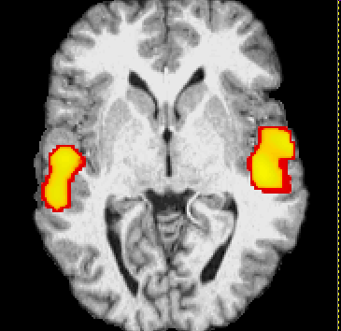
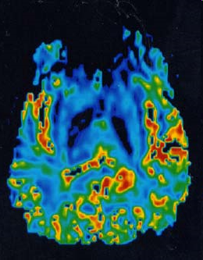
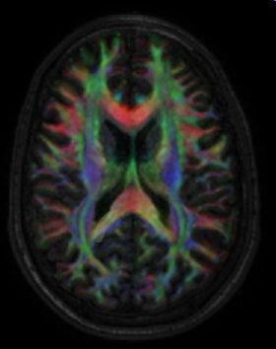
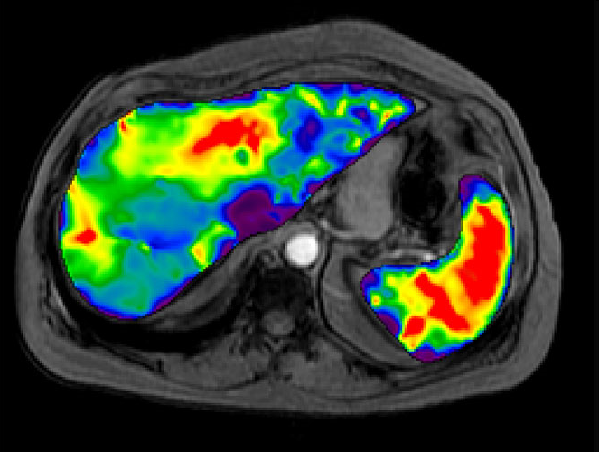
Example Physiological qMRI Applications
A non-inclusive list*:
Functional MRI (fMRI)
Flow
T1/T2 Mapping
Pharmacokinetics
Fat+Water Decomposition
Elastography
Diffusion
Perfusion
Thermometry
Susceptibility Mapping (QSM)
Metabolite Concentration
*apologies for unintentional omissions

Slide 9
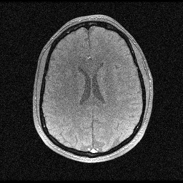
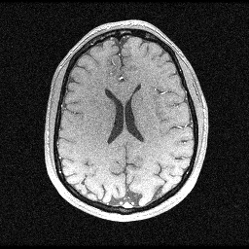
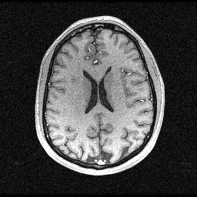
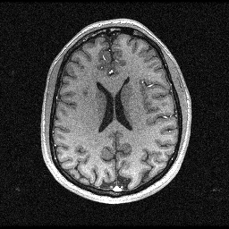
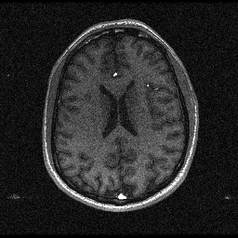
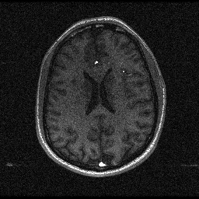
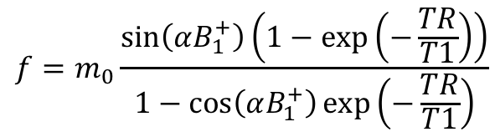
How is qMRI Data Acquired?
Due to a variety of physical (e.g., receiver gains) and physiological factors (e.g., patient motion), MR image intensity values are not intrinsically quantitative….
However, we typically have (via physics) a solid understanding of the causal factors of an image’s appearance; e.g., in spoiled gradient echo (SPGR) MRI, a pixels intensity is modeled as:
By repeating a scan with different acquisition parameters (e.g., flip angle), the individual contributions of underlying variables (e.g., T1) are revealed:
$$f=m_{0}\frac{\sin\left(αB_{1}^{+}\right)\left(1−\exp\left(−\frac{TR}{T1}\right)\right)}{1−\cos\left(αB_{1}^{+}\right)\exp\left(−\frac{TR}{T1}\right)}$$
Arbitrary Scaling Factor (∝ PD)
5º
10º
15º
20º
25º
30º

Slide 10
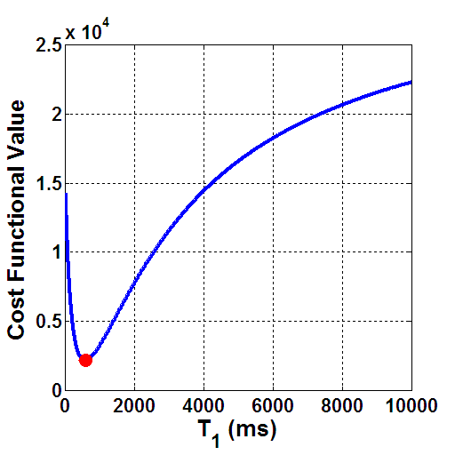
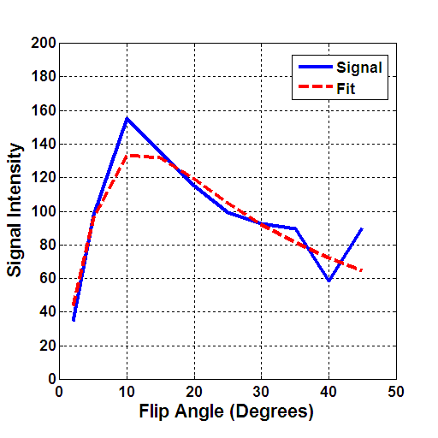
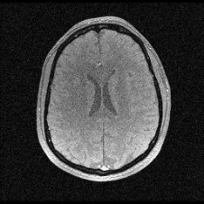
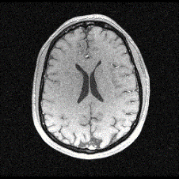
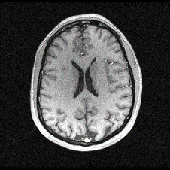
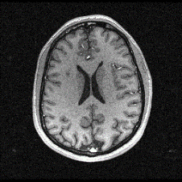
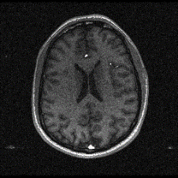
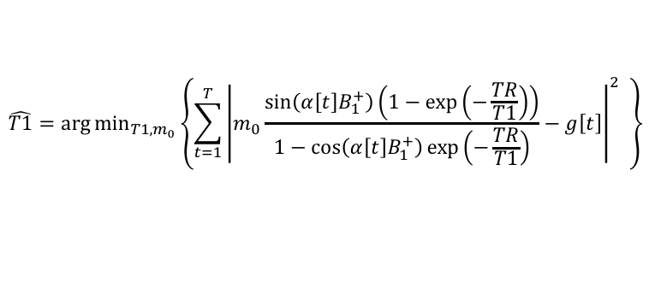
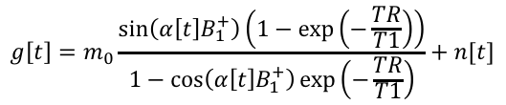
How is qMRI Data Processed?
qMRI data is typically processed by:
Forming a signal model
Identify known vs. unknown variables
Defining a fitting strategy
Evaluating performance
5º
10º
15º
20º
25º
30º
$$g\left[t\right]=m_{0}\frac{\sin\left(α\left[t\right]B_{1}^{+}\right)\left(1−\exp\left(−\frac{TR}{T1}\right)\right)}{1−\cos\left(α\left[t\right]B_{1}^{+}\right)\exp\left(−\frac{TR}{T1}\right)}+n[t]$$
$$\hat{T1}=\arg{\min_{T1,m_{0}}\left\{\sum_{t=1}^{T}{{\left|m_{0}\frac{\sin\left(α\left[t\right]B_{1}^{+}\right)\left(1−\exp\left(−\frac{TR}{T1}\right)\right)}{1−\cos\left(α\left[t\right]B_{1}^{+}\right)\exp\left(−\frac{TR}{T1}\right)}−g\left[t\right]\right|}^{2} }\right\}}$$

Slide 11
Outline
What is Quantitative MRI (qMRI)?
qMRI: a Signal Processing Perspective
Sources of Error in qMRI
Noise Model
Signal Model
Fitting Strategy
Summary and Closing Remarks
Notes:
Broaden persepctive
Unifying theme

Slide 12
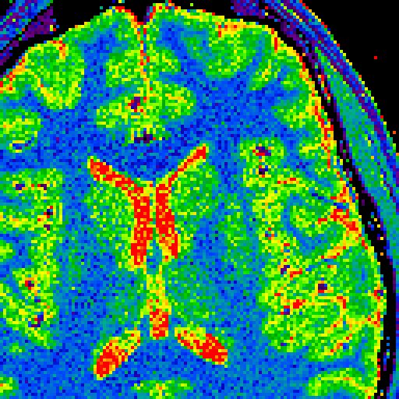
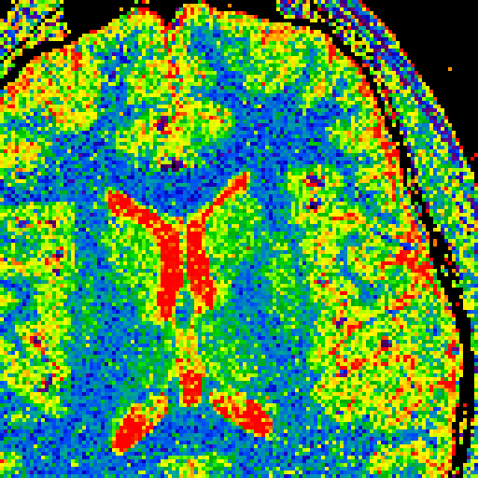
The Challenge of Being Quantitative
Acquisition settings aside, there will be different ways in which parameters can be estimated from qMRI data sets – how do we know which is the “best”?
?
T1 Map - Method 1
T1 Map - Method 2
To fully answer this question, we must first understand why different methods yield (sometimes significantly) different results.

Slide 13
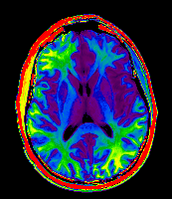
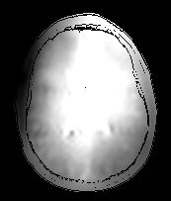
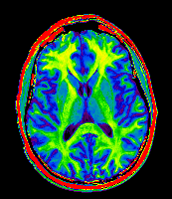
Sources of Error in qMRI Data Processing
qMRI processing methods each rely on different assumptions about the data and/or fitting method. If these assumptions are violated, errors will form in the parameter estimates. Common error sources include:
Incomplete/inaccurate noise model
Incomplete/inaccurate signal model
Unstable fitting strategy
Insufficient data diversity*
vs
R1 Map (w/o B1+ Correction)
B1+ Map
R1 Map (w/ B1+ Correction)
*Will not be covered in detail here

Slide 14
qMRI Processing is a Model Fitting Problem
qMRI parameter estimation – like image reconstruction and artifact correction – is fundamentally a parametric model fitting problem. As such, established statistical signal processing tools can be used to both develop and rigorously characterize/optimize qMRI method performance.
Image Reconstruction
qMRI

Slide 15
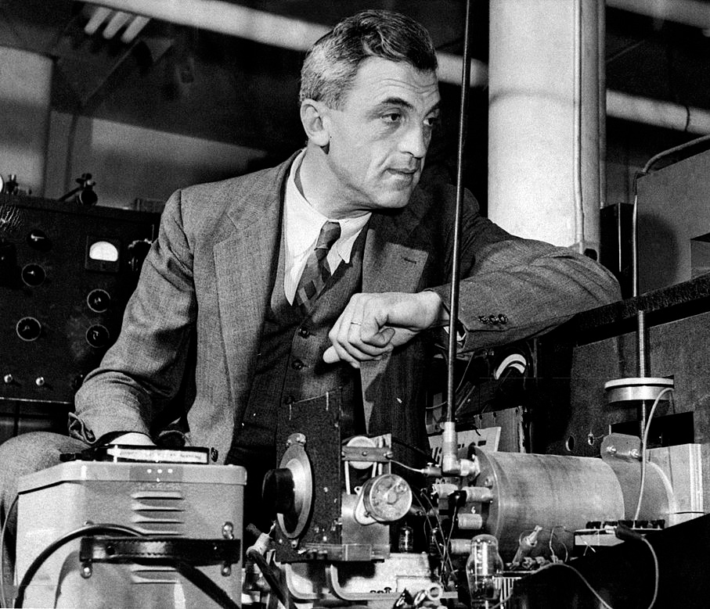
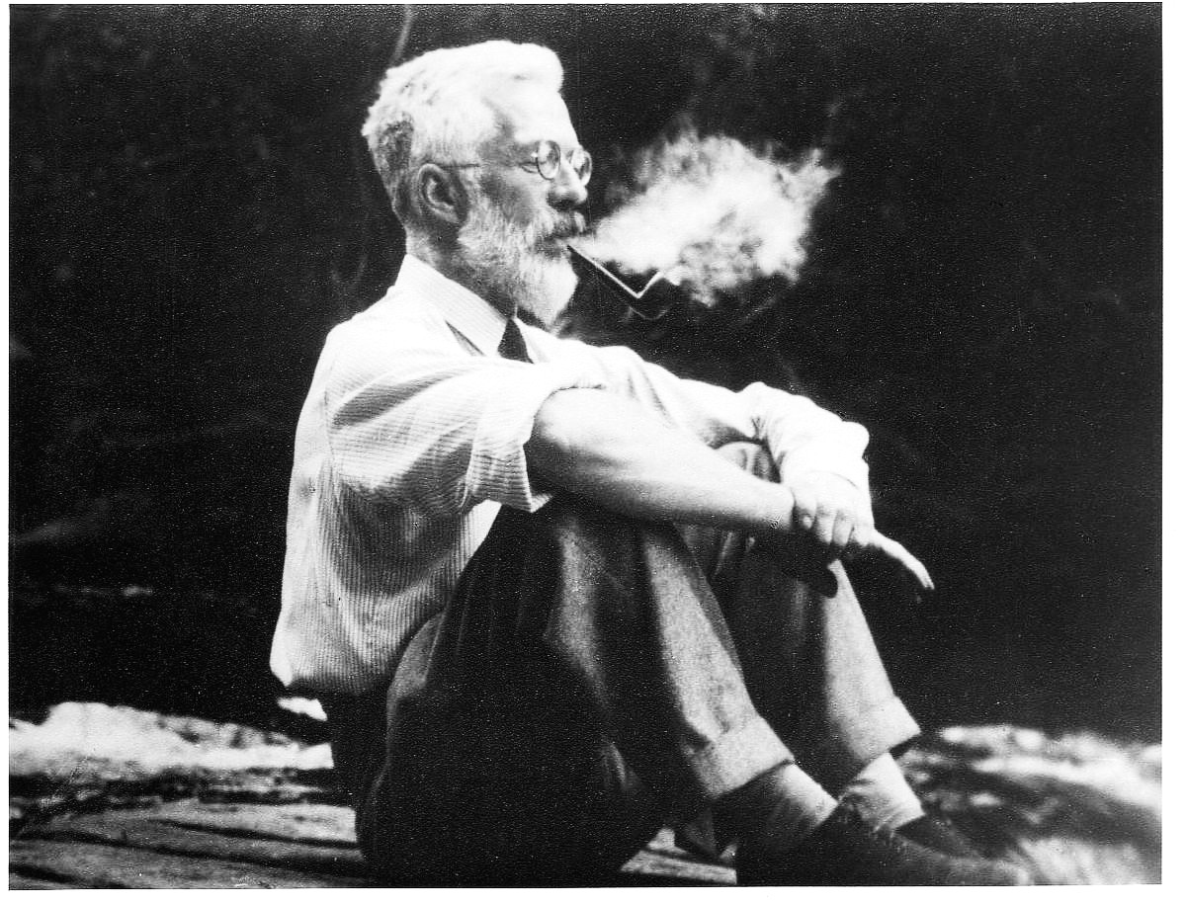
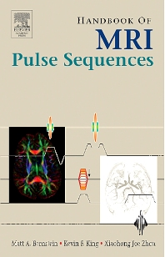
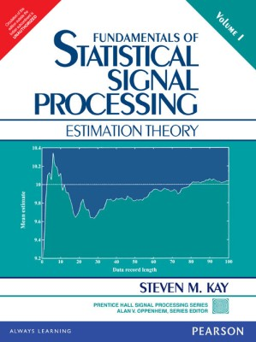
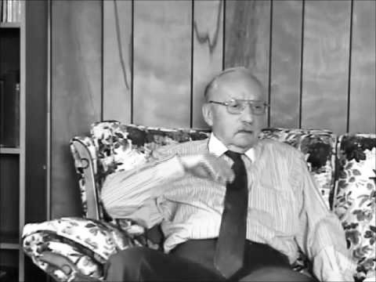

Key Tools for qMRI Parameter Estimationr
Hey Ron, want to work together?
Sounds like a jolly good time, Felix!
Felix Bloch, 1952
Ronald Fisher, 1956
You’re probably going to need a little help….
MR Physics
Statistical Signal Processing
Nonlinear Optimization Theory
George Dantzig, 2001
Notes:
Maximize current systems
Value to patient – lower cost
Speed
Better
Diminishing healthcare reimbursements

Slide 16
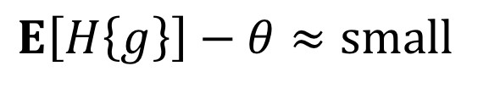
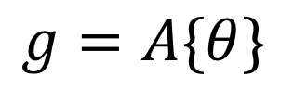
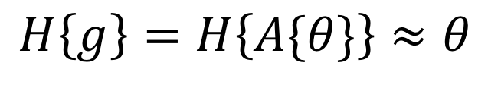
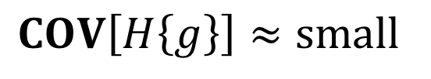
Introduction to Estimation Theory
Given a data set, g, parameter vector θ, and random variable model, A{}:
our goal in qMRI is to design a estimator (mathematical functional), H{}, that we will apply to the measured data, g, to obtain an estimate of θ:
We have total freedom in designing H{}; however, a useful estimator will have:
Reminder: since g is random, any estimate derived from it is itself random.
$$g=A\{θ\}$$
$$H\left\{g\right\}=H\left\{A\{θ\}\right\}≈θ$$
$$E\left[H\left\{g\right\}\right]−θ≈small$$
$$COV\left[H\left\{g\right\}\right]≈small$$
Bias = Accuracy⁻¹
Variance = Precision⁻¹

Slide 17
Mean Square Error (MSE)
Both the bias and variance of any estimator parameter are important – how can measure both quantities simultaneously?
Low Accuracy
Low Precision
Low Accuracy
High Precision
High Accuracy
Low Precision
High Accuracy
High Precision
MSE is the standard estimator performance metric:
$$MSE\left[H\left\{g\right\}\right]=E[{\left|H\left\{g\right\}−θ\right|}^{2}]=BIAS^{2}\left(H\left\{g\right\}\right)+VAR(H\left\{g\right\})$$

Slide 18
Outline
What is Quantitative MRI (qMRI)?
qMRI: a Signal Processing Perspective
Sources of Error in qMRI
Noise Model
Signal Model
Fitting Strategy
Summary and Closing Remarks
Notes:
Broaden persepctive
Unifying theme

Slide 19
Noise in MRI
All MRI data – whether raw or reconstructed – contains “noise”, or random fluctuations from thermal interactions in our bodies and scanner electronics.
Noise in raw MRI data is proper complex AWGN*. However, this is generally no longer true once data has been processed; e.g., computing a magnitude:
AWGN (Real, Imag)
Rician
Inaccurate noise modeling (e.g., ignoring it) is one of the greatest sources of error in qMRI parameter estimation.
*Phased array data may be correlated across the channel dimension

Slide 20
Example: T2 Mapping
T2 mapping is often considered one of the “easiest” qMRI applications – but is this just a case of “ignorance is bliss”? Consider the following decay curve:
m0 = 1;
TE = linspace(5,500,12)'*1e-3; %ms
T2 = 70e-3; % ms
g0 = m0*exp(-TE/T2);

Slide 21
Example: T2 Mapping
Now let’s add some complex AWGN and compute the signal’s magnitude. Repeat this 1000x at 1000 different noise levels.
m0 = 1;
TE = linspace(5,500,12)'*1e-3; %ms
T2 = 70e-3; % ms
g0 = m0*exp(-TE/T2);
T = 1000; Ns = 1000; Nt = length(TE);
sigma = linspace(1e-4,0.05,Ns)';
X.raw = zeros([Nt Ns T]);
for s=1:Ns
for t=1:T
X.raw(:,s,t) = g0 + sigma(s)*(randn([Nt 1]) + 1i*randn([Nt 1]));
end
end
X.mag = abs(X.raw);
*Only a subset of instances visualized

Slide 22
Example: T2 Mapping
Compute the mean across trials. Observe that as noise increases, the exponential (erroneously) appears to decay more slowly – this is noise bias.
m0 = 1;
TE = linspace(5,500,12)'*1e-3; %ms
T2 = 70e-3; % ms
g0 = m0*exp(-TE/T2);
T = 1000; Ns = 1000; Nt = length(TE);
sigma = linspace(1e-4,0.05,Ns)';
X.raw = zeros([Nt Ns T]);
for s=1:Ns
for t=1:T
X.raw(:,s,t) = g0 + sigma(s)*(randn([Nt 1]) + 1i*randn([Nt 1]));
end
end
X.mag = abs(X.raw);
Y = mean(Y,3);

Slide 23
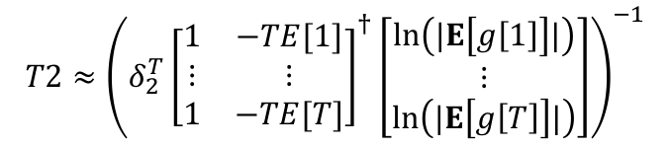
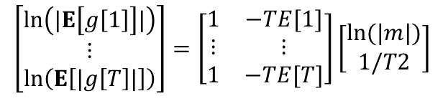


Example: T2 Mapping
Monte Carlo simulation can also be used to reveal the bias-variance behavior of specific estimators; e.g., linearized method-of-moments for T2 estimation:
$$g\left[t\right]=me^{−TE[t]/T2}+n[t]$$
$$E\left[g\left[t\right]\right]=me^{−TE[t]/T2}$$
$$ln\left(|E\left[g\left[t\right]|\right]\right)=\ln{(|m|)}−TE[t]/T2$$
Mean+Std. Dev
Mean
$$\left[\begin{matrix}ln\left(|E\left[g\left[1\right]\right]|\right) \\ ⋮ \\ ln\left(E\left[|g\left[T\right]|\right]\right)\end{matrix}\right]=\left[\begin{matrix}1 & −TE[1] \\ ⋮ & ⋮ \\ 1 & −TE[T]\end{matrix}\right]\left[\begin{matrix}\ln{(|m|)} \\ 1/T2\end{matrix}\right]$$
Mean-Std. Dev
$$T2≈{\left({δ_{2}^{T}\left[\begin{matrix}1 & −TE[1] \\ ⋮ & ⋮ \\ 1 & −TE[T]\end{matrix}\right]}^{†}\left[\begin{matrix}ln\left(|E\left[g\left[1\right]\right]|\right) \\ ⋮ \\ ln\left(|E\left[g\left[T\right]\right]|\right)\end{matrix}\right]\right)}^{−1}$$

Slide 24
Example: T2 Mapping
For real-world SNR levels, noise-based errors in standard T2 fitting results are dominated by lost accuracy (bias) rather than lost precision (variance).

Slide 25
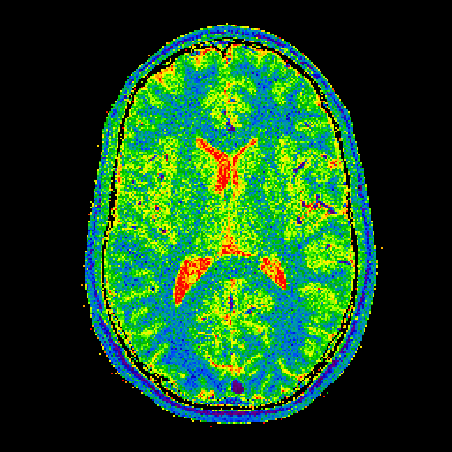
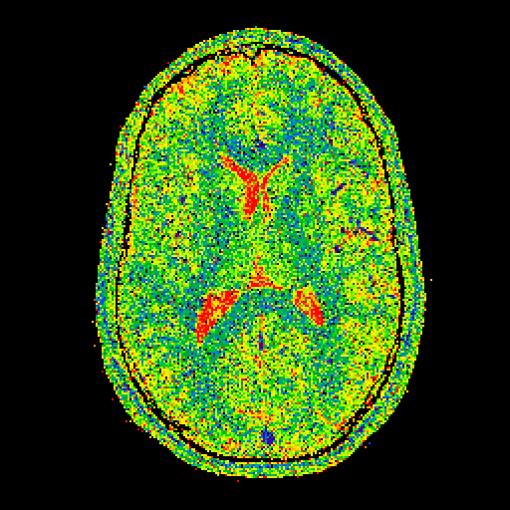
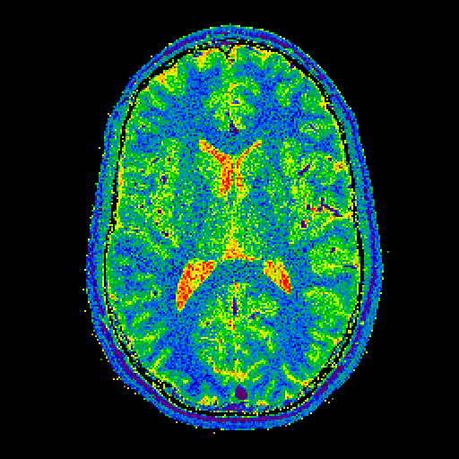
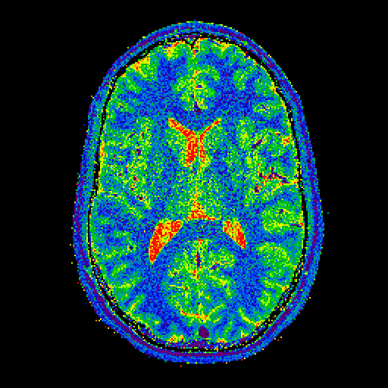
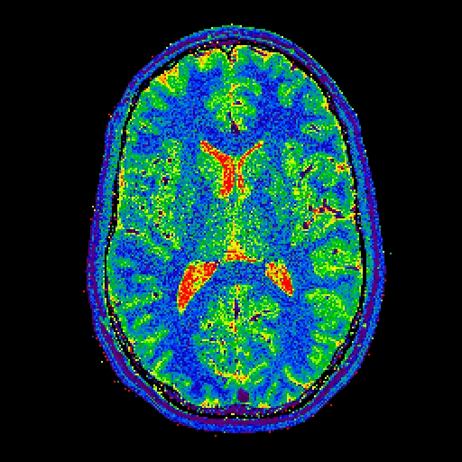
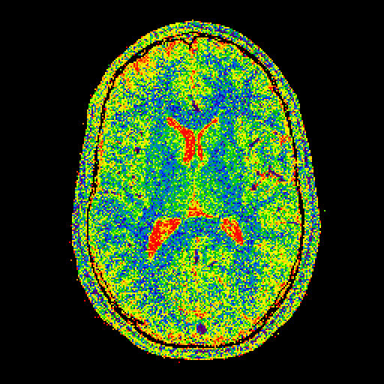
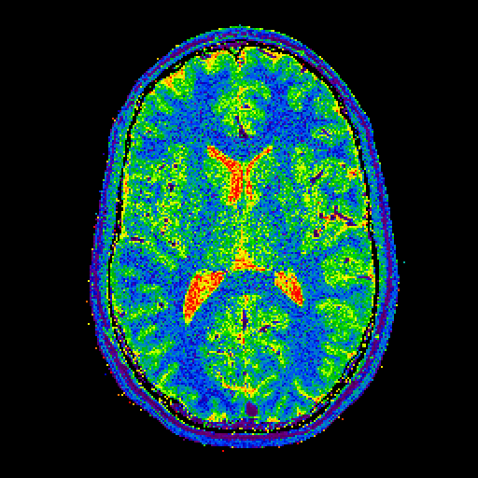
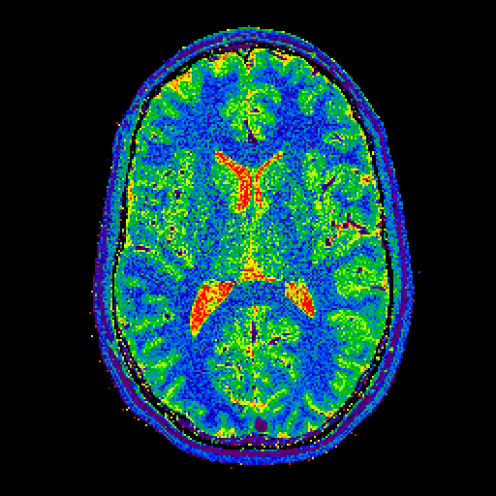
Noise Affects Every Method Differently
Below are the results of 8 different T1 mapping variants applied to the same (complex) multi-channel VFA-SPGR data set – note how performance varies.
Joint
Channel-by-Channel
RSS Composite
Debiased RSS
4000 ms
Linearized Approx.
Volunteer #1
1000 ms
NLLS
200 ms
Trzasko et al. MRM 69(6):1787-1794, 2013.

Slide 26
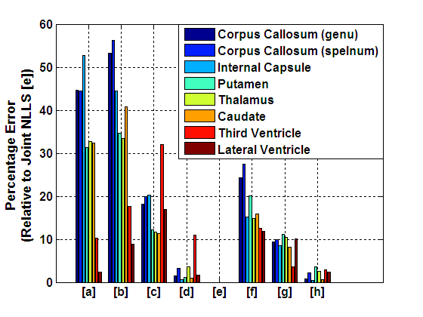
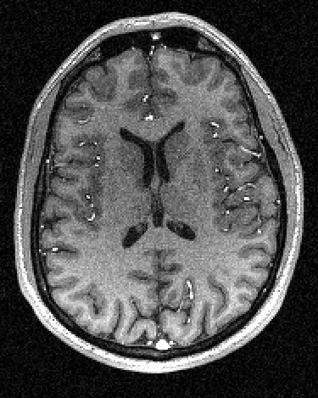
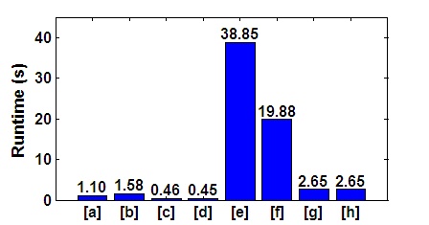
Making Informed Tradeoffs
Joint nonlinear least squares (NLLS) fitting is expected to yield the lowest MSE results for this application – how do the other methods perform relatively?
[a] Linearized Approx. – Joint [e] NLLS – Joint
[b] Linearized Approx. – Channel-by-Channel [f] NLLS – Channel-by-Channel
[c] Linearized Approx. – RSS Composite [g] NLLS – RSS Composite
[d] Linearized Approx. – Debiased RSS Composite [h] NLLS – Debiased RSS Composite
Trzasko et al. MRM 69(6):1787-1794, 2013.

Slide 27
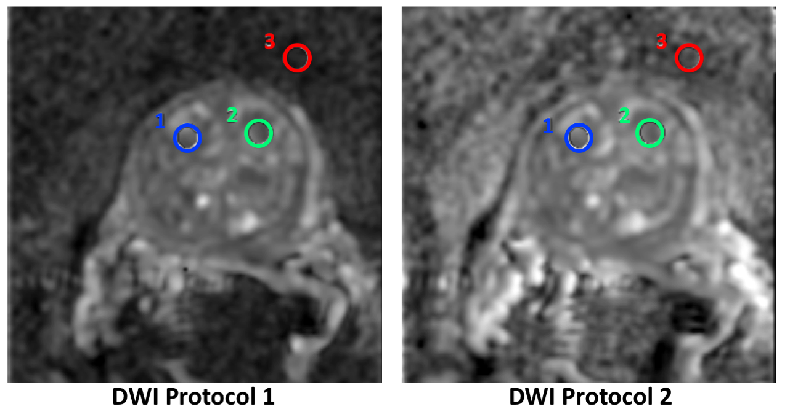
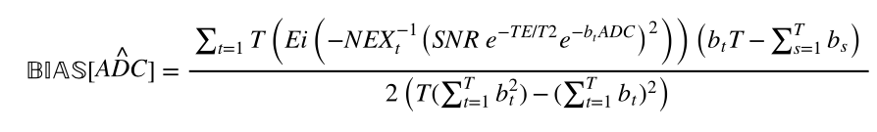
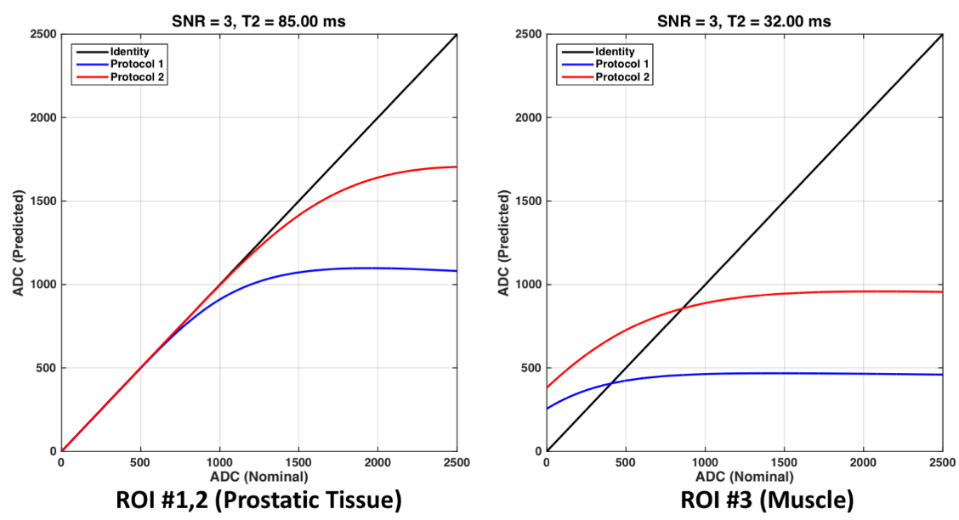

Explaining the Unexpected
Noise is also commonly the source of unanticipated changes in results that can occur following qMRI protocol changes; e.g., DWI with log-linear fitting:
Saritas et al. IEEE TMI 30:424-437, 2011
Trzasko et al. Proc. ISMRM 2018
Notes:
Changing b-values, NEX
For the first protocol (P1), TR/TE=3700/82.8ms, b=[100;1000;1600]s/mm², and NEX=[5;16;16]; and for the second protocol (P2), TR/TE= 4050/69.3ms, b=[100;400;1000]s/mm², and NEX=[3;5;14].
Complex averaging

Slide 28


Regularization: Trading Bias for Variance
Estimation performance can often be improved by leveraging auxiliary prior knowledge about the target quantity, such as spatial smoothness or sparsity. In such scenarios, one is intentionally biasing the result in a specific direction.
Prior knowledge is typically incorporated into a fitting procedure by (additively) augmenting its cost function with an regularization/penalty term; e.g.,
If the data fidelity term coincides with that of the Maximum Likelihood estimator, this strategy is often called maximum a posteriori (MAP) estimation.
$$[\hat{θ]}=arg\min_{θ}\left\{\sum_{t=0}^{T−1}{{\left|F\left\{θ\right\}[t]−g\left[t\right]\right|}^{2}}\right\}$$
$$[\hat{θ]}=arg\min_{θ}\left\{λP\left(θ\right)+\sum_{t=0}^{T−1}{{\left|F\left\{θ\right\}[t]−g\left[t\right]\right|}^{2}}\right\}$$
Mixing
Parameter
Penalty
Data Fidelity

Slide 29




Example: Diffusion Weighted Imaging
The signal in a diffusion weighted imaging (DWI) can be modeled as $g\left[t\right]=m_{0}e^{−b_{t}∙ADC}+n[t]$, where the apparent diffusion coefficient (ADC) is the primary quantity of interest.
Standard (MOM)
Maximum Likelihood
$${\hat{ADC}=−\left(\sum_{t=0}^{T−1}{b_{t}^{2}}\right)}^{−1}\sum_{t=0}^{T−1}{b_{t}}\text{ln}\left(\frac{\text{E}\left[g\left[t\right]\right]}{\text{E}\left[g\left[0\right]\right]}\right)$$
$$[\hat{m_{0}},\hat{ADC]}=arg\min_{m_{0},ADC}\left\{\sum_{t=0}^{T−1}{{\left|m_{0}e^{−b_{t}∙ADC}−g\left[t\right]\right|}^{2}}\right\}$$
E. Borisch et al., Proc. ISMRM 2018
K. Keenan et al. MRM 79(1):48–61, 2018

Slide 30

Example: Diffusion Weighted Imaging
The signal in a diffusion weighted imaging (DWI) can be modeled as $g\left[t\right]=m_{0}e^{−b_{t}∙ADC}+n[t]$, where the apparent diffusion coefficient (ADC) is the primary quantity of interest.
Standard (MOM)
Regularized
$${\hat{ADC}=−\left(\sum_{t=0}^{T−1}{b_{t}^{2}}\right)}^{−1}\sum_{t=0}^{T−1}{b_{t}}\text{ln}\left(\frac{\text{E}\left[g\left[t\right]\right]}{\text{E}\left[g\left[0\right]\right]}\right)$$
$$[\hat{m_{0}},\hat{ADC]}=arg\min_{m_{0},ADC}\left\{λP(Γ\{ADC\})+\sum_{t=0}^{T−1}{{\left|m_{0}e^{−b_{t}∙ADC}−g\left[t\right]\right|}^{2}}\right\}$$
E. Borisch et al., Proc. ISMRM 2018
K. Keenan et al. MRM 79(1):48–61, 2018

Slide 31

Example: MR Elastography
Regularized harmonic estimation improves MRE displacement estimates, which in turn yields more accurate/precise tissue stiffness estimates and pathology localization; e.g., vestibular schwannoma (skull base tumor):
Trzasko et al. Proc. ISMRM 2016

Slide 32






Minimizing Error Propagation
Advanced image reconstruction methods often rely on quantitative reference information like ∆B0 maps. Any errors in these quantities will propagate into and compromise the quality of the final reconstruction results; e.g., spiral:
No ORC
ORC + Standard
ORC + Robust
Field Map
Gridding Recon
Sutton et al. IEEE TMI 22(2):178-188, 2003
Trzasko et al. Proc. RSNA, SSQ17-04, 2012
Tao et al. Medical Physics 42(12):7190–7201, 2015.

Slide 33
Minimizing Error Propagation
Advanced image reconstruction methods often rely on quantitative reference information like ∆B0 maps. Any errors in these quantities will propagate into and compromise the quality of the final reconstruction results; e.g., spiral:
No ORC
ORC + Standard
ORC + Robust
Field Map
Gridding Recon
Sutton et al. IEEE TMI 22(2):178-188, 2003
Trzasko et al. Proc. RSNA, SSQ17-04, 2012
Tao et al. Medical Physics 42(12):7190–7201, 2015.

Slide 34
Outline
What is Quantitative MRI (qMRI)?
qMRI: a Signal Processing Perspective
Sources of Error in qMRI
Noise Model
Signal Model
Fitting Strategy
Summary and Closing Remarks
Notes:
Broaden persepctive
Unifying theme

Slide 35



Model Mismatch
Mismatch between the data generating mechanism and the model presumed during data fitting is another key source of error in parameter estimates. In qMRI, mismatch is typically due to use of an oversimplified model.
f(x)
x
$res=$ $\sum_{t=1}^{T}{{\left|f\left(θ\right)\left[t\right]−g\left[t\right]\right|}^{2}=\sum_{t=1}^{T}{{\left|n\left[t\right]\right|}^{2}}}$
$$g\left[t\right]=f\left(θ\right)\left[t\right]+n[t]$$
$res=$ $\sum_{t=1}^{T}{{\left|h\left(θ\right)\left[t\right]−g\left[t\right]\right|}^{2}=\sum_{t=1}^{T}{{\left|(f\left(θ\right)\left[t\right]−h\left(θ\right)\left[t\right])+n\left[t\right]\right|}^{2}}}$

Slide 36
Example: Variable Flip Angle T1/R1 Mapping
It is well-known that RF transmit (B1+) is not spatially uniform, especially at high field. If this reality is ignored during model fitting (e.g., universal flip angle), model-data mismatch will cause erroneous T1/R1 values to be generated.
B₁⁺ Map
R₁ Map – w/o correction
R₁ Map – w/ correction
Cheng and Wright. MRM 55:566–574, 2006
Trzasko et al., in preparation

Slide 37


Example: Variable Flip Angle T1/R1 Mapping
How significant are errors from ignoring B1+? Even when imaging at 3T with a non-accelerated 5-angle VFA-SPGR sequence and Maximum Likelihood R1 estimation, errors are in the 10-20% range (ISMRM-NIST Phantom):
Keenan et al. MRM 79(1):48–61, 2018
Trzasko et al., in preparation

Slide 38
Example: Fat+Water Imaging
It is well known that accurate estimation of water+fat from multi-echo GRE data requires fitting with a model that includes off-resonance and R2*. However, ignoring T1, tissue temperature, and concomitant fields can also cause model mismatch and error generation in parameter estimates.
Liu et al., MRM 58(2):354-364, 2007
Hernando et al., MRM 72 (2), 464-470, 2014
Colgan et al., MRM 78 (2), 730-738, 2017

Slide 39








Example: Simultaneous FWS+MRE
By utilizing a different TE for each motion encoding direction in an MRE scan, chemical shift information is simultaneously encoded. However, the concomitant fields from the motion encoding gradients (MEG) differ by axis. If this effect is not accounted for, water+fat estimates will be erroneous.
Uncorrected
Reference
Water
Fat
B₀ Field Map
20
15
10
5
0
Waves - R/L
Waves - A/P
Waves - S/I
Shear Modulus (kPa)
Trzasko et al., Proc. ISMRM 2015
Le et al., Proc. ISMRM 2018
Notes:
The stiffness map indicates that vegetable shortening (18.3±4.1kPa) – which is crystalized at room temperature – is substantially more stiff then gelatin

Slide 40



Example: Simultaneous FWS+MRE
By utilizing a different TE for each motion encoding direction in an MRE scan, chemical shift information is simultaneously encoded. However, the concomitant fields from the motion encoding gradients (MEG) differ by axis. If this effect is not accounted for, water+fat estimates will be erroneous.
Corrected
Reference
Water
Fat
B₀ Field Map
20
15
10
5
0
Waves - R/L
Waves - A/P
Waves - S/I
Shear Modulus (kPa)
Trzasko et al., Proc. ISMRM 2015
Le et al., Proc. ISMRM 2018
Notes:
The stiffness map indicates that vegetable shortening (18.3±4.1kPa) – which is crystalized at room temperature – is substantially more stiff then gelatin

Slide 41













Example: Diffusion Imaging
Gradient nonlinearity is typically associated with geometric image distortion. However, it also causes gradient-based motion encoding strength (i.e., b-values) to spatially vary. If this is not accounted for during model fitting, diffusion parameters will exhibit spatially-varying errors.
~ isocenter
MD
FA
Difference Ratio Map
+6cm (S)
pre-GNC
GNC
pre-GNC
GNC
MD
FA
Beyond diffusion, gradient nonlinearity affects every motion encoding-based scheme, including flow and elastography.
Tao et al, JMRI, in press
Tan et al., MRM 38(2):448-53, 2013
Bammer et al., MRM 50(3):560-9, 2003
Notes:
The stiffness map indicates that vegetable shortening (18.3±4.1kPa) – which is crystalized at room temperature – is substantially more stiff then gelatin

Slide 42
Outline
What is Quantitative MRI (qMRI)?
qMRI: a Signal Processing Perspective
Sources of Error in qMRI
Noise Model
Signal Model
Fitting Strategy
Summary and Closing Remarks
Notes:
Broaden persepctive
Unifying theme

Slide 43
Can My Algorithm Really Cause Errors?
Yes! Many qMRI fitting problems require minimization of non-convex cost functions that contain spurious local minima, whose results may violate data and/or prior assumptions (e.g., phase wrap ≠ smooth).
Convex
Non-Convex
f(x)
f(x)
Local Minimum
Global Minimum
x
x
In lieu of using general-purpose numerical solvers, qMRI model fitting performance can often be improved by developing/applying custom solvers designed specifically for the target (mathematical) class of problem.

Slide 44
Example: Fat+Water Imaging
In fat+water imaging, “swaps” occur if the model fitting algorithm cannot robustly manage cost periodicity or local minima in the ∆B0 estimate. Few algorithms are capable of performing robustly in this scenario – an exception being iterated graph cuts (for binary Markov random fields (MRF)).
Graph Cuts
ICM
Descent
Field Map
Water
Fat
Hernando et al. MRM 63(1): 79-90, 2010

Slide 45

Example: Fat+Water Imaging
Researchers often rely on vendor-provided qMRI solutions for their studies – always be cognizant of all parts of the tools you adopt, include the fitting algorithms used under-the-hood.
MBIR + Graph Cuts
mDIXON
Stinson et al. MRM, 78(6):2203–2215, 2017

Slide 46





Example: MR Elastography
We noted earlier that noise can tissue displacement estimation from phase contrast data in MR elastography. For MAP estimators the cost function also exhibits high-dimensional periodicity, yielding a challenging optimization task:
max
$$g\left[n,t\right]=m\left[n,t\right]e^{±jRe\{η\left[n\right]ζ\left[t\right]\}}+z[n,t]$$
$$L\left(η\right)=−\sum_{n,t}{\left|K\left[n,t\right]\right|\cos{(2Re\left\{η\left[n\right]ζ\left[t\right]\right\}−∠K\left[n,t\right])}}$$
imaginary
$$J\left(η\right)=λP\left(η\right)+J\left(η\right)$$
min
real
Voxel Solution Space for T=4 Phase offsets
Trzasko et al., Proc. ISMRM 2014

Slide 47








Example: MR Elastography
Complex harmonic estimation in rectal MRE; comparison of fitting algorithms:
ML - Descent
ML – Descent - Unwrap
MAP - Descent
MAP – Graph Cuts
Real
Imag
Trzasko et al., Proc. ISMRM 2014

Slide 48
Example: MR Elastography
Complex harmonic estimation in rectal MRE; comparison of fitting algorithms:
ML - Descent
ML – Descent - Unwrap
MAP - Descent
MAP – Graph Cuts
Real
Imag
Trzasko et al., Proc. ISMRM 2014

Slide 49





Back to Error Propagation…
Compared to the propagation of noise-based errors through reconstruction, how algorithmic errors propagate and manifest can be more subtle; e.g., 3D Shells:
None
MAP - Descent
MAP - Robust
Field Map
Gridding Recon
Sutton et al. IEEE TMI 22(2):178-188, 2003
Trzasko et al. Proc. RSNA, SSQ17-04, 2012
Tao et al. Medical Physics 42(12):7190–7201, 2015.

Slide 50
Back to Error Propagation…
Compared to the propagation of noise-based errors through reconstruction, how algorithmic errors propagate and manifest can be more subtle; e.g., 3D Shells:
None
MAP - Descent
MAP - Robust
Field Map
Gridding Recon
Sutton et al. IEEE TMI 22(2):178-188, 2003
Trzasko et al. Proc. RSNA, SSQ17-04, 2012
Tao et al. Medical Physics 42(12):7190–7201, 2015.

Slide 51
Summary
In this lecture we:
Defined and overviewed qMRI
Discussed how qMRI processing is fundamentally a parametric model fitting problem
Introduced statistical signal processing tools that are useful for qMRI applications
Defined and demonstrated several independent sources error in qMRI processing
Described modern signal processing tools for mitigating qMRI error
Notes:
Take on old JAVA phrase

Slide 52
Closing Remarks
Hopefully you now have an appreciation for the many potential sources of error in qMRI parameter estimation, and the tools that can be used to both characterize and mitigate them.
Whether you’re revisiting an old qMRI methods or checking out a new one, approach all with the same rigor and scrutiny.
Notes:
Take on old JAVA phrase

Slide 53
?
trzasko.joshua@mayo.edu

